Slide 1
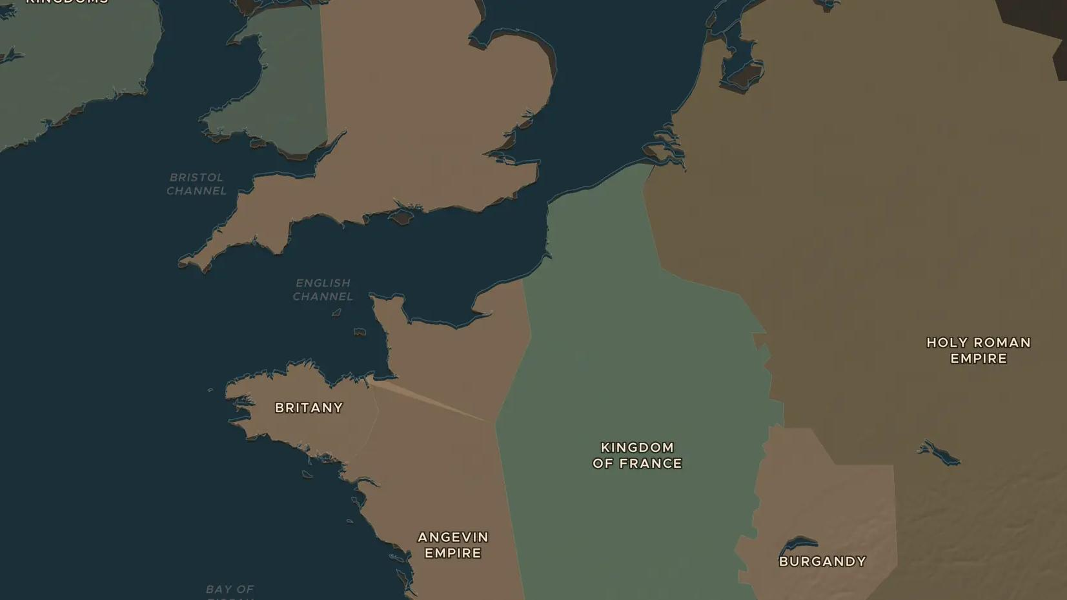
MEDIEVAL ENGLAND · 1199-1225
Magna Carta: the king under the law
ChronoAtlas Classroom · Plate 241 · Ages 12-15 · 50 min
ChronoAtlas Classroom · chronoatlas.nl/classroom/lesson/magna-carta-1215

Slide 2
THIS LESSON
What students take from it
In June 1215 King John seals a charter in a meadow beside the Thames, promising to rule by the law. Students explore why the barons forced him, read the most famous clauses and ask who Magna Carta really protected.
LENGTH
50 min
AGES
12-15
ON THE MAP
BY THE END, STUDENTS CAN
3 steps, AD 1200
Explain why King John and the barons came into conflict by 1215.
Read and explain clauses 39 and 40 of Magna Carta in modern words.
Evaluate who Magna Carta protected in 1215 and how its meaning grew later.
QUIZ
7 rounds
ChronoAtlas Classroom · chronoatlas.nl/classroom/lesson/magna-carta-1215
2

Slide 3
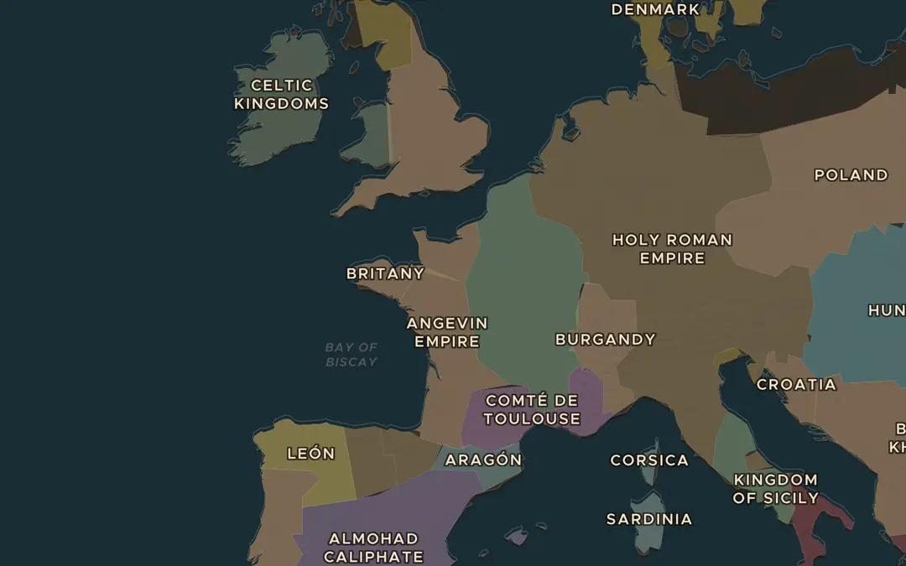
EXPLORE THE MAP · STEP A OF 3 · AD 1200
a
An empire lost
Open the map in 1200 and find the Angevin Empire, the lands of the English kings in England and France. Then jump to 1279. What has the English king lost?
Open this view on the live map →
ChronoAtlas Classroom · chronoatlas.nl/classroom/lesson/magna-carta-1215
3
Notes:
Open the map in 1200 and find the Angevin Empire, the lands of the English kings in England and France. Then jump to 1279. What has the English king lost?
https://chronoatlas.nl/?year=1200&lat=48&lng=0&zoom=4.6

Slide 4
CHRONOATLAS CLASSROOM
The rest of this deck comes with Classroom
19 more slides: the other map steps, the discussion questions, the quiz with its answers, and the worksheet.
Every lesson as a deck, every worksheet, every live lesson and homework.
€19 a month, cancel anytime. The free lesson, Rome at its height, comes whole.
https://chronoatlas.nl/pricing
ChronoAtlas Classroom · chronoatlas.nl/classroom/lesson/magna-carta-1215
4

