Slide 1
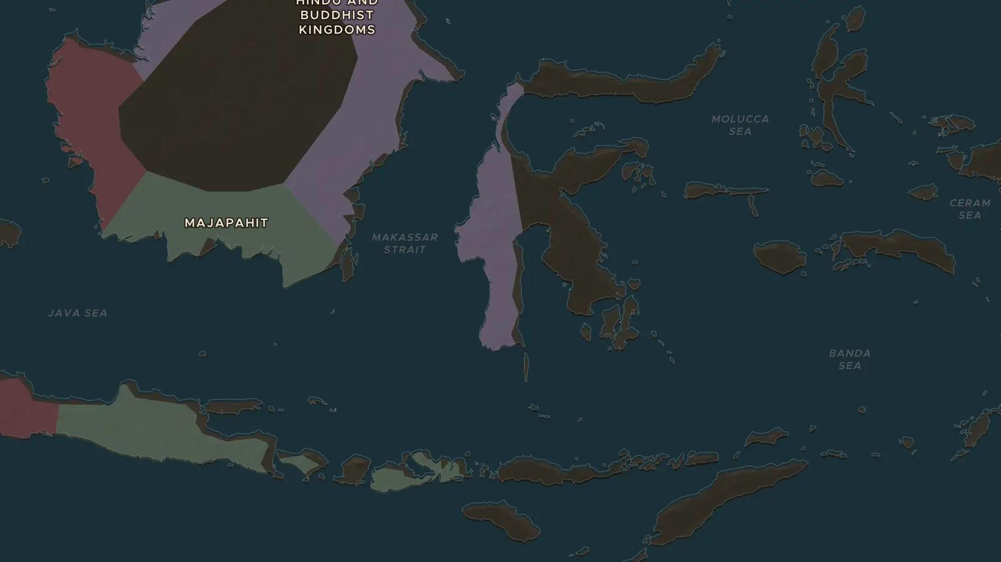
MAJAPAHIT · 1293-1527
Majapahit: an island empire
ChronoAtlas Classroom · Plate 276 · Ages 11-14 · 45 min
ChronoAtlas Classroom · chronoatlas.nl/classroom/lesson/majapahit-island-empire

Slide 2
THIS LESSON
What students take from it
Founded in 1293 by a prince who outwitted a Mongol fleet, Majapahit grew from East Java into the greatest power of the islands under its chief minister Gajah Mada. Students explore a sea empire of rice, spices and court poetry.
LENGTH
45 min
AGES
11-14
ON THE MAP
BY THE END, STUDENTS CAN
3 steps, AD 1350
Locate Majapahit and the islands it claimed, and explain how sea power held them together.
Describe the roles of Raden Wijaya, Gajah Mada and Hayam Wuruk.
Evaluate the court poem Nagarakretagama as a source on the size of Majapahit.
QUIZ
7 rounds
ChronoAtlas Classroom · chronoatlas.nl/classroom/lesson/majapahit-island-empire
2

Slide 3
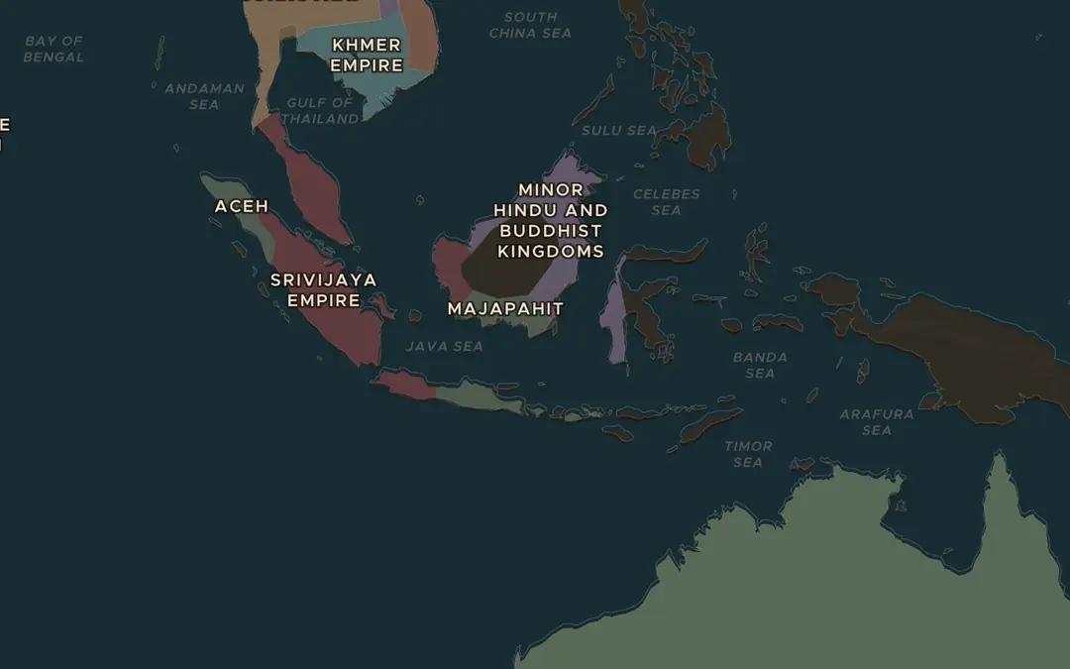
EXPLORE THE MAP · STEP A OF 3 · AD 1350
a
A world of islands
Open the map in 1350 and zoom out over the islands between Sumatra and New Guinea. How many large islands can you count? Why would ruling them need ships?
Open this view on the live map →
ChronoAtlas Classroom · chronoatlas.nl/classroom/lesson/majapahit-island-empire
3
Notes:
Open the map in 1350 and zoom out over the islands between Sumatra and New Guinea. How many large islands can you count? Why would ruling them need ships?
https://chronoatlas.nl/?year=1350&lat=-4&lng=115&zoom=4

Slide 4
CHRONOATLAS CLASSROOM
The rest of this deck comes with Classroom
19 more slides: the other map steps, the discussion questions, the quiz with its answers, and the worksheet.
Every lesson as a deck, every worksheet, every live lesson and homework.
€19 a month, cancel anytime. The free lesson, Rome at its height, comes whole.
https://chronoatlas.nl/pricing
ChronoAtlas Classroom · chronoatlas.nl/classroom/lesson/majapahit-island-empire
4

