Slide 1
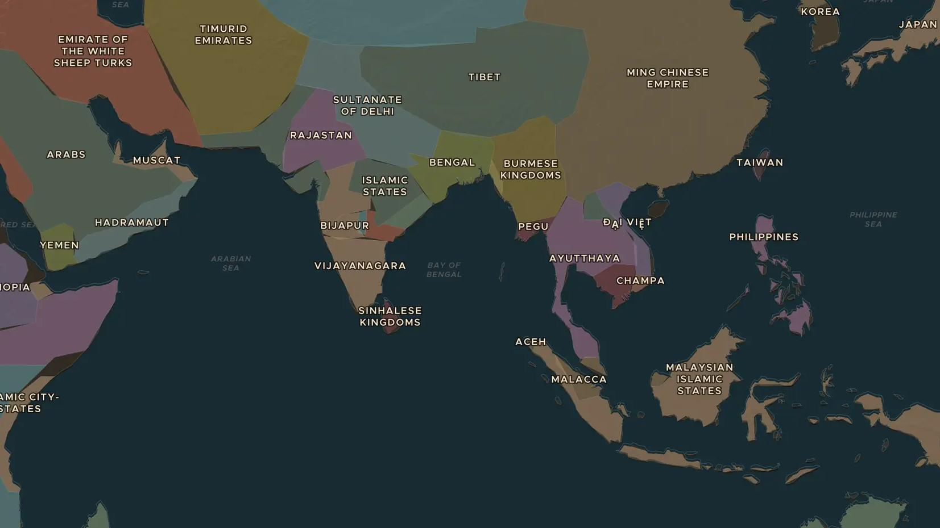
MALACCA SULTANATE · 1400-1511
Malacca: the port of the monsoon winds
ChronoAtlas Classroom · Plate 293 · Ages 11-14 · 45 min
ChronoAtlas Classroom · chronoatlas.nl/classroom/lesson/malacca-sultanate-port

Slide 2
THIS LESSON
What students take from it
Around 1400 a prince from Sumatra founded Malacca on the narrow strait between the Indian Ocean and the South China Sea. Within a century it was one of the greatest ports in the world, until a Portuguese fleet took it in 1511.
LENGTH
45 min
AGES
11-14
ON THE MAP
BY THE END, STUDENTS CAN
3 steps, AD 1492
Locate Malacca and explain how the monsoon winds made it a great port.
Explain how Malacca's rulers used Ming protection and Islam to build their state.
Describe the Portuguese conquest of 1511 and its effects.
QUIZ
7 rounds
ChronoAtlas Classroom · chronoatlas.nl/classroom/lesson/malacca-sultanate-port
2

Slide 3
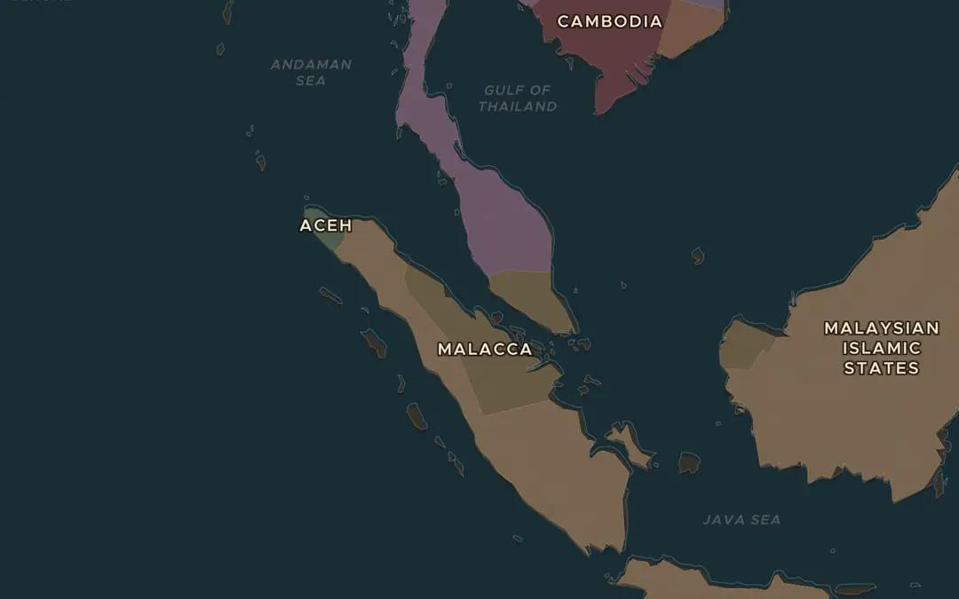
EXPLORE THE MAP · STEP A OF 3 · AD 1492
a
Gate between two oceans
Open the map in 1492 and find Malacca on the strait between the Malay Peninsula and Sumatra. Why did ships from India and from China both have to pass here?
Open this view on the live map →
ChronoAtlas Classroom · chronoatlas.nl/classroom/lesson/malacca-sultanate-port
3
Notes:
Open the map in 1492 and find Malacca on the strait between the Malay Peninsula and Sumatra. Why did ships from India and from China both have to pass here?
https://chronoatlas.nl/?year=1492&lat=2.5&lng=101&zoom=5

Slide 4
CHRONOATLAS CLASSROOM
The rest of this deck comes with Classroom
19 more slides: the other map steps, the discussion questions, the quiz with its answers, and the worksheet.
Every lesson as a deck, every worksheet, every live lesson and homework.
€19 a month, cancel anytime. The free lesson, Rome at its height, comes whole.
https://chronoatlas.nl/pricing
ChronoAtlas Classroom · chronoatlas.nl/classroom/lesson/malacca-sultanate-port
4

