Slide 1
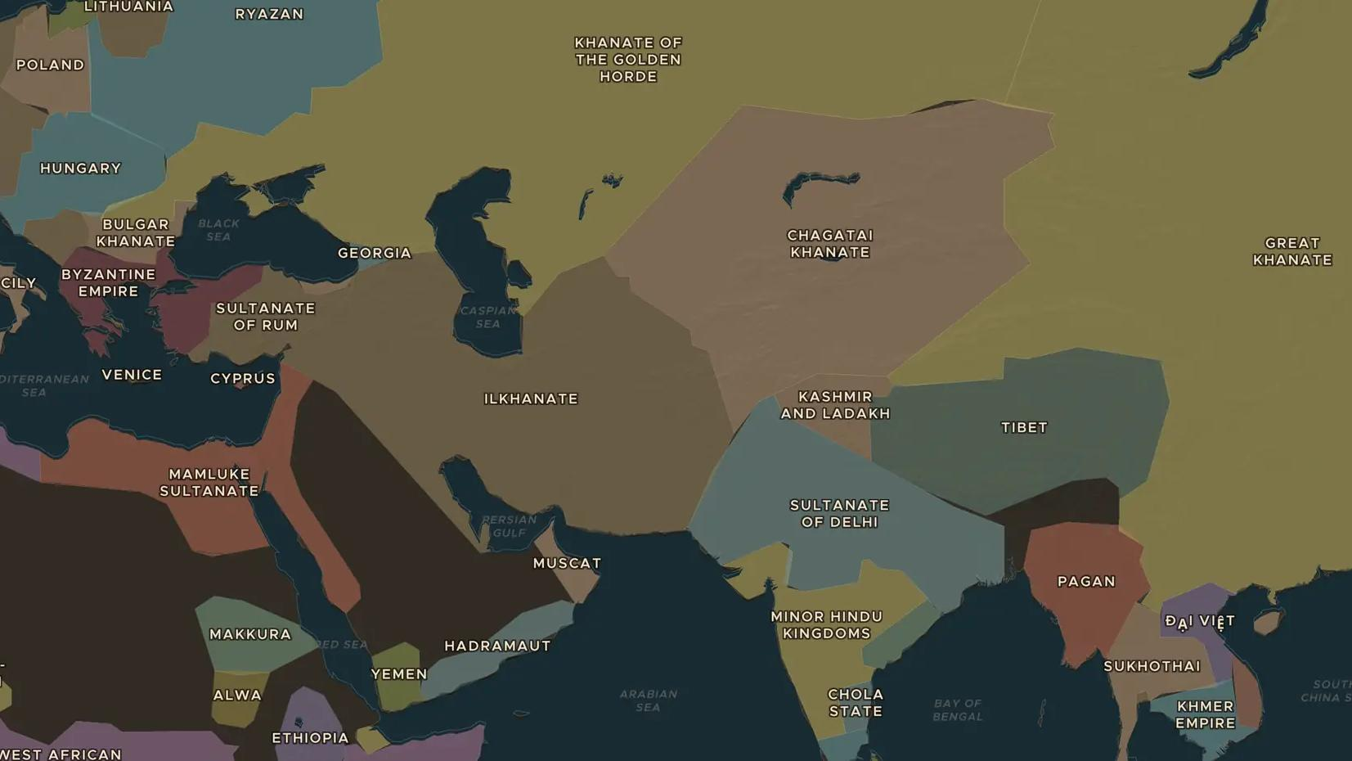
YUAN DYNASTY · 1271-1295
Marco Polo: the road to Kublai Khan
ChronoAtlas Classroom · Plate 248 · Ages 10-13 · 45 min
ChronoAtlas Classroom · chronoatlas.nl/classroom/lesson/marco-polo-journey-to-china

Slide 2
THIS LESSON
What students take from it
In 1271 a 17-year-old Venetian set out with his father and uncle for the court of Kublai Khan. Students follow Marco Polo's journey on the map, look at Yuan China through his eyes and ask how far we can trust his famous book.
LENGTH
45 min
AGES
10-13
ON THE MAP
BY THE END, STUDENTS CAN
3 steps, AD 1271
Trace Marco Polo's route to China and back on the map.
Describe three things Marco Polo reported about Yuan China.
Evaluate a travel account as a historical source, including its weak points.
QUIZ
7 rounds
ChronoAtlas Classroom · chronoatlas.nl/classroom/lesson/marco-polo-journey-to-china
2

Slide 3
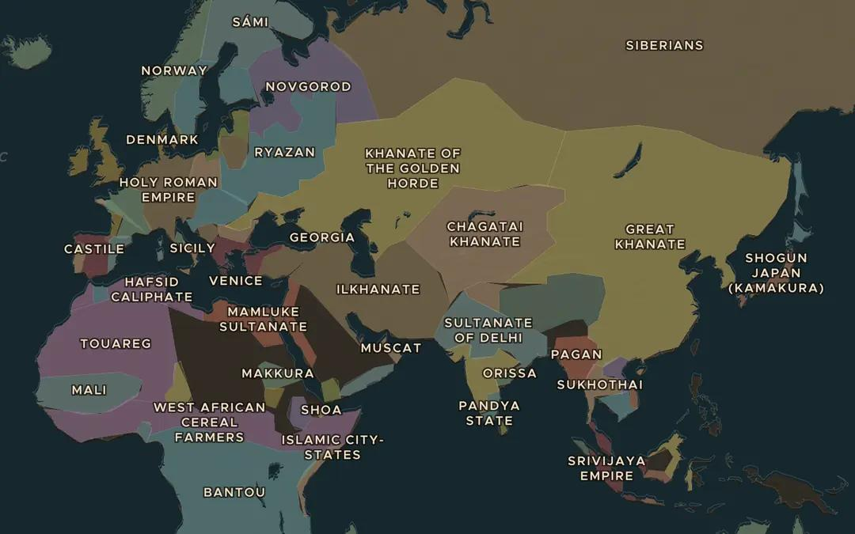
EXPLORE THE MAP · STEP A OF 3 · AD 1271
a
Play the journey
Click Stories at the top left and start the Marco Polo journey. Follow it from Venice. Which parts of the trip go over land, and which by sea?
Open this view on the live map →
ChronoAtlas Classroom · chronoatlas.nl/classroom/lesson/marco-polo-journey-to-china
3
Notes:
Click Stories at the top left and start the Marco Polo journey. Follow it from Venice. Which parts of the trip go over land, and which by sea?
https://chronoatlas.nl/?year=1271&lat=38&lng=65&zoom=2.5

Slide 4
CHRONOATLAS CLASSROOM
The rest of this deck comes with Classroom
19 more slides: the other map steps, the discussion questions, the quiz with its answers, and the worksheet.
Every lesson as a deck, every worksheet, every live lesson and homework.
€19 a month, cancel anytime. The free lesson, Rome at its height, comes whole.
https://chronoatlas.nl/pricing
ChronoAtlas Classroom · chronoatlas.nl/classroom/lesson/marco-polo-journey-to-china
4

