Slide 1
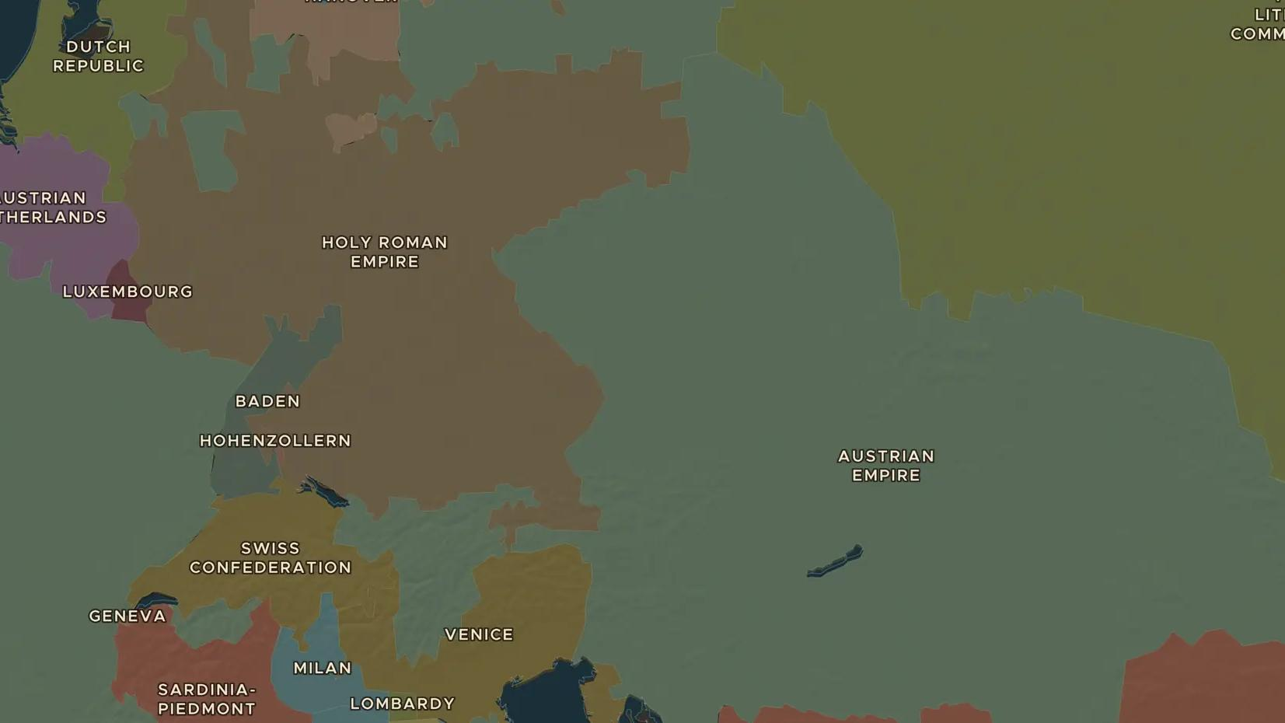
HABSBURG MONARCHY · 1740-1780
Maria Theresa and Habsburg Austria
ChronoAtlas Classroom · Plate 382 · Ages 11-14 · 45 min
ChronoAtlas Classroom · chronoatlas.nl/classroom/lesson/maria-theresa-habsburg-austria

Slide 2
THIS LESSON
What students take from it
At 23 Maria Theresa inherits the Habsburg lands, and enemies attack at once. Students follow how she held her lands together, won the support of Hungary, reformed schools and government, and why she never forgave Frederick for Silesia.
LENGTH
45 min
AGES
11-14
ON THE MAP
BY THE END, STUDENTS CAN
3 steps, AD 1740
Explain why Maria Theresa's inheritance in 1740 led to a European war.
Locate Vienna, Pressburg (Bratislava), Prague and Silesia on the map.
Describe two reforms of Maria Theresa and who benefited from them.
QUIZ
7 rounds
ChronoAtlas Classroom · chronoatlas.nl/classroom/lesson/maria-theresa-habsburg-austria
2

Slide 3
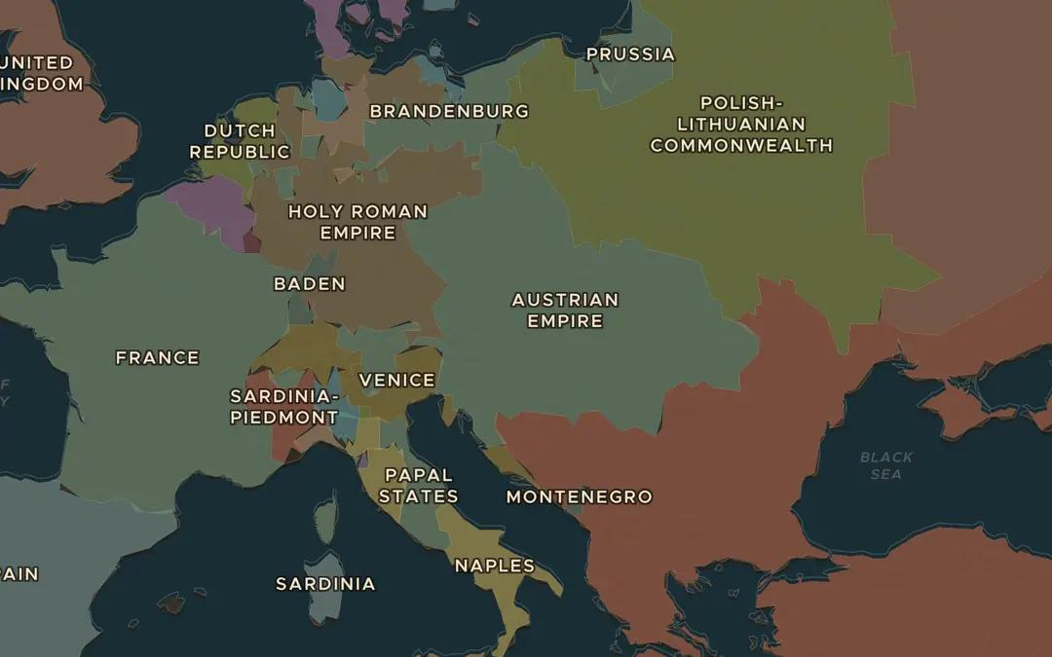
EXPLORE THE MAP · STEP A OF 3 · AD 1740
a
The Habsburg lands
Open the map in 1740 and find the Austrian Habsburg lands around Vienna. How many peoples and languages might live inside these borders?
Open this view on the live map →
ChronoAtlas Classroom · chronoatlas.nl/classroom/lesson/maria-theresa-habsburg-austria
3
Notes:
Open the map in 1740 and find the Austrian Habsburg lands around Vienna. How many peoples and languages might live inside these borders?
https://chronoatlas.nl/?year=1740&lat=47.5&lng=17&zoom=4.6

Slide 4
CHRONOATLAS CLASSROOM
The rest of this deck comes with Classroom
19 more slides: the other map steps, the discussion questions, the quiz with its answers, and the worksheet.
Every lesson as a deck, every worksheet, every live lesson and homework.
€19 a month, cancel anytime. The free lesson, Rome at its height, comes whole.
https://chronoatlas.nl/pricing
ChronoAtlas Classroom · chronoatlas.nl/classroom/lesson/maria-theresa-habsburg-austria
4

