Slide 1
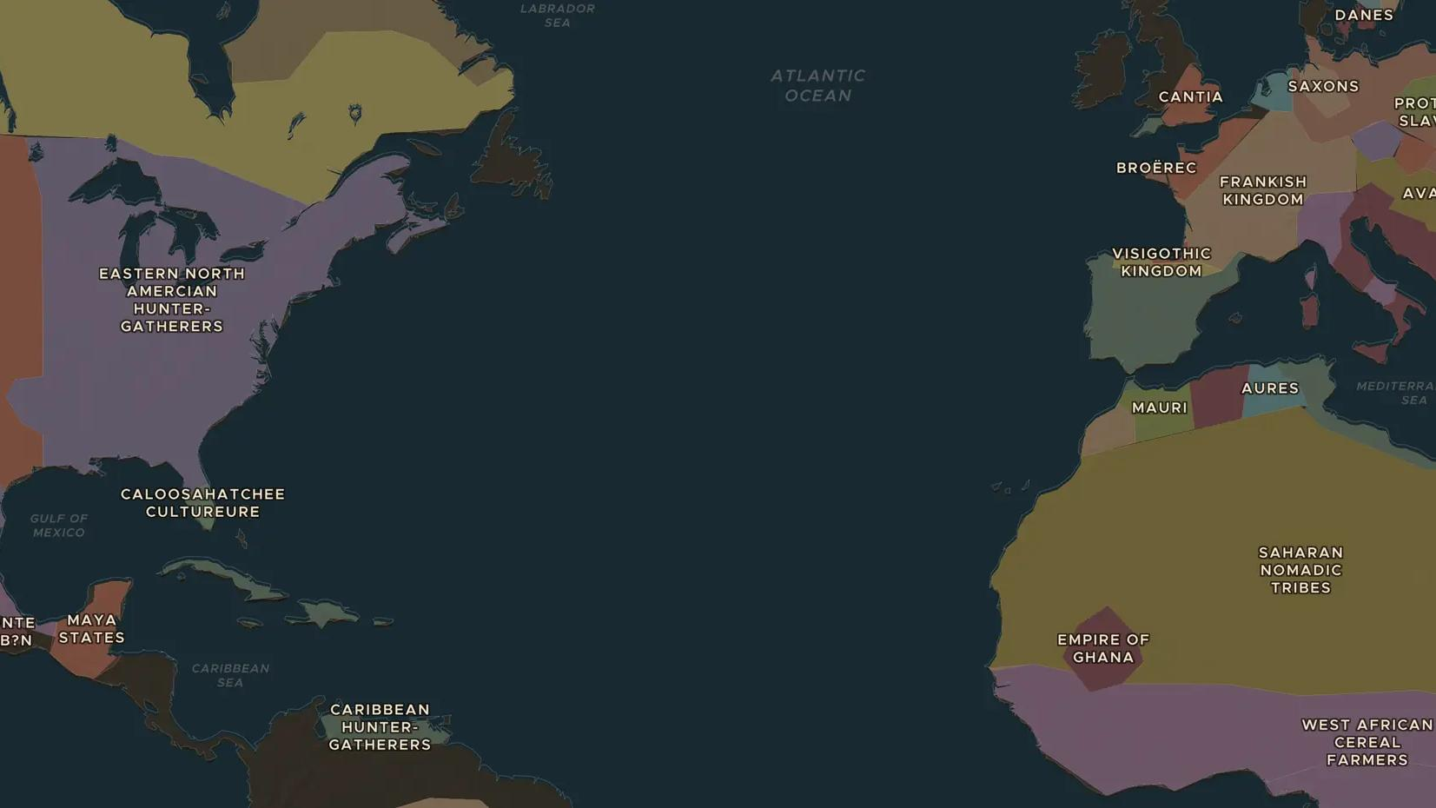
CLASSIC MAYA · 250-900
Maya writing, numbers and calendars
ChronoAtlas Classroom · Plate 177 · Ages 12-15 · 50 min
ChronoAtlas Classroom · chronoatlas.nl/classroom/lesson/maya-writing-and-calendars

Slide 2
THIS LESSON
What students take from it
The Maya built the most complete writing system of the ancient Americas, counted with zero and tracked time in great cycles. Students read Maya numbers, learn how the script was cracked, and ask who should keep the four Maya books that survived.
LENGTH
50 min
AGES
12-15
ON THE MAP
BY THE END, STUDENTS CAN
3 steps, AD 750
Read and write Maya numbers from 0 to 19 with dots, bars and the shell sign for zero.
Explain how the 260-day and 365-day calendars worked together.
Describe how Maya books were destroyed and how the script was deciphered in the 20th century.
QUIZ
7 rounds
ChronoAtlas Classroom · chronoatlas.nl/classroom/lesson/maya-writing-and-calendars
2

Slide 3
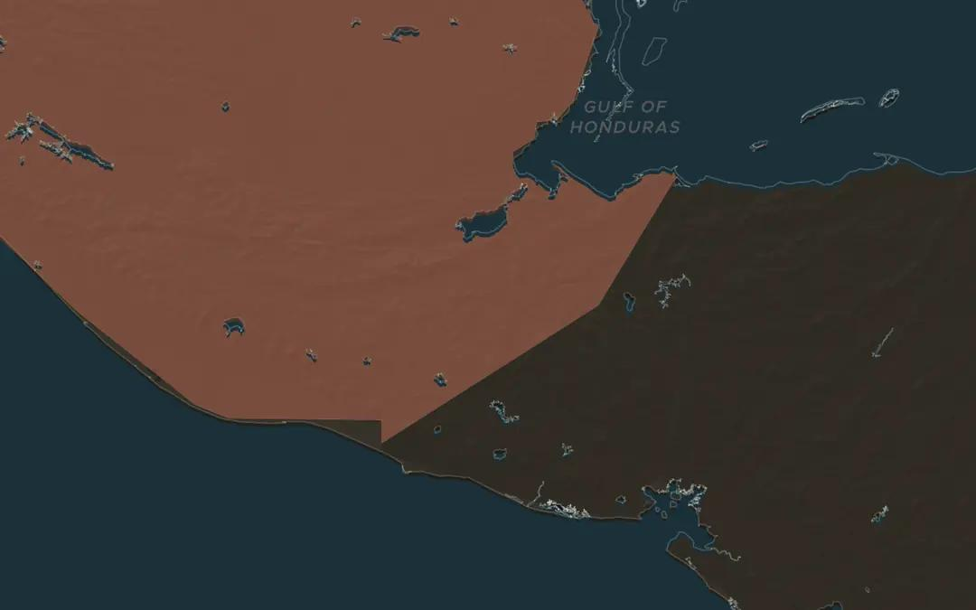
EXPLORE THE MAP · STEP A OF 3 · AD 750
a
A stairway of words
Open the map in 750 and zoom in on Copán, in the south of the Maya world. Its Hieroglyphic Stairway holds the longest known Maya text. Who do you think was meant to read it?
Open this view on the live map →
ChronoAtlas Classroom · chronoatlas.nl/classroom/lesson/maya-writing-and-calendars
3
Notes:
Open the map in 750 and zoom in on Copán, in the south of the Maya world. Its Hieroglyphic Stairway holds the longest known Maya text. Who do you think was meant to read it?
https://chronoatlas.nl/?year=750&lat=14.84&lng=-89.14&zoom=7

Slide 4
CHRONOATLAS CLASSROOM
The rest of this deck comes with Classroom
19 more slides: the other map steps, the discussion questions, the quiz with its answers, and the worksheet.
Every lesson as a deck, every worksheet, every live lesson and homework.
€19 a month, cancel anytime. The free lesson, Rome at its height, comes whole.
https://chronoatlas.nl/pricing
ChronoAtlas Classroom · chronoatlas.nl/classroom/lesson/maya-writing-and-calendars
4

