Slide 1
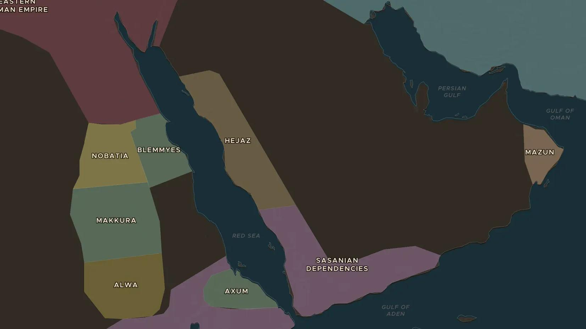
PRE-ISLAMIC ARABIA · ABOUT 500-610
Mecca before Islam: caravans and the Kaaba
ChronoAtlas Classroom · Plate 162 · Ages 11-14 · 45 min
ChronoAtlas Classroom · chronoatlas.nl/classroom/lesson/mecca-before-islam-caravans

Slide 2
THIS LESSON
What students take from it
Around 600, Arabia lay between two exhausted empires. Students explore the oasis towns, caravan routes and the sanctuary of Mecca: the world into which the Prophet Muhammad was born.
LENGTH
45 min
AGES
11-14
ON THE MAP
BY THE END, STUDENTS CAN
3 steps, AD 600
Locate Mecca, Yathrib (later Medina) and the two great empires around Arabia in 600 on the map.
Describe how people in Arabia lived: as nomads, as farmers in oases and as traders in towns.
Explain why Mecca mattered as a place of pilgrimage and trade before Islam.
QUIZ
7 rounds
ChronoAtlas Classroom · chronoatlas.nl/classroom/lesson/mecca-before-islam-caravans
2

Slide 3
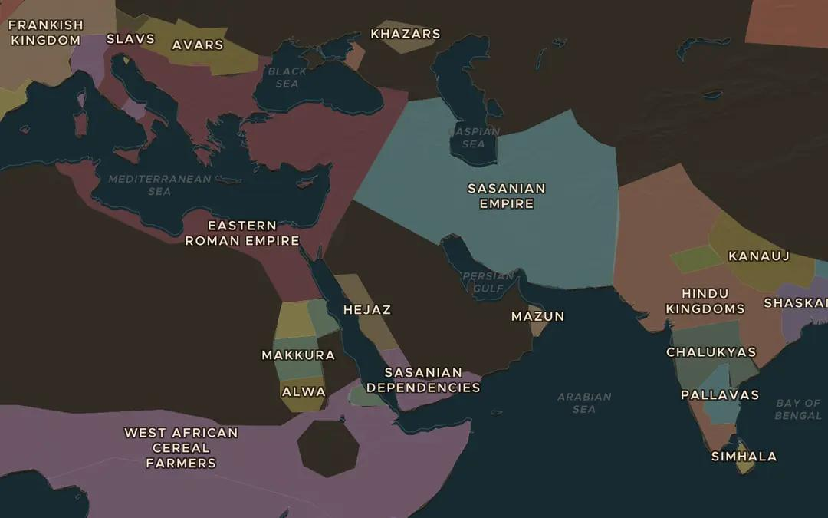
EXPLORE THE MAP · STEP A OF 3 · AD 600
a
Two giants around Arabia
Open the map in 600. Find the Eastern Roman (Byzantine) Empire and the Sasanian Empire. Which one borders Arabia in the north-west, and which in the north-east? Who controls Yemen in the south?
Open this view on the live map →
ChronoAtlas Classroom · chronoatlas.nl/classroom/lesson/mecca-before-islam-caravans
3
Notes:
Open the map in 600. Find the Eastern Roman (Byzantine) Empire and the Sasanian Empire. Which one borders Arabia in the north-west, and which in the north-east? Who controls Yemen in the south?
https://chronoatlas.nl/?year=600&lat=28&lng=45&zoom=3.5

Slide 4
CHRONOATLAS CLASSROOM
The rest of this deck comes with Classroom
19 more slides: the other map steps, the discussion questions, the quiz with its answers, and the worksheet.
Every lesson as a deck, every worksheet, every live lesson and homework.
€19 a month, cancel anytime. The free lesson, Rome at its height, comes whole.
https://chronoatlas.nl/pricing
ChronoAtlas Classroom · chronoatlas.nl/classroom/lesson/mecca-before-islam-caravans
4

