Slide 1
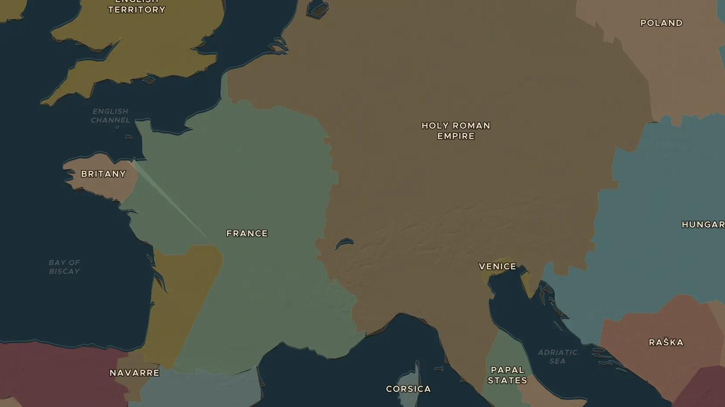
HIGH MIDDLE AGES · 1100-1300
Towns, markets and guilds
ChronoAtlas Classroom · Plate 264 · Ages 11-14 · 45 min
ChronoAtlas Classroom · chronoatlas.nl/classroom/lesson/medieval-towns-guilds

Slide 2
THIS LESSON
What students take from it
After 1100 towns grow fast across Europe. Students visit the cloth towns of Flanders and the great fairs of Champagne, join a guild as an apprentice, and ask why a medieval saying linked town life with freedom.
LENGTH
45 min
AGES
11-14
ON THE MAP
BY THE END, STUDENTS CAN
3 steps, AD 1300
Explain why towns grew in Europe between 1100 and 1300.
Describe how a craft guild worked, from apprentice to master.
Locate the cloth towns of Flanders and the fairs of Champagne and explain how they were linked.
QUIZ
7 rounds
ChronoAtlas Classroom · chronoatlas.nl/classroom/lesson/medieval-towns-guilds
2

Slide 3
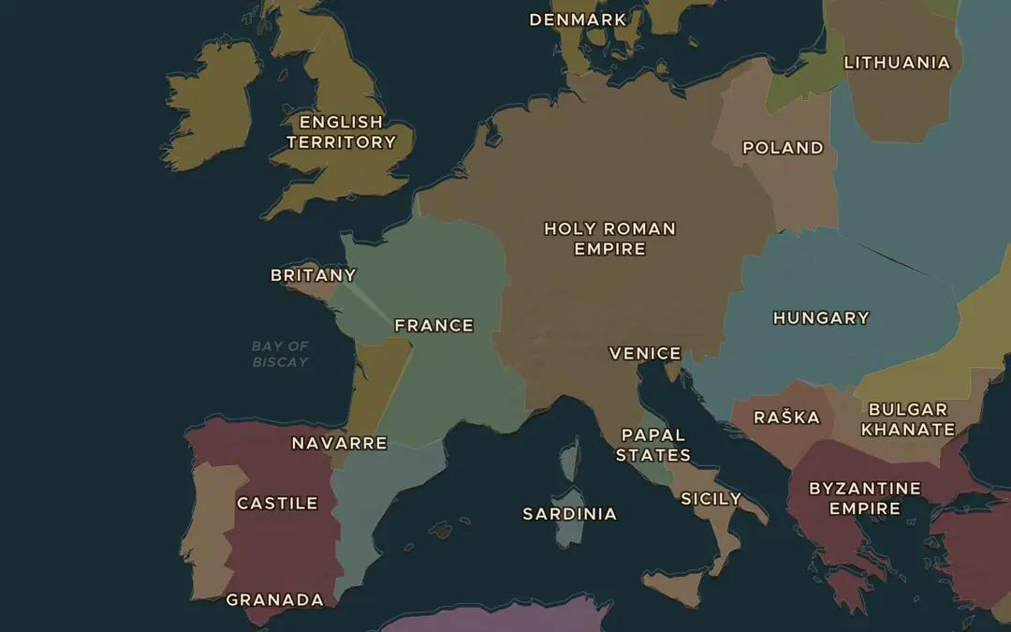
EXPLORE THE MAP · STEP A OF 3 · AD 1300
a
The big cities
Open the map in 1300 and turn on Cities. Which are the largest cities of Western Europe? Compare Paris, London, Venice and Florence.
Open this view on the live map →
ChronoAtlas Classroom · chronoatlas.nl/classroom/lesson/medieval-towns-guilds
3
Notes:
Open the map in 1300 and turn on Cities. Which are the largest cities of Western Europe? Compare Paris, London, Venice and Florence.
https://chronoatlas.nl/?year=1300&lat=47&lng=6&zoom=4.4

Slide 4
CHRONOATLAS CLASSROOM
The rest of this deck comes with Classroom
19 more slides: the other map steps, the discussion questions, the quiz with its answers, and the worksheet.
Every lesson as a deck, every worksheet, every live lesson and homework.
€19 a month, cancel anytime. The free lesson, Rome at its height, comes whole.
https://chronoatlas.nl/pricing
ChronoAtlas Classroom · chronoatlas.nl/classroom/lesson/medieval-towns-guilds
4

