Slide 1
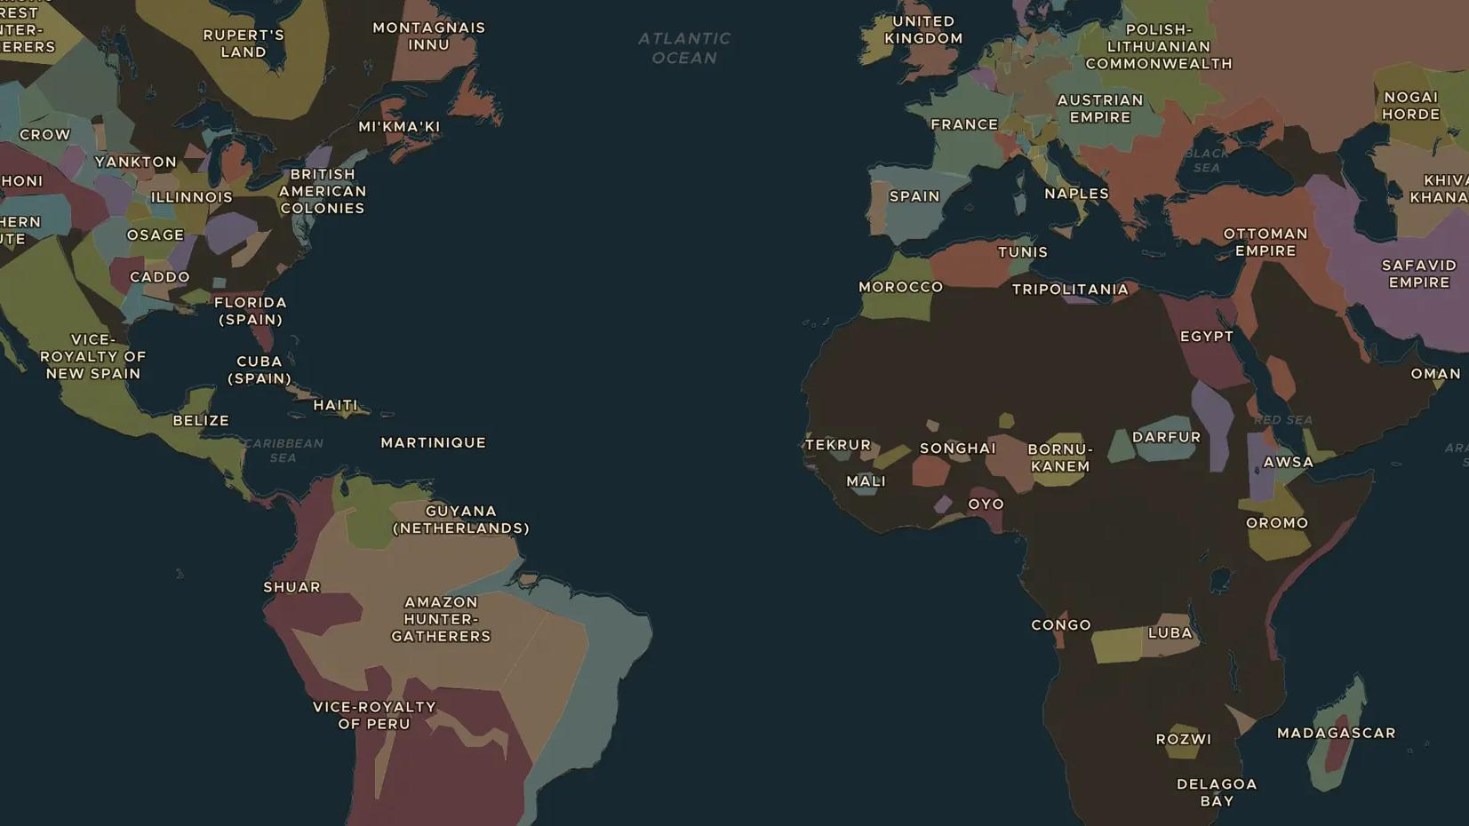
ATLANTIC WORLD · 1500S-1860S
The Middle Passage and the Atlantic slave trade
ChronoAtlas Classroom · Plate 385 · Ages 13-16 · 50 min
ChronoAtlas Classroom · chronoatlas.nl/classroom/lesson/middle-passage-atlantic-slave-trade

Slide 2
THIS LESSON
What students take from it
For more than three centuries, about 12.5 million Africans were forced onto ships bound for the Americas. Students map where captives came from and where they were taken, hear the voices of those who survived, and ask how this history should be remembered.
LENGTH
50 min
AGES
13-16
ON THE MAP
BY THE END, STUDENTS CAN
3 steps, AD 1750
Describe the scale of the transatlantic slave trade and the regions it connected.
Locate slave-trading ports in Europe and the Americas and one place of resistance.
Explain how enslaved people resisted and how the trade is remembered today.
QUIZ
7 rounds
ChronoAtlas Classroom · chronoatlas.nl/classroom/lesson/middle-passage-atlantic-slave-trade
2

Slide 3
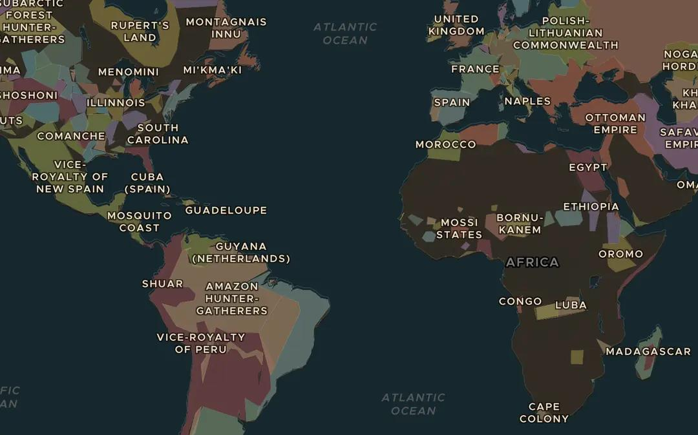
EXPLORE THE MAP · STEP A OF 3 · AD 1750
a
Three continents
Open the map in 1750 and turn on Trade Routes. Follow the Atlantic Triangular Trade between Europe, West Africa and the Americas. What was carried on each side of the triangle?
Open this view on the live map →
ChronoAtlas Classroom · chronoatlas.nl/classroom/lesson/middle-passage-atlantic-slave-trade
3
Notes:
Open the map in 1750 and turn on Trade Routes. Follow the Atlantic Triangular Trade between Europe, West Africa and the Americas. What was carried on each side of the triangle?
https://chronoatlas.nl/?year=1750&lat=15&lng=-30&zoom=2.5

Slide 4
CHRONOATLAS CLASSROOM
The rest of this deck comes with Classroom
19 more slides: the other map steps, the discussion questions, the quiz with its answers, and the worksheet.
Every lesson as a deck, every worksheet, every live lesson and homework.
€19 a month, cancel anytime. The free lesson, Rome at its height, comes whole.
https://chronoatlas.nl/pricing
ChronoAtlas Classroom · chronoatlas.nl/classroom/lesson/middle-passage-atlantic-slave-trade
4

