Slide 1
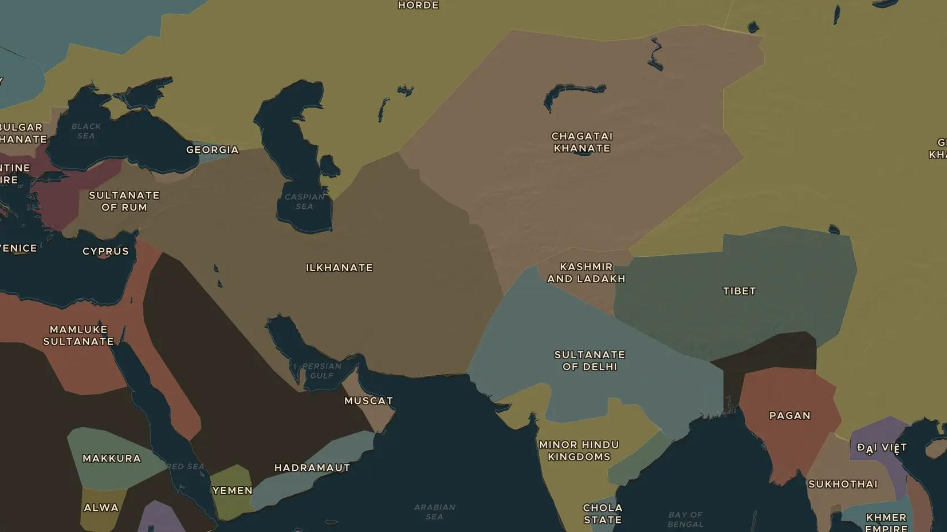
MONGOL EMPIRE · 1253-1261
1258: the fall of Abbasid Baghdad
ChronoAtlas Classroom · Plate 250 · Ages 13-16 · 45 min
ChronoAtlas Classroom · chronoatlas.nl/classroom/lesson/mongol-fall-of-abbasid-baghdad-1258

Slide 2
THIS LESSON
What students take from it
In 1258 a Mongol army took Baghdad and ended five centuries of Abbasid rule there. Students explore what was lost, what survived, and how historians remember a disaster whose death toll is still uncertain.
LENGTH
45 min
AGES
13-16
ON THE MAP
BY THE END, STUDENTS CAN
3 steps, AD 1279
Describe the campaign of Hulagu and the fall of Baghdad in 1258.
Explain why the numbers in old sources about 1258 are uncertain.
Describe what came after: the Ilkhanate, the Maragheh observatory and the caliphs in Cairo.
QUIZ
7 rounds
ChronoAtlas Classroom · chronoatlas.nl/classroom/lesson/mongol-fall-of-abbasid-baghdad-1258
2

Slide 3
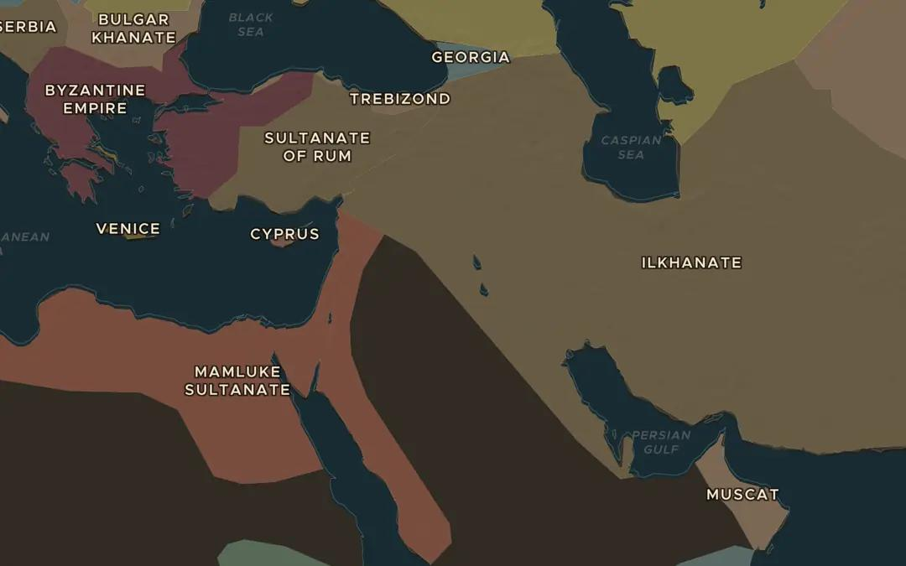
EXPLORE THE MAP · STEP A OF 3 · AD 1279
a
A new khanate
Open the map in 1279. Find the Ilkhanate, the Mongol state founded by Hulagu, and the Mamluk Sultanate to its west. Where does the border between them run?
Open this view on the live map →
ChronoAtlas Classroom · chronoatlas.nl/classroom/lesson/mongol-fall-of-abbasid-baghdad-1258
3
Notes:
Open the map in 1279. Find the Ilkhanate, the Mongol state founded by Hulagu, and the Mamluk Sultanate to its west. Where does the border between them run?
https://chronoatlas.nl/?year=1279&lat=33&lng=42&zoom=4.4

Slide 4
CHRONOATLAS CLASSROOM
The rest of this deck comes with Classroom
19 more slides: the other map steps, the discussion questions, the quiz with its answers, and the worksheet.
Every lesson as a deck, every worksheet, every live lesson and homework.
€19 a month, cancel anytime. The free lesson, Rome at its height, comes whole.
https://chronoatlas.nl/pricing
ChronoAtlas Classroom · chronoatlas.nl/classroom/lesson/mongol-fall-of-abbasid-baghdad-1258
4

