Slide 1
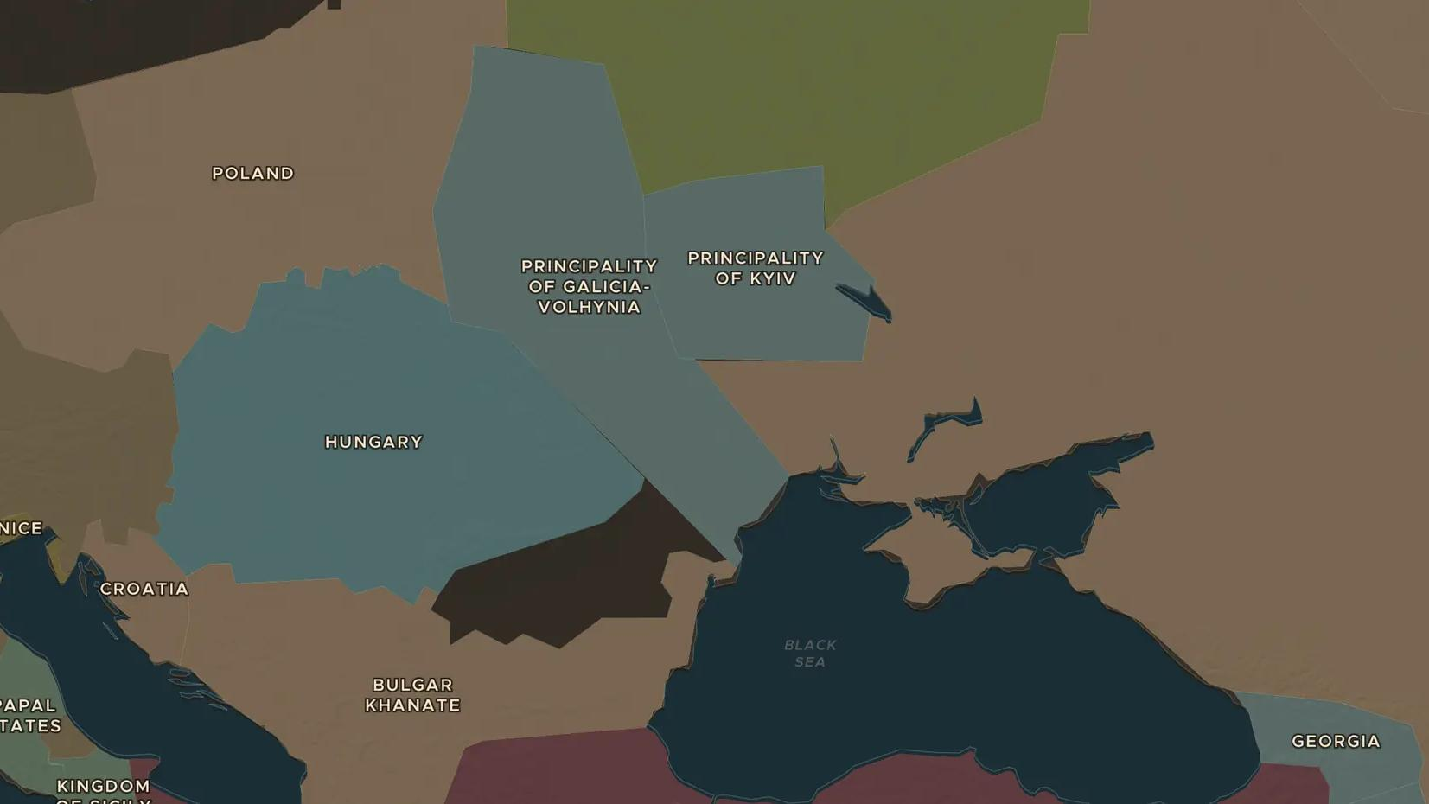
MONGOL EMPIRE · 1237-1242
The Mongols in Eastern Europe
ChronoAtlas Classroom · Plate 246 · Ages 12-15 · 50 min
ChronoAtlas Classroom · chronoatlas.nl/classroom/lesson/mongol-invasion-of-europe

Slide 2
THIS LESSON
What students take from it
Between 1237 and 1242 Mongol armies under Batu Khan sweep through the Rus principalities and into Poland and Hungary, then suddenly turn back. Students follow the campaign on the map, weigh why the Mongols withdrew, and see how the Golden Horde ruled the Rus for two centuries.
LENGTH
50 min
AGES
12-15
ON THE MAP
BY THE END, STUDENTS CAN
3 steps, AD 1241
Trace the Mongol campaign of 1237-1242 from the Volga to Poland, Hungary and the Adriatic.
Explain how the Mongols won battles such as Legnica and Mohi in 1241.
Evaluate the reasons historians give for the Mongol withdrawal in 1242 and its long-term effects on the Rus.
QUIZ
7 rounds
ChronoAtlas Classroom · chronoatlas.nl/classroom/lesson/mongol-invasion-of-europe
2

Slide 3
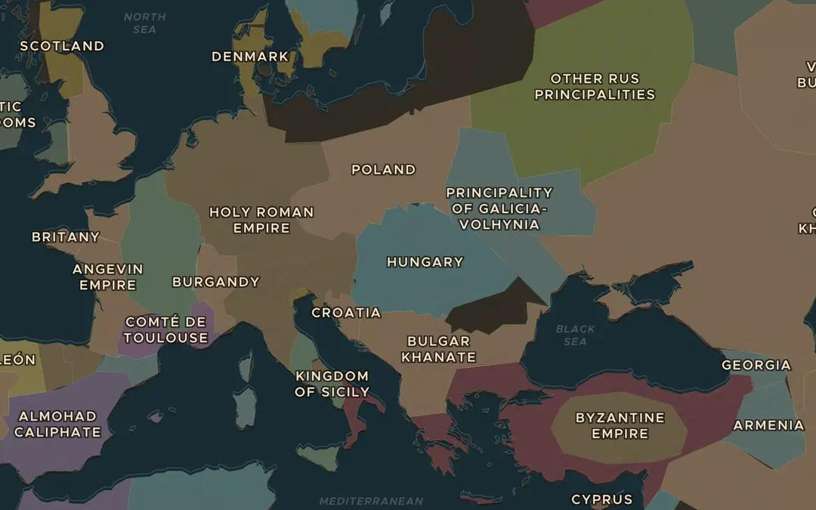
EXPLORE THE MAP · STEP A OF 3 · AD 1241
a
The Mongol Storm
Open Stories and play The Mongol Storm. Pause at "Europe trembles" in 1241. How far west is this from the Mongol homeland where the story began?
Open this view on the live map →
ChronoAtlas Classroom · chronoatlas.nl/classroom/lesson/mongol-invasion-of-europe
3
Notes:
Open Stories and play The Mongol Storm. Pause at "Europe trembles" in 1241. How far west is this from the Mongol homeland where the story began?
https://chronoatlas.nl/?year=1241&lat=47.5&lng=20&zoom=4.2

Slide 4
CHRONOATLAS CLASSROOM
The rest of this deck comes with Classroom
19 more slides: the other map steps, the discussion questions, the quiz with its answers, and the worksheet.
Every lesson as a deck, every worksheet, every live lesson and homework.
€19 a month, cancel anytime. The free lesson, Rome at its height, comes whole.
https://chronoatlas.nl/pricing
ChronoAtlas Classroom · chronoatlas.nl/classroom/lesson/mongol-invasion-of-europe
4

