Slide 1
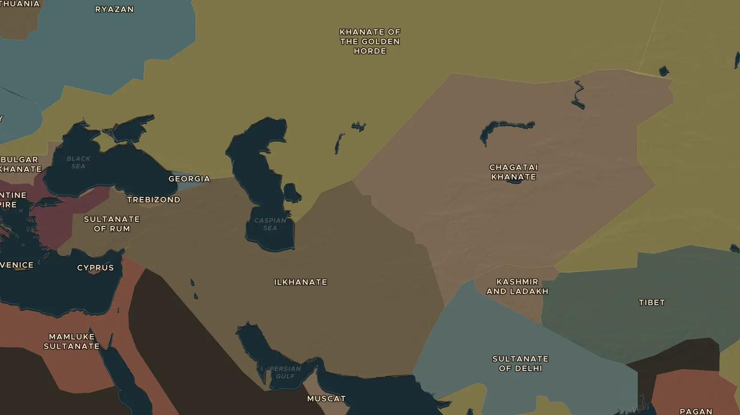
MONGOL EMPIRE · 1227-1294
The Mongol Empire: the largest land empire
ChronoAtlas Classroom · Plate 254 · Ages 11-14 · 50 min
ChronoAtlas Classroom · chronoatlas.nl/classroom/lesson/mongol-world-empire

Slide 2
THIS LESSON
What students take from it
Within 70 years of Genghis Khan's rise, his heirs ruled from Korea to eastern Europe. Students explore the largest land empire in history, how relay stations and passports held it together, and why it split into four khanates.
LENGTH
50 min
AGES
11-14
ON THE MAP
BY THE END, STUDENTS CAN
3 steps, AD 1279
Locate the Mongol Empire at its height and the four khanates that followed.
Explain how the Mongols held their empire together with relay stations, passports and trade.
Explain why the empire split after 1260.
QUIZ
7 rounds
ChronoAtlas Classroom · chronoatlas.nl/classroom/lesson/mongol-world-empire
2

Slide 3
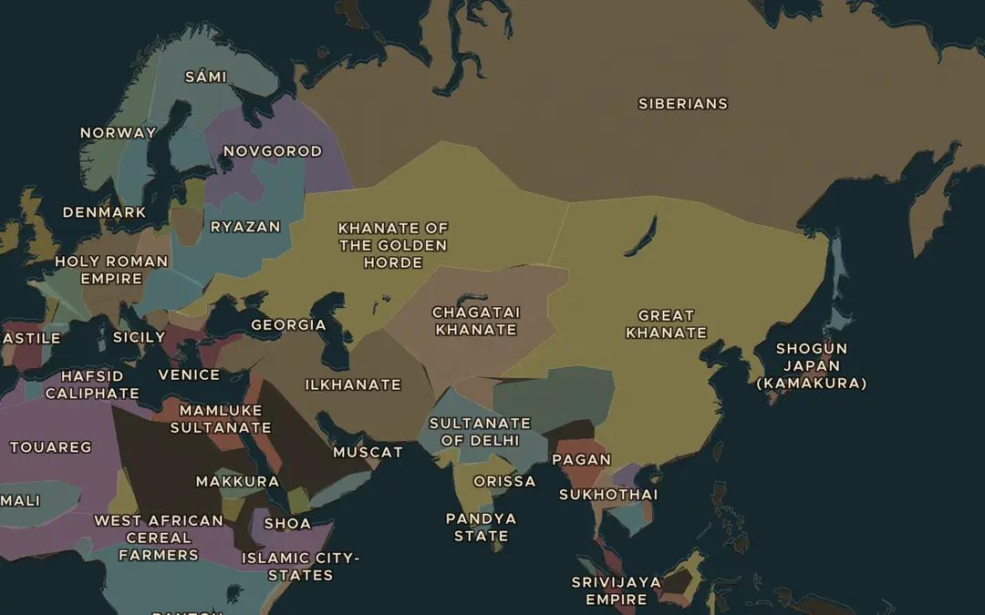
EXPLORE THE MAP · STEP A OF 3 · AD 1279
a
Four khanates
Open the map in 1279 and zoom out. Find the Great Khanate in China and the Chagatai Khanate, the Ilkhanate and the Golden Horde to the west. Which seas mark the edges of the Mongol world?
Open this view on the live map →
ChronoAtlas Classroom · chronoatlas.nl/classroom/lesson/mongol-world-empire
3
Notes:
Open the map in 1279 and zoom out. Find the Great Khanate in China and the Chagatai Khanate, the Ilkhanate and the Golden Horde to the west. Which seas mark the edges of the Mongol world?
https://chronoatlas.nl/?year=1279&lat=45&lng=80&zoom=2.5

Slide 4
CHRONOATLAS CLASSROOM
The rest of this deck comes with Classroom
19 more slides: the other map steps, the discussion questions, the quiz with its answers, and the worksheet.
Every lesson as a deck, every worksheet, every live lesson and homework.
€19 a month, cancel anytime. The free lesson, Rome at its height, comes whole.
https://chronoatlas.nl/pricing
ChronoAtlas Classroom · chronoatlas.nl/classroom/lesson/mongol-world-empire
4

