Slide 1
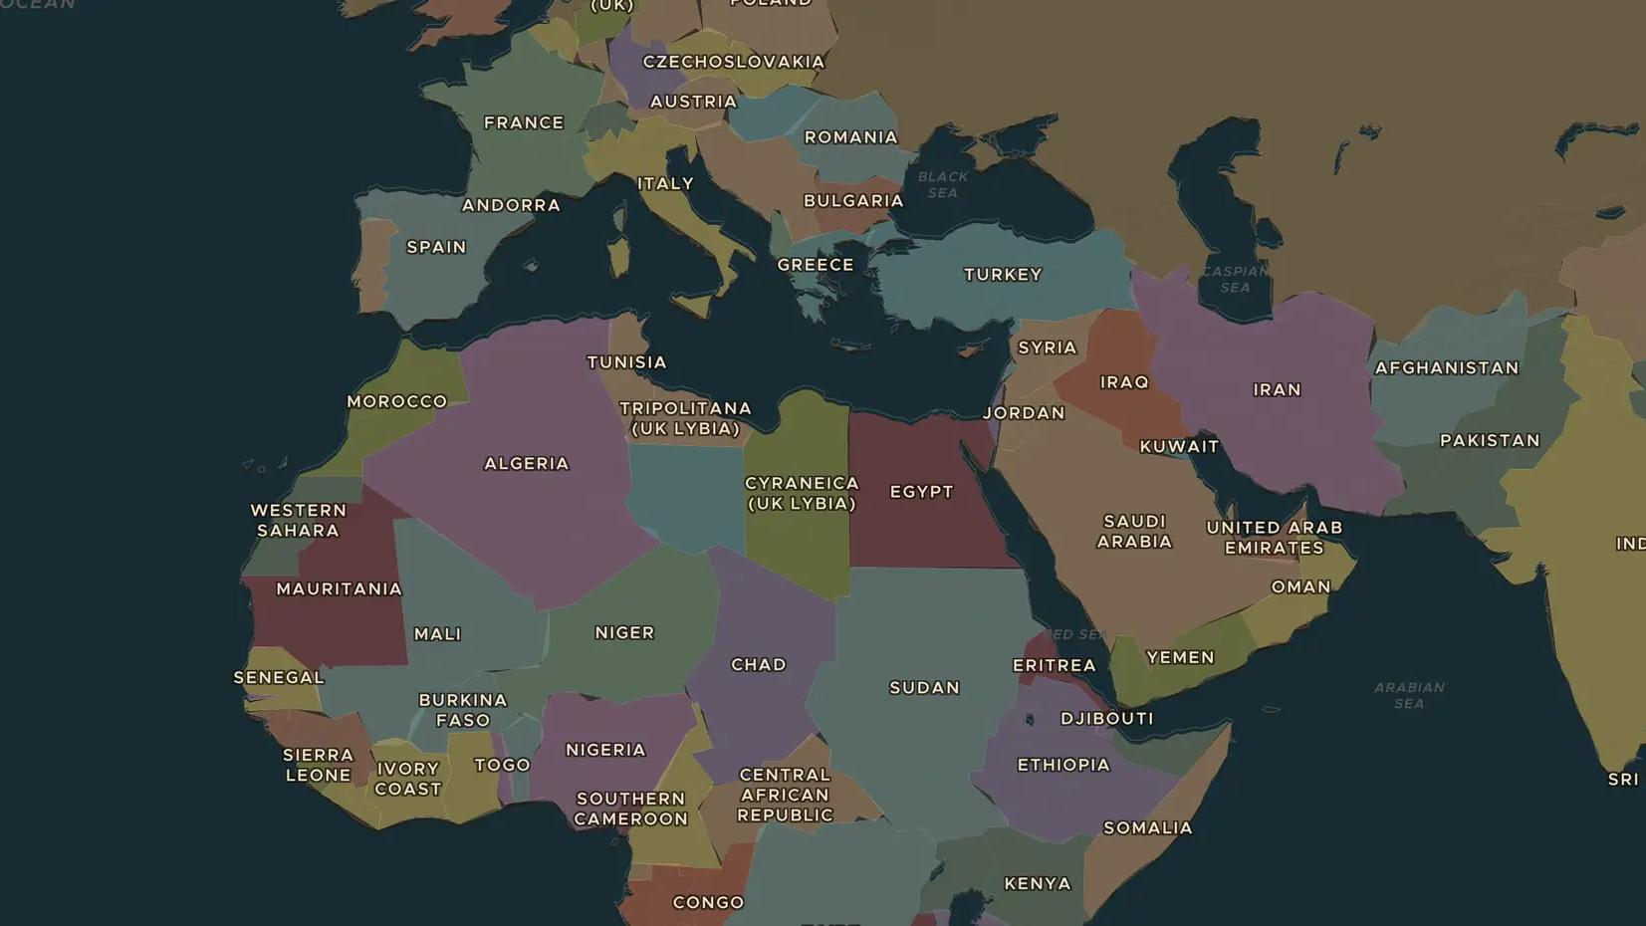
INTERWAR YEARS · 1922-1936
Mussolini and Fascist Italy
ChronoAtlas Classroom · Plate 472 · Ages 13-16 · 50 min
ChronoAtlas Classroom · chronoatlas.nl/classroom/lesson/mussolini-fascist-italy

Slide 2
THIS LESSON
What students take from it
In 1922 Benito Mussolini became prime minister of Italy and soon ruled as a dictator. He promised order and the glory of ancient Rome, and in 1935 he invaded Ethiopia. Students explore how fascism took power and why the League of Nations failed to stop it.
LENGTH
50 min
AGES
13-16
ON THE MAP
BY THE END, STUDENTS CAN
3 steps, AD 1930
Explain how Mussolini came to power in 1922.
Describe what life in a fascist state meant, with at least three examples.
Explain why the invasion of Ethiopia in 1935 showed the weakness of the League of Nations.
QUIZ
7 rounds
ChronoAtlas Classroom · chronoatlas.nl/classroom/lesson/mussolini-fascist-italy
2

Slide 3
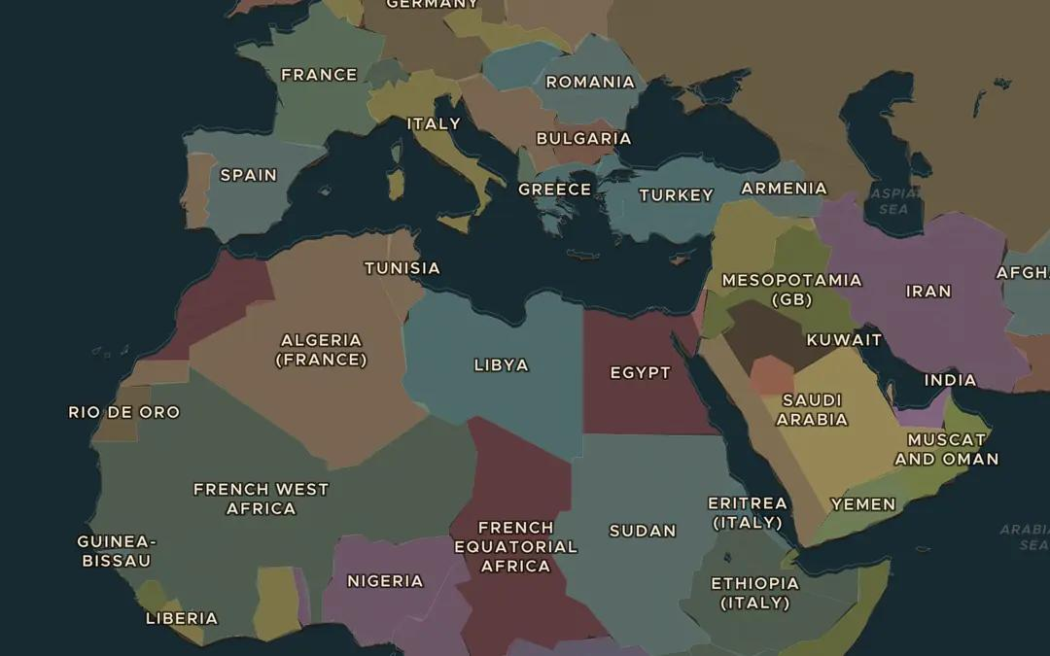
EXPLORE THE MAP · STEP A OF 3 · AD 1930
a
Italy in 1930
Open the map in 1930. Find Italy and its colonies across the sea in Libya and in East Africa. Where else might Mussolini want to expand?
Open this view on the live map →
ChronoAtlas Classroom · chronoatlas.nl/classroom/lesson/mussolini-fascist-italy
3
Notes:
Open the map in 1930. Find Italy and its colonies across the sea in Libya and in East Africa. Where else might Mussolini want to expand?
https://chronoatlas.nl/?year=1930&lat=30&lng=20&zoom=3.5

Slide 4
CHRONOATLAS CLASSROOM
The rest of this deck comes with Classroom
19 more slides: the other map steps, the discussion questions, the quiz with its answers, and the worksheet.
Every lesson as a deck, every worksheet, every live lesson and homework.
€19 a month, cancel anytime. The free lesson, Rome at its height, comes whole.
https://chronoatlas.nl/pricing
ChronoAtlas Classroom · chronoatlas.nl/classroom/lesson/mussolini-fascist-italy
4

