Slide 1
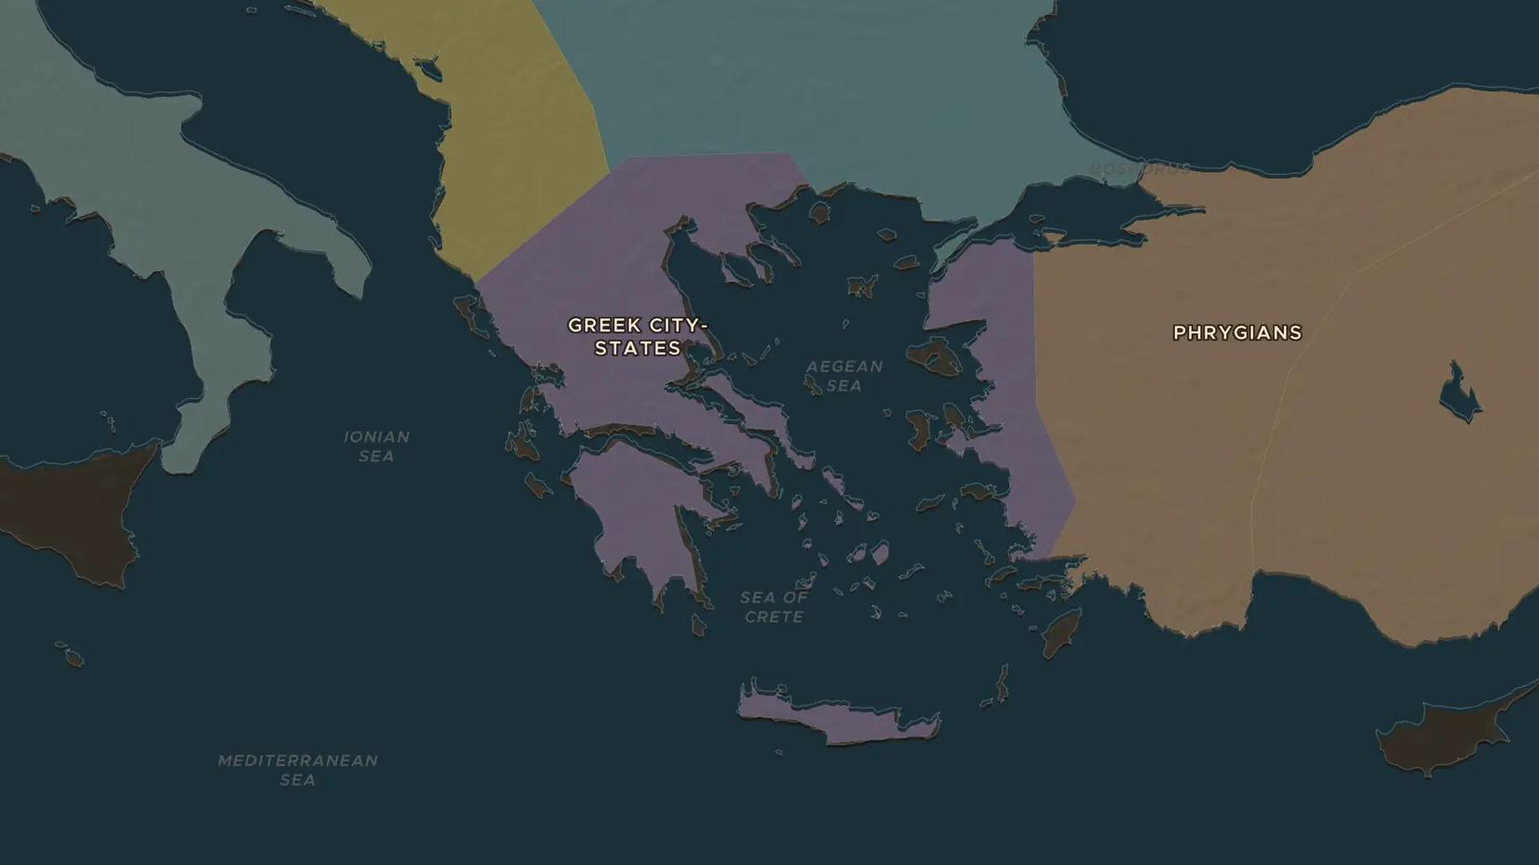
MYCENAEAN GREECE · ABOUT 1600-1100 BC
Mycenae: Greece in the age of heroes
ChronoAtlas Classroom · Plate 35 · Ages 11-14 · 50 min
ChronoAtlas Classroom · chronoatlas.nl/classroom/lesson/mycenaean-greece

Slide 2
THIS LESSON
What students take from it
Fortress palaces, gold masks and tablets full of sheep counts: the Mycenaeans were the Greeks of the Bronze Age. Students explore Mycenae, Pylos and Troy, and ask how much of Homer's Trojan War really happened.
LENGTH
50 min
AGES
11-14
ON THE MAP
BY THE END, STUDENTS CAN
3 steps, 1,250 BC
Locate the main Mycenaean palaces and Troy on the map.
Explain what Linear B tablets reveal about how a Mycenaean palace worked.
Weigh the evidence for and against a real Trojan War.
QUIZ
7 rounds
ChronoAtlas Classroom · chronoatlas.nl/classroom/lesson/mycenaean-greece
2

Slide 3
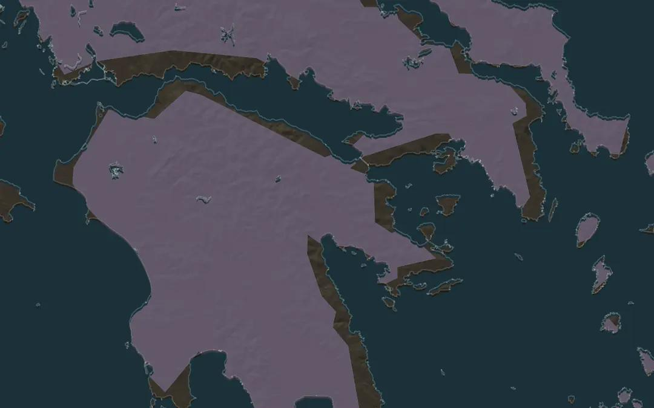
EXPLORE THE MAP · STEP A OF 3 · 1,250 BC
a
The citadel of Mycenae
Open the map in 1250 BC and zoom in on the northeast Peloponnese. Mycenae sits on a hill above the plain of Argos. Why would a king build his fortress here?
Open this view on the live map →
ChronoAtlas Classroom · chronoatlas.nl/classroom/lesson/mycenaean-greece
3
Notes:
Open the map in 1250 BC and zoom in on the northeast Peloponnese. Mycenae sits on a hill above the plain of Argos. Why would a king build his fortress here?
https://chronoatlas.nl/?year=-1250&lat=37.73&lng=22.76&zoom=8

Slide 4
CHRONOATLAS CLASSROOM
The rest of this deck comes with Classroom
19 more slides: the other map steps, the discussion questions, the quiz with its answers, and the worksheet.
Every lesson as a deck, every worksheet, every live lesson and homework.
€19 a month, cancel anytime. The free lesson, Rome at its height, comes whole.
https://chronoatlas.nl/pricing
ChronoAtlas Classroom · chronoatlas.nl/classroom/lesson/mycenaean-greece
4

