Slide 1
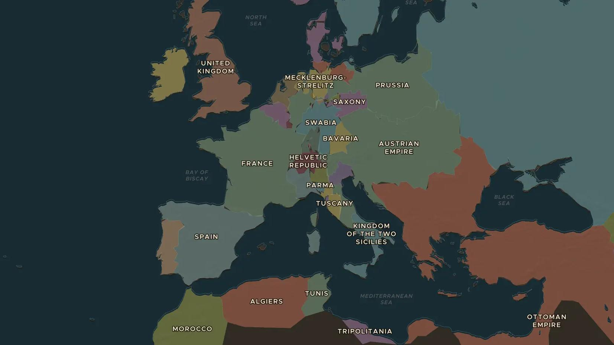
NAPOLEONIC WARS · 1805-1810
Napoleon's Europe: Austerlitz to Tilsit
ChronoAtlas Classroom · Plate 406 · Ages 12-15 · 50 min
ChronoAtlas Classroom · chronoatlas.nl/classroom/lesson/napoleon-empire-in-europe

Slide 2
THIS LESSON
What students take from it
Beaten at sea at Trafalgar, unbeatable on land at Austerlitz and Jena: by 1807 Napoleon dominates the continent and an empire of 800 years disappears. Students map Napoleon's Europe and ask how it was held together.
LENGTH
50 min
AGES
12-15
ON THE MAP
BY THE END, STUDENTS CAN
3 steps, AD 1805
Locate Trafalgar, Austerlitz, Jena and Tilsit and explain what each decided.
Explain why the Holy Roman Empire ended in 1806.
Describe the Continental System and why it was hard to enforce.
QUIZ
7 rounds
ChronoAtlas Classroom · chronoatlas.nl/classroom/lesson/napoleon-empire-in-europe
2

Slide 3
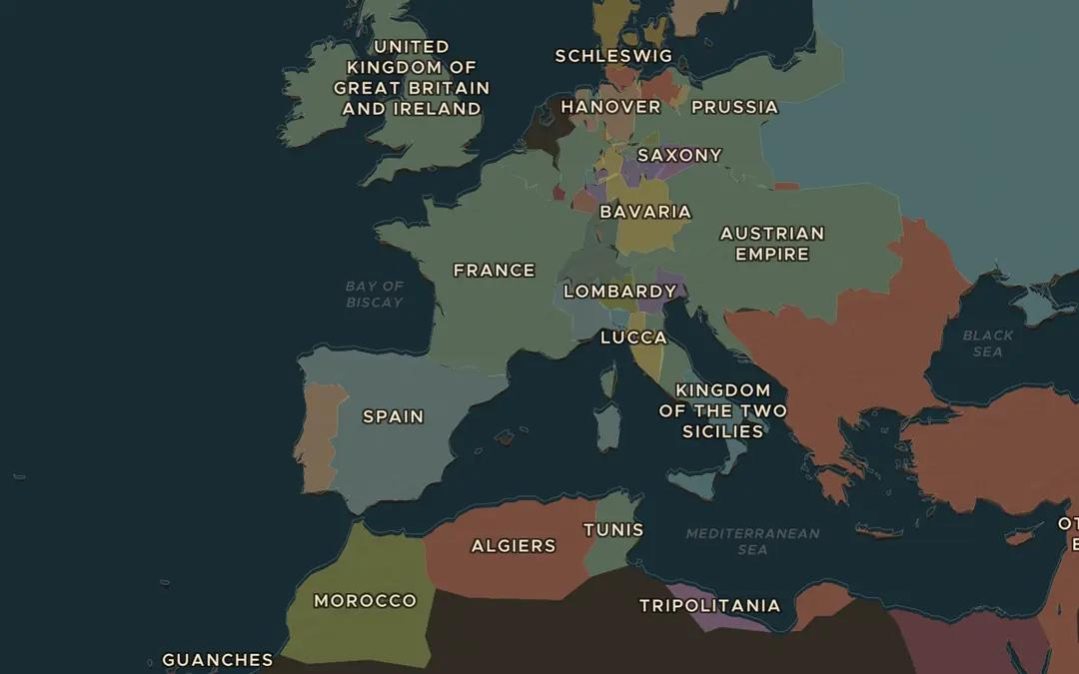
EXPLORE THE MAP · STEP A OF 3 · AD 1805
a
Two battles of 1805
Open the map in 1805 and turn on Historical Events. Find Trafalgar and Austerlitz. Which was fought at sea and which on land, and what did each one decide?
Open this view on the live map →
ChronoAtlas Classroom · chronoatlas.nl/classroom/lesson/napoleon-empire-in-europe
3
Notes:
Open the map in 1805 and turn on Historical Events. Find Trafalgar and Austerlitz. Which was fought at sea and which on land, and what did each one decide?
https://chronoatlas.nl/?year=1805&lat=44&lng=5&zoom=4

Slide 4
CHRONOATLAS CLASSROOM
The rest of this deck comes with Classroom
19 more slides: the other map steps, the discussion questions, the quiz with its answers, and the worksheet.
Every lesson as a deck, every worksheet, every live lesson and homework.
€19 a month, cancel anytime. The free lesson, Rome at its height, comes whole.
https://chronoatlas.nl/pricing
ChronoAtlas Classroom · chronoatlas.nl/classroom/lesson/napoleon-empire-in-europe
4

