Slide 1
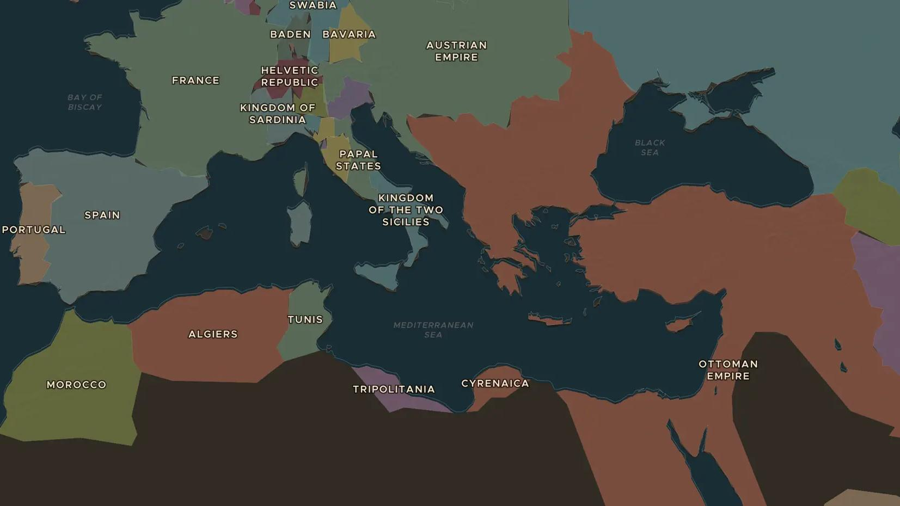
NAPOLEONIC FRANCE · 1793-1804
Napoleon: from Corsica to emperor
ChronoAtlas Classroom · Plate 393 · Ages 11-14 · 50 min
ChronoAtlas Classroom · chronoatlas.nl/classroom/lesson/napoleon-rise-to-power

Slide 2
THIS LESSON
What students take from it
An artillery officer from Corsica becomes a general at 24, conquers Italy, invades Egypt and crowns himself emperor. Students follow Napoleon's rise on the map and ask how a revolution produced an emperor.
LENGTH
50 min
AGES
11-14
ON THE MAP
BY THE END, STUDENTS CAN
3 steps, AD 1783
Trace the main steps of Napoleon's rise from Toulon (1793) to emperor (1804) on the map.
Explain how the coup of 1799 gave Napoleon power while France was still called a republic.
Give two lasting results of Napoleon's rule, such as the Civil Code.
QUIZ
7 rounds
ChronoAtlas Classroom · chronoatlas.nl/classroom/lesson/napoleon-rise-to-power
2

Slide 3
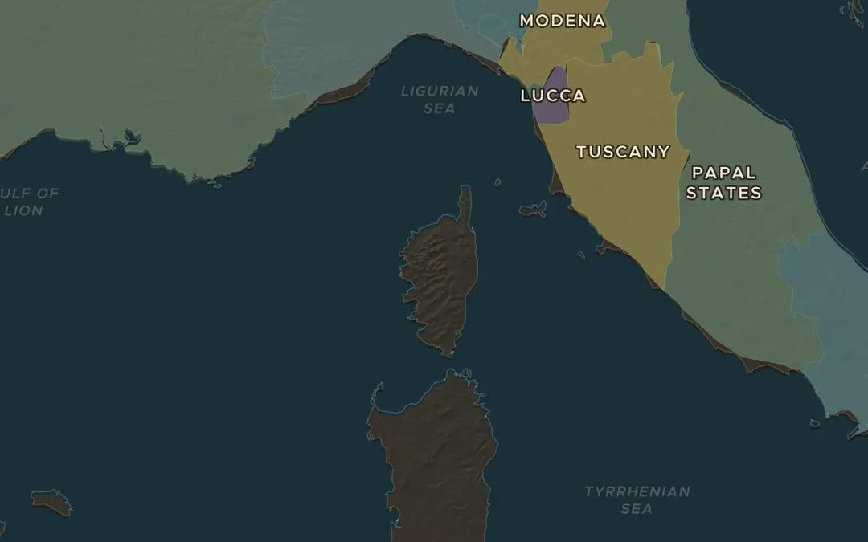
EXPLORE THE MAP · STEP A OF 3 · AD 1783
a
An island childhood
Open the map in 1783 and find Corsica. Genoa had handed the island to France in 1768, a year before Napoleon was born there. Which coasts are closer to Corsica: France or Italy?
Open this view on the live map →
ChronoAtlas Classroom · chronoatlas.nl/classroom/lesson/napoleon-rise-to-power
3
Notes:
Open the map in 1783 and find Corsica. Genoa had handed the island to France in 1768, a year before Napoleon was born there. Which coasts are closer to Corsica: France or Italy?
https://chronoatlas.nl/?year=1783&lat=42.2&lng=9&zoom=6.5

Slide 4
CHRONOATLAS CLASSROOM
The rest of this deck comes with Classroom
19 more slides: the other map steps, the discussion questions, the quiz with its answers, and the worksheet.
Every lesson as a deck, every worksheet, every live lesson and homework.
€19 a month, cancel anytime. The free lesson, Rome at its height, comes whole.
https://chronoatlas.nl/pricing
ChronoAtlas Classroom · chronoatlas.nl/classroom/lesson/napoleon-rise-to-power
4

