Slide 1
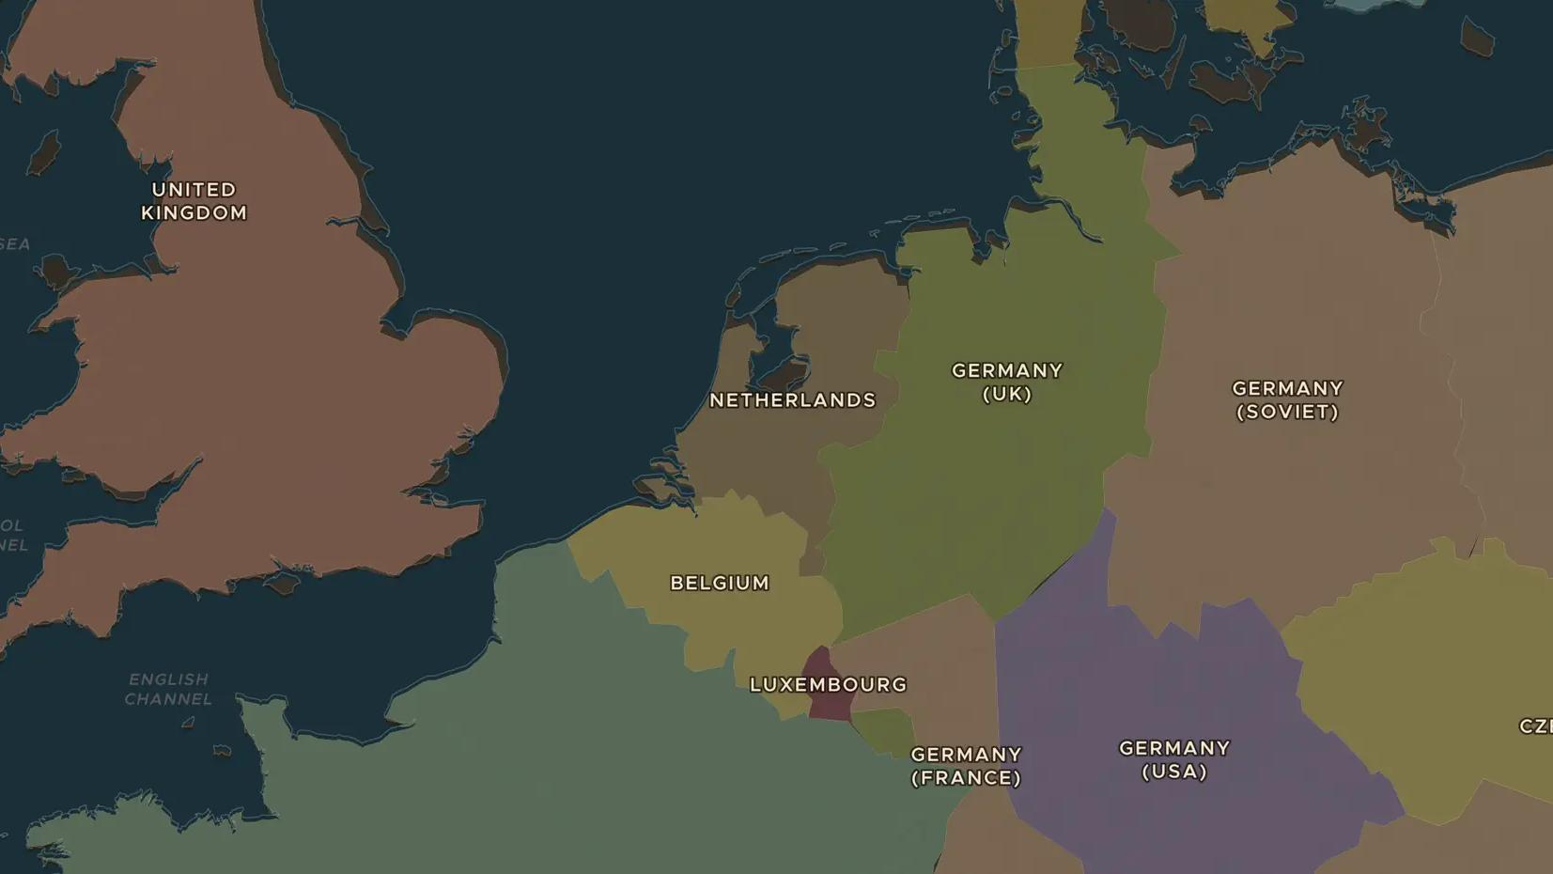
SECOND WORLD WAR · 1940-1945
The Netherlands under occupation
ChronoAtlas Classroom · Plate 486 · Ages 12-15 · 50 min
ChronoAtlas Classroom · chronoatlas.nl/classroom/lesson/netherlands-occupation

Slide 2
THIS LESSON
What students take from it
In May 1940 Germany conquered the Netherlands in five days. Five years of occupation followed: persecution, adaptation, collaboration and resistance, the Hunger Winter and finally liberation. Students locate key places on the map and explore the choices ordinary people faced.
LENGTH
50 min
AGES
12-15
ON THE MAP
BY THE END, STUDENTS CAN
3 steps, AD 1938
Describe how Germany invaded and occupied the Netherlands in May 1940.
Give examples of collaboration, adaptation and resistance during the occupation.
Explain how the Netherlands was liberated in 1944-1945, and why the west suffered a Hunger Winter.
QUIZ
7 rounds
ChronoAtlas Classroom · chronoatlas.nl/classroom/lesson/netherlands-occupation
2

Slide 3
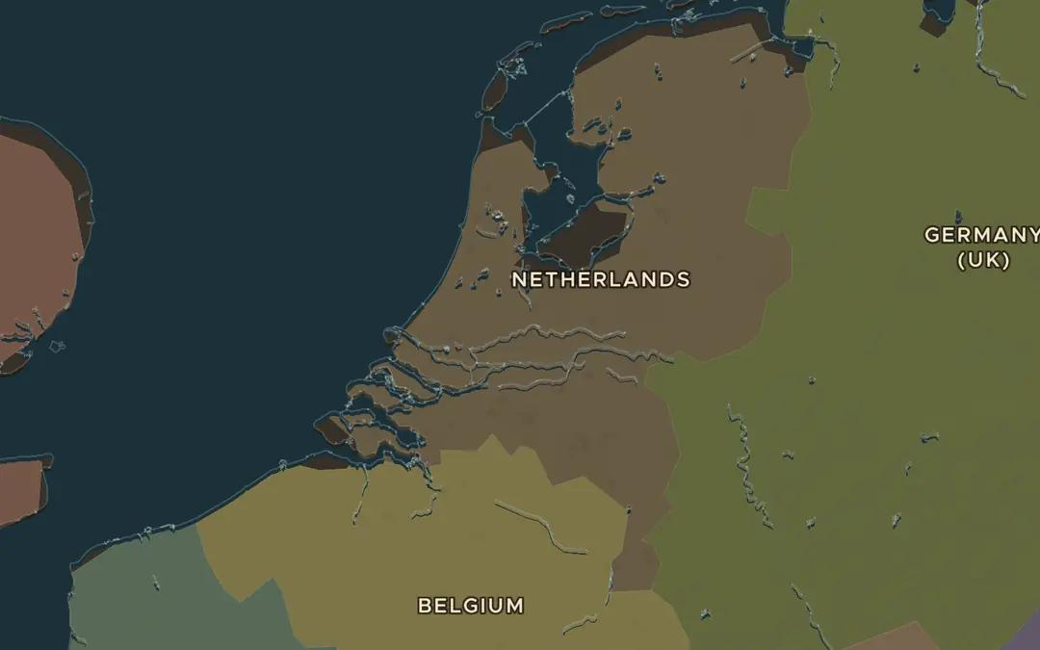
EXPLORE THE MAP · STEP A OF 3 · AD 1938
a
Five days in May
Open the map in 1938 and zoom in on the Netherlands. Find the Grebbeberg near Rhenen, Rotterdam and The Hague. Ask the atlas: "Why did the Netherlands surrender on 15 May 1940?"
Open this view on the live map →
ChronoAtlas Classroom · chronoatlas.nl/classroom/lesson/netherlands-occupation
3
Notes:
Open the map in 1938 and zoom in on the Netherlands. Find the Grebbeberg near Rhenen, Rotterdam and The Hague. Ask the atlas: "Why did the Netherlands surrender on 15 May 1940?"
https://chronoatlas.nl/?year=1938&lat=52&lng=5&zoom=7

Slide 4
CHRONOATLAS CLASSROOM
The rest of this deck comes with Classroom
19 more slides: the other map steps, the discussion questions, the quiz with its answers, and the worksheet.
Every lesson as a deck, every worksheet, every live lesson and homework.
€19 a month, cancel anytime. The free lesson, Rome at its height, comes whole.
https://chronoatlas.nl/pricing
ChronoAtlas Classroom · chronoatlas.nl/classroom/lesson/netherlands-occupation
4

