Slide 1
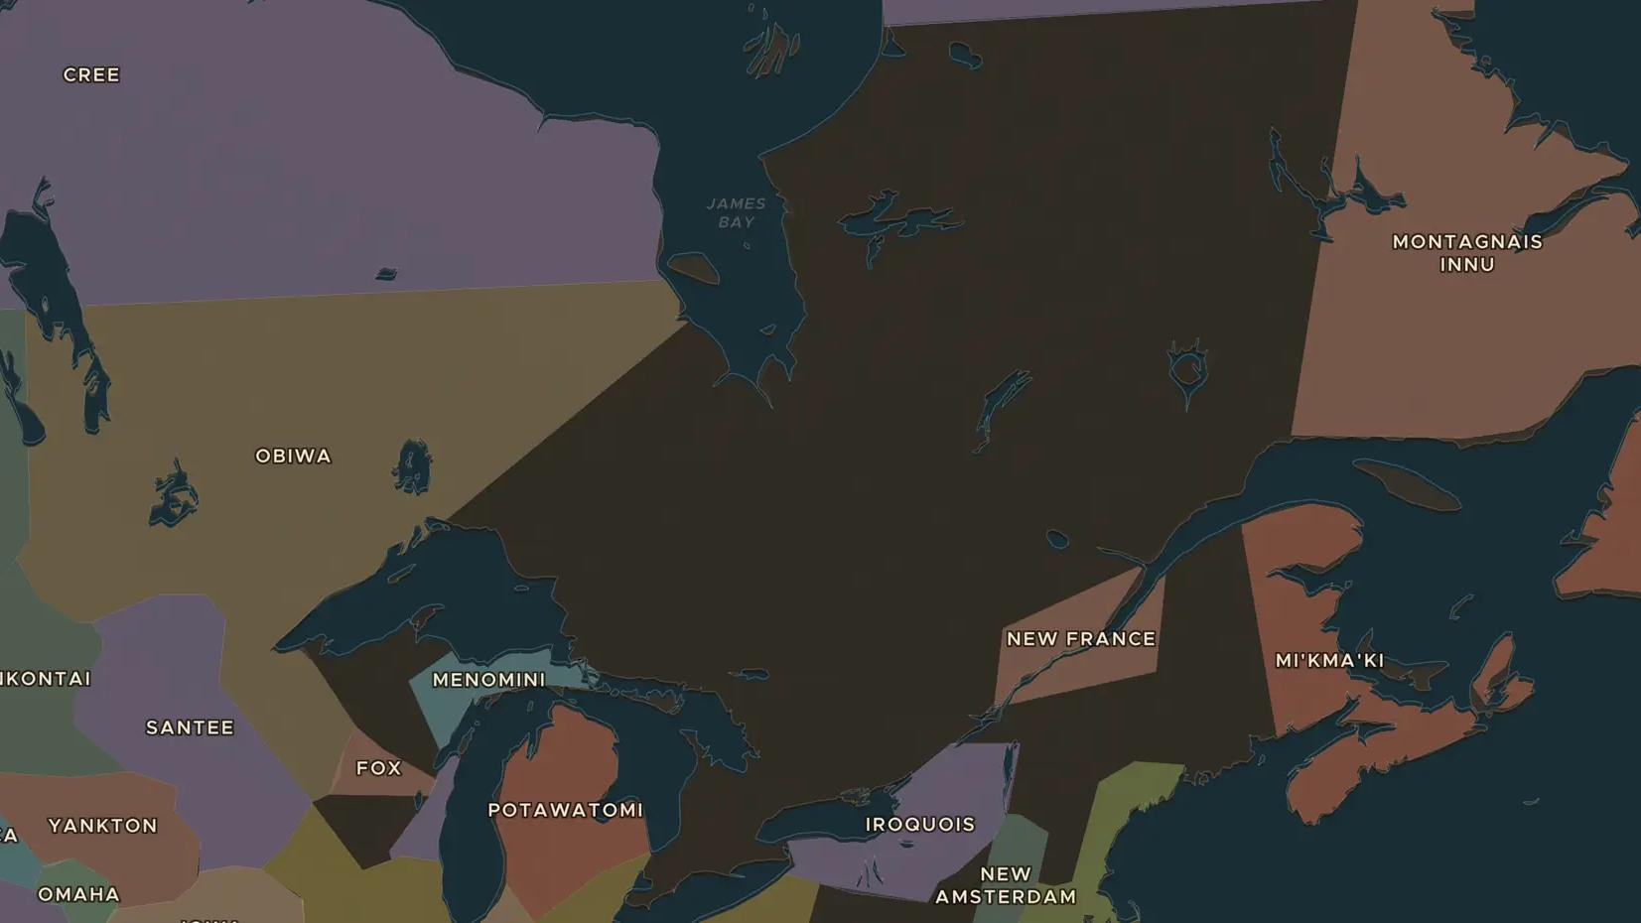
NEW FRANCE · 1608-1701
New France and the fur trade
ChronoAtlas Classroom · Plate 357 · Ages 11-14 · 50 min
ChronoAtlas Classroom · chronoatlas.nl/classroom/lesson/new-france-fur-trade

Slide 2
THIS LESSON
What students take from it
In 1608 Samuel de Champlain founded Quebec on the St. Lawrence River. New France lived from the fur trade, which depended on alliances with First Nations such as the Wendat, Algonquin and Innu. Students follow the canoe routes, the wars over furs and the Great Peace of 1701.
LENGTH
50 min
AGES
11-14
ON THE MAP
BY THE END, STUDENTS CAN
3 steps, AD 1650
Locate Quebec, Montreal and the Great Lakes and explain why rivers mattered to New France.
Explain how the fur trade depended on alliances with First Nations.
Describe the Great Peace of Montreal of 1701 and why it mattered.
QUIZ
7 rounds
ChronoAtlas Classroom · chronoatlas.nl/classroom/lesson/new-france-fur-trade
2

Slide 3
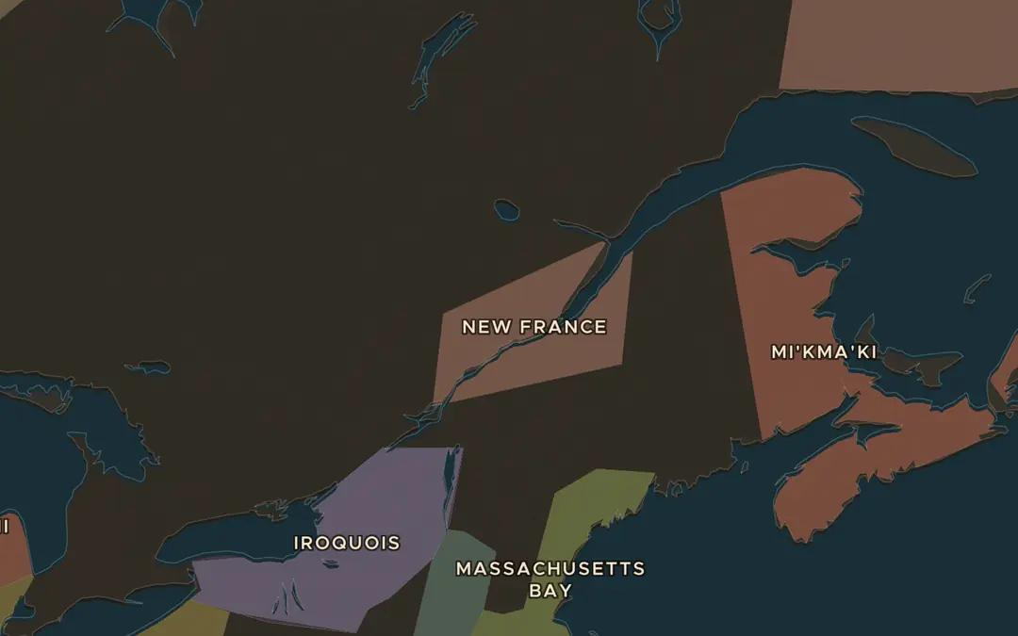
EXPLORE THE MAP · STEP A OF 3 · AD 1650
a
A colony on a river
Open the map in 1650 and find New France along the St. Lawrence River. Compare its size with the lands around it. Who controlled most of the land in 1650?
Open this view on the live map →
ChronoAtlas Classroom · chronoatlas.nl/classroom/lesson/new-france-fur-trade
3
Notes:
Open the map in 1650 and find New France along the St. Lawrence River. Compare its size with the lands around it. Who controlled most of the land in 1650?
https://chronoatlas.nl/?year=1650&lat=47&lng=-72&zoom=5.5

Slide 4
CHRONOATLAS CLASSROOM
The rest of this deck comes with Classroom
19 more slides: the other map steps, the discussion questions, the quiz with its answers, and the worksheet.
Every lesson as a deck, every worksheet, every live lesson and homework.
€19 a month, cancel anytime. The free lesson, Rome at its height, comes whole.
https://chronoatlas.nl/pricing
ChronoAtlas Classroom · chronoatlas.nl/classroom/lesson/new-france-fur-trade
4

