Slide 1
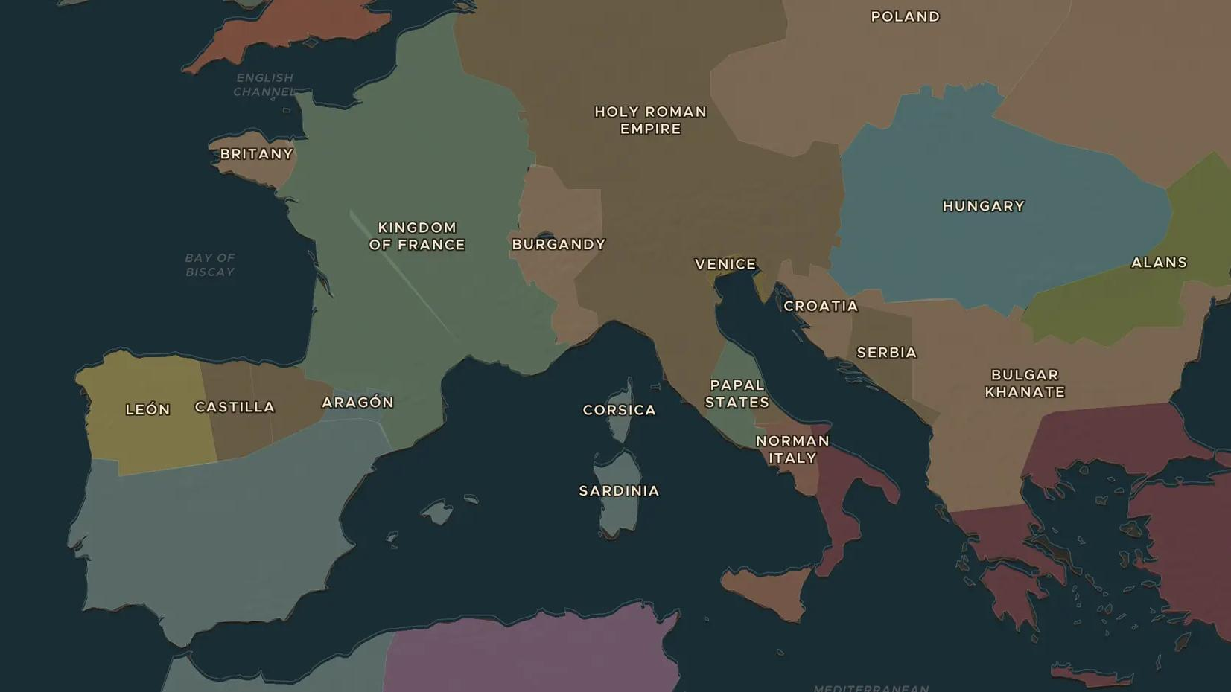
NORMANS · 911-1154
The Normans: from Viking settlers to kings
ChronoAtlas Classroom · Plate 201 · Ages 12-15 · 50 min
ChronoAtlas Classroom · chronoatlas.nl/classroom/lesson/normans-vikings-to-kings

Slide 2
THIS LESSON
What students take from it
Viking raiders settle on the Seine, become French-speaking Christians and then conquer England, southern Italy and Sicily. Students follow the Normans across Europe and visit Palermo, where a Norman king ruled Latin, Greek and Arab subjects.
LENGTH
50 min
AGES
12-15
ON THE MAP
BY THE END, STUDENTS CAN
3 steps, AD 911
Explain how a group of Viking settlers became the Normans of Normandy.
Trace on the map the Norman conquests in England, southern Italy and Sicily.
Describe the mixed culture of Norman Sicily under Roger II.
QUIZ
7 rounds
ChronoAtlas Classroom · chronoatlas.nl/classroom/lesson/normans-vikings-to-kings
2

Slide 3
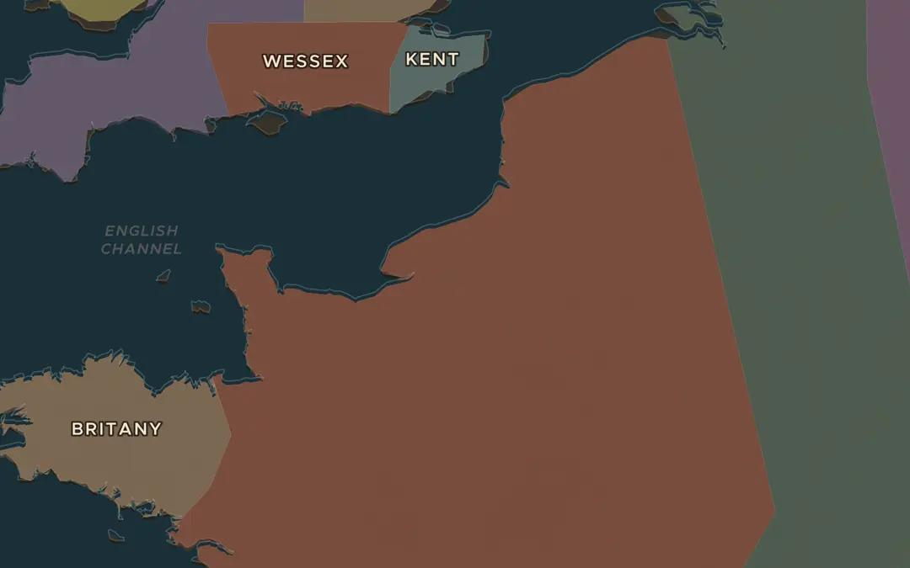
EXPLORE THE MAP · STEP A OF 3 · AD 911
a
A land on the Seine
Open the map in 911 and zoom in on the lower Seine around Rouen. This land was granted to the Viking leader Rollo. Why would a king hand land to raiders?
Open this view on the live map →
ChronoAtlas Classroom · chronoatlas.nl/classroom/lesson/normans-vikings-to-kings
3
Notes:
Open the map in 911 and zoom in on the lower Seine around Rouen. This land was granted to the Viking leader Rollo. Why would a king hand land to raiders?
https://chronoatlas.nl/?year=911&lat=49.4&lng=1&zoom=6.5

Slide 4
CHRONOATLAS CLASSROOM
The rest of this deck comes with Classroom
19 more slides: the other map steps, the discussion questions, the quiz with its answers, and the worksheet.
Every lesson as a deck, every worksheet, every live lesson and homework.
€19 a month, cancel anytime. The free lesson, Rome at its height, comes whole.
https://chronoatlas.nl/pricing
ChronoAtlas Classroom · chronoatlas.nl/classroom/lesson/normans-vikings-to-kings
4

