Slide 1
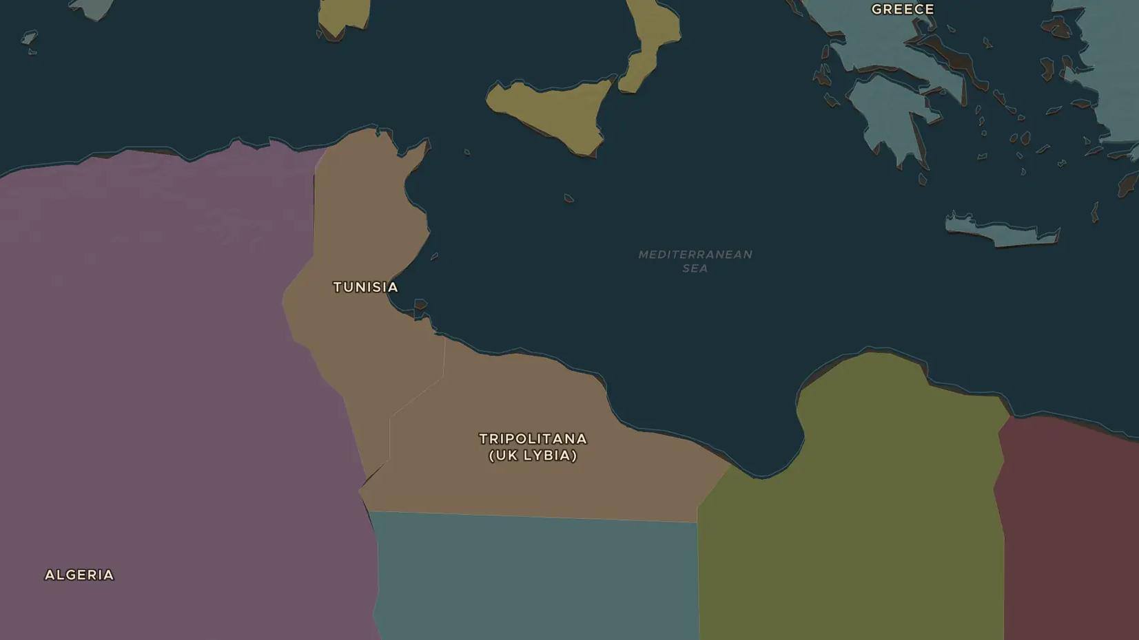
SECOND WORLD WAR · 1940-1943
El Alamein and the war in North Africa
ChronoAtlas Classroom · Plate 479 · Ages 12-15 · 45 min
ChronoAtlas Classroom · chronoatlas.nl/classroom/lesson/north-africa-el-alamein

Slide 2
THIS LESSON
What students take from it
For three years armies fought back and forth along the coast of North Africa, with the Suez Canal as the prize. At El Alamein in 1942 the British Eighth Army stopped Rommel, and American landings trapped the Axis in Tunisia. Students follow the desert war on the map.
LENGTH
45 min
AGES
12-15
ON THE MAP
BY THE END, STUDENTS CAN
3 steps, AD 1938
Explain why North Africa and the Suez Canal mattered in the Second World War.
Locate Tobruk, El Alamein and the Torch landings on the map.
Explain why El Alamein and the Allied victory in Tunisia changed the course of the war.
QUIZ
7 rounds
ChronoAtlas Classroom · chronoatlas.nl/classroom/lesson/north-africa-el-alamein
2

Slide 3
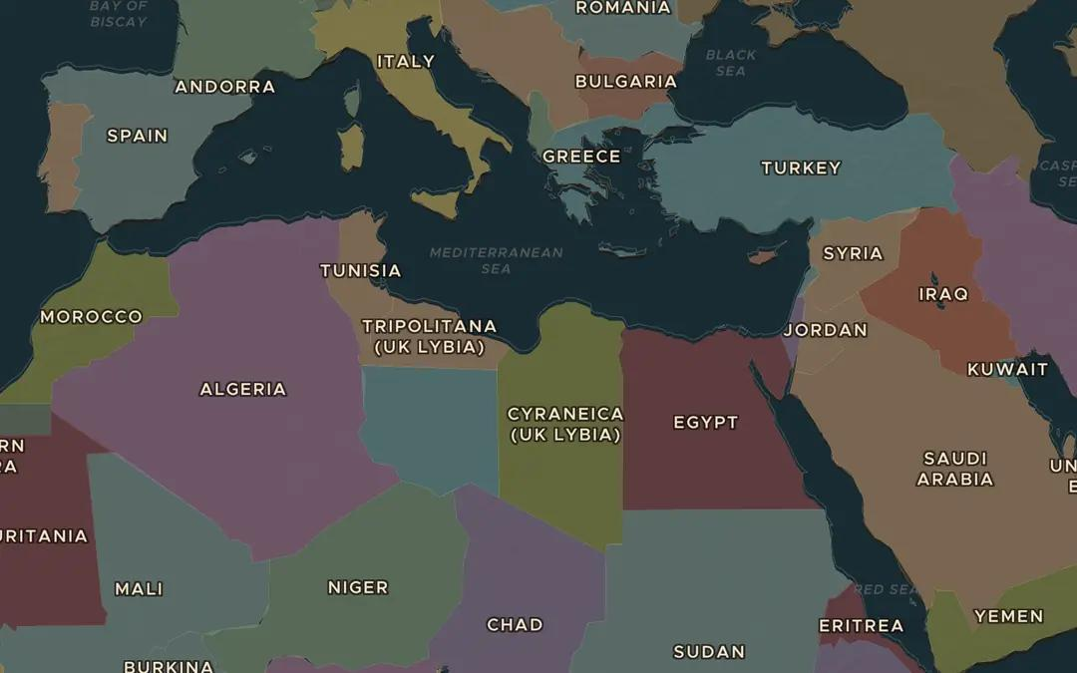
EXPLORE THE MAP · STEP A OF 3 · AD 1938
a
The coast road
Open the map in 1938 and find Italy's colony of Libya and Egypt next to it. Follow the coast from Tripoli to Alexandria. Why did both sides fight along the coast and not deep in the desert?
Open this view on the live map →
ChronoAtlas Classroom · chronoatlas.nl/classroom/lesson/north-africa-el-alamein
3
Notes:
Open the map in 1938 and find Italy's colony of Libya and Egypt next to it. Follow the coast from Tripoli to Alexandria. Why did both sides fight along the coast and not deep in the desert?
https://chronoatlas.nl/?year=1938&lat=31&lng=20&zoom=4

Slide 4
CHRONOATLAS CLASSROOM
The rest of this deck comes with Classroom
19 more slides: the other map steps, the discussion questions, the quiz with its answers, and the worksheet.
Every lesson as a deck, every worksheet, every live lesson and homework.
€19 a month, cancel anytime. The free lesson, Rome at its height, comes whole.
https://chronoatlas.nl/pricing
ChronoAtlas Classroom · chronoatlas.nl/classroom/lesson/north-africa-el-alamein
4

