Slide 1
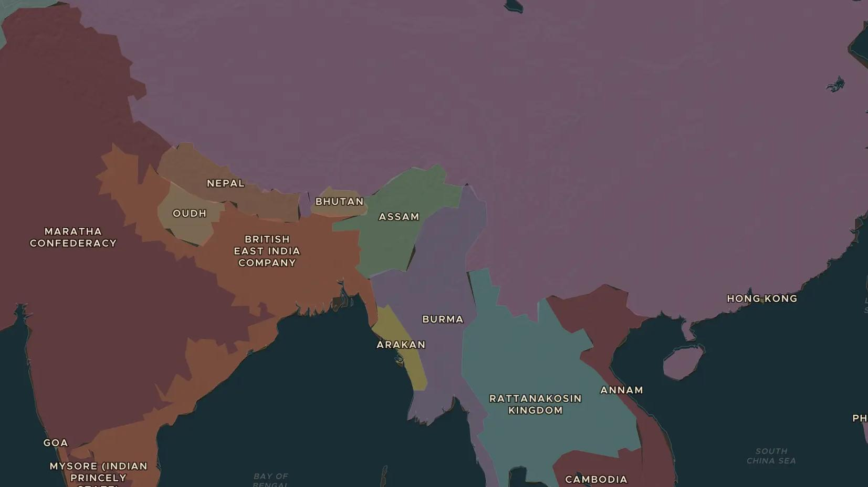
QING CHINA · 1839-1860
The Opium Wars
ChronoAtlas Classroom · Plate 421 · Ages 13-16 · 50 min
ChronoAtlas Classroom · chronoatlas.nl/classroom/lesson/opium-wars

Slide 2
THIS LESSON
What students take from it
Britain wants Chinese tea and pays with opium grown in India. When China tries to stop the drug trade, British warships force it open. Students follow the Opium Wars from Canton to Hong Kong and Shanghai, and see why China calls this the start of a "century of humiliation".
LENGTH
50 min
AGES
13-16
ON THE MAP
BY THE END, STUDENTS CAN
3 steps, AD 1840
Explain how the tea and opium trade linked Britain, India and China.
Describe the causes and results of the First (1839-1842) and Second (1856-1860) Opium Wars.
Explain what the "unequal treaties" were and why they still matter in China today.
QUIZ
7 rounds
ChronoAtlas Classroom · chronoatlas.nl/classroom/lesson/opium-wars
2

Slide 3
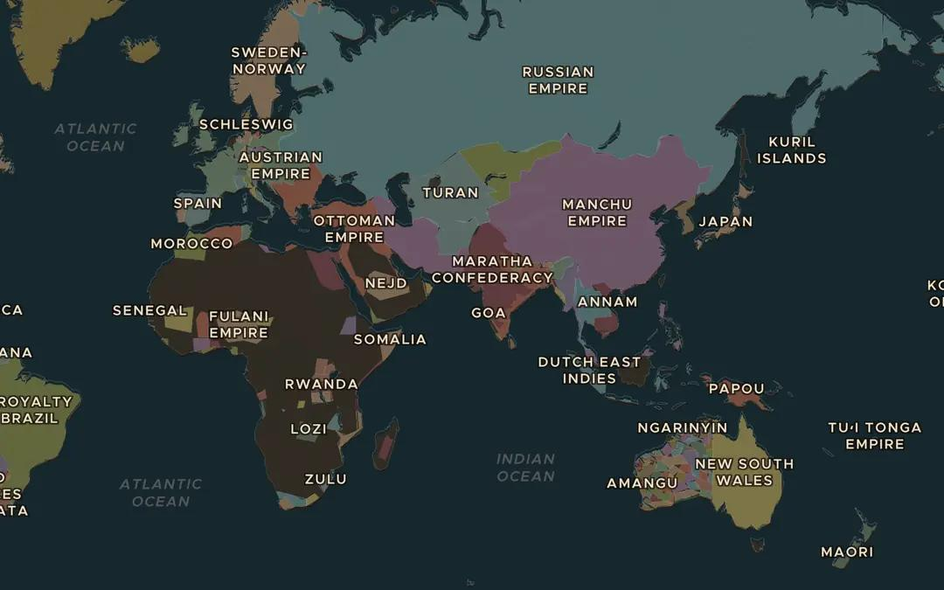
EXPLORE THE MAP · STEP A OF 3 · AD 1840
a
The tea trade
Open the map in 1840 and turn on Trade Routes. Follow the Cape Route to the Indies from Europe to Asia, then find the Kyakhta Tea Road over land. Which countries bought Chinese tea along each route?
Open this view on the live map →
ChronoAtlas Classroom · chronoatlas.nl/classroom/lesson/opium-wars
3
Notes:
Open the map in 1840 and turn on Trade Routes. Follow the Cape Route to the Indies from Europe to Asia, then find the Kyakhta Tea Road over land. Which countries bought Chinese tea along each route?
https://chronoatlas.nl/?year=1840&lat=20&lng=70&zoom=2

Slide 4
CHRONOATLAS CLASSROOM
The rest of this deck comes with Classroom
19 more slides: the other map steps, the discussion questions, the quiz with its answers, and the worksheet.
Every lesson as a deck, every worksheet, every live lesson and homework.
€19 a month, cancel anytime. The free lesson, Rome at its height, comes whole.
https://chronoatlas.nl/pricing
ChronoAtlas Classroom · chronoatlas.nl/classroom/lesson/opium-wars
4

