Slide 1
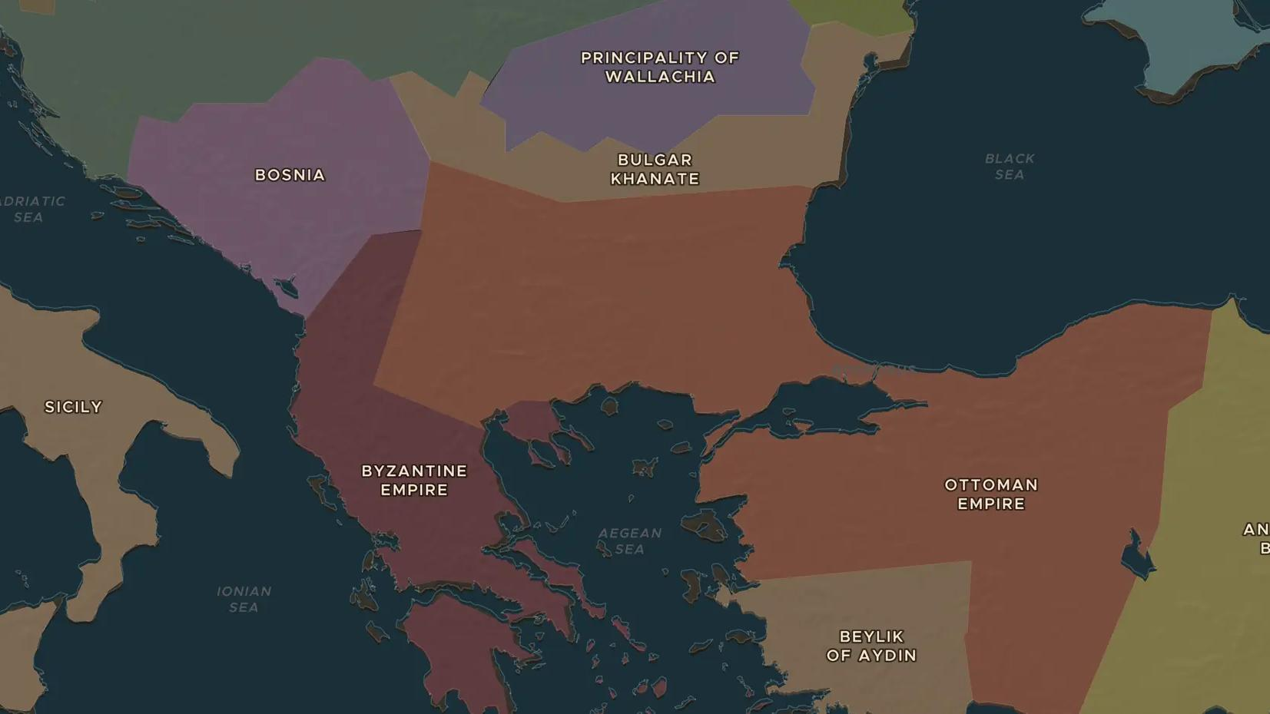
OTTOMAN EMPIRE · 1299-1402
From Osman to Bayezid: the first Ottomans
ChronoAtlas Classroom · Plate 272 · Ages 12-15 · 45 min
ChronoAtlas Classroom · chronoatlas.nl/classroom/lesson/osman-and-the-first-ottomans

Slide 2
THIS LESSON
What students take from it
Around 1300 the Ottomans were one small Turkish state among many. Within a century they ruled lands on two continents. Students trace this rise on the map and weigh the reasons historians give for it.
LENGTH
45 min
AGES
12-15
ON THE MAP
BY THE END, STUDENTS CAN
3 steps, AD 1326
Describe the growth of the Ottoman state between about 1300 and 1400 using the map.
Locate Bursa, Gallipoli, Edirne and Kosovo and explain why each mattered.
Compare at least two explanations for the rise of the Ottomans.
QUIZ
7 rounds
ChronoAtlas Classroom · chronoatlas.nl/classroom/lesson/osman-and-the-first-ottomans
2

Slide 3
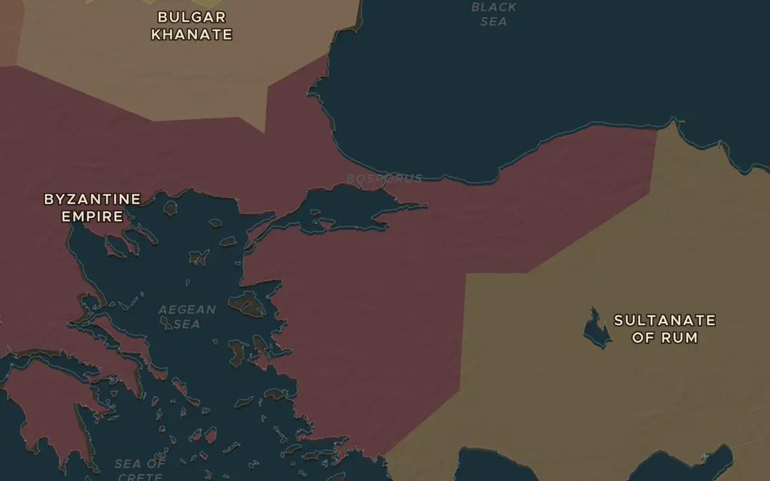
EXPLORE THE MAP · STEP A OF 3 · AD 1326
a
A small frontier state
Open Stories and start The Ottoman Ascent. At the first step, 1326, the Ottomans take Bursa. Look around: who are their neighbors?
Open this view on the live map →
ChronoAtlas Classroom · chronoatlas.nl/classroom/lesson/osman-and-the-first-ottomans
3
Notes:
Open Stories and start The Ottoman Ascent. At the first step, 1326, the Ottomans take Bursa. Look around: who are their neighbors?
https://chronoatlas.nl/?year=1326&lat=40.18&lng=29.06&zoom=6

Slide 4
CHRONOATLAS CLASSROOM
The rest of this deck comes with Classroom
19 more slides: the other map steps, the discussion questions, the quiz with its answers, and the worksheet.
Every lesson as a deck, every worksheet, every live lesson and homework.
€19 a month, cancel anytime. The free lesson, Rome at its height, comes whole.
https://chronoatlas.nl/pricing
ChronoAtlas Classroom · chronoatlas.nl/classroom/lesson/osman-and-the-first-ottomans
4

