Slide 1
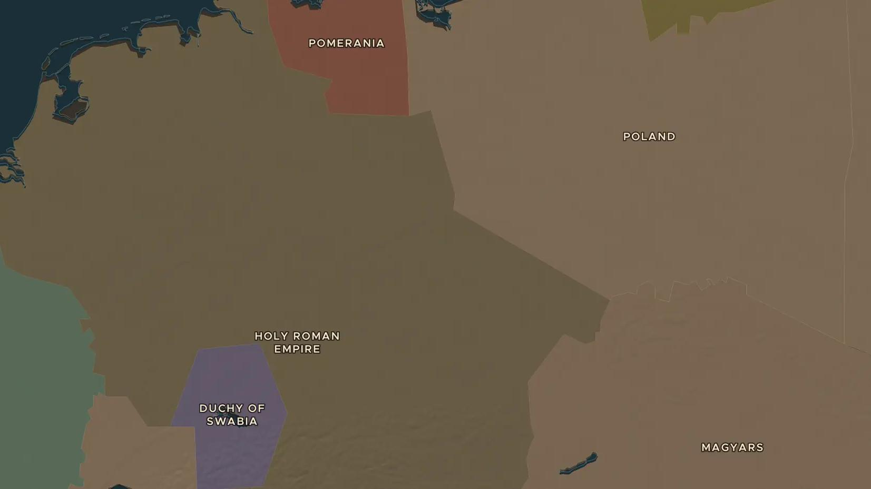
HOLY ROMAN EMPIRE · 936-1001
Otto the Great and the birth of the Holy Roman Empire
ChronoAtlas Classroom · Plate 202 · Ages 12-15 · 50 min
ChronoAtlas Classroom · chronoatlas.nl/classroom/lesson/otto-the-great-lechfeld

Slide 2
THIS LESSON
What students take from it
In 955 King Otto defeats the Magyar horsemen near Augsburg, and in 962 the pope crowns him emperor in Rome. Students trace the birth of what was later called the Holy Roman Empire and see how Poland and Hungary joined Latin Christian Europe.
LENGTH
50 min
AGES
12-15
ON THE MAP
BY THE END, STUDENTS CAN
3 steps, AD 940
Explain the importance of the battle on the Lechfeld (955) and the coronation of 962.
Locate the Holy Roman Empire, Poland and the land of the Magyars on the map of 1000.
Describe how the Magyars changed from raiders into the Christian kingdom of Hungary.
QUIZ
7 rounds
ChronoAtlas Classroom · chronoatlas.nl/classroom/lesson/otto-the-great-lechfeld
2

Slide 3
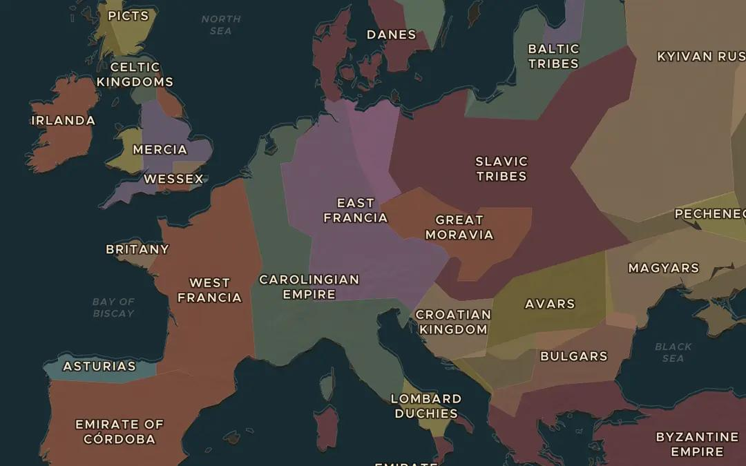
EXPLORE THE MAP · STEP A OF 3 · AD 940
a
Europe in the 10th century
Open the map in 940 and turn on Historical Maps. Compare the scanned map of 10th-century Europe with the borders. Where are East Francia and the Magyars?
Open this view on the live map →
ChronoAtlas Classroom · chronoatlas.nl/classroom/lesson/otto-the-great-lechfeld
3
Notes:
Open the map in 940 and turn on Historical Maps. Compare the scanned map of 10th-century Europe with the borders. Where are East Francia and the Magyars?
https://chronoatlas.nl/?year=940&lat=49&lng=12&zoom=4.4

Slide 4
CHRONOATLAS CLASSROOM
The rest of this deck comes with Classroom
19 more slides: the other map steps, the discussion questions, the quiz with its answers, and the worksheet.
Every lesson as a deck, every worksheet, every live lesson and homework.
€19 a month, cancel anytime. The free lesson, Rome at its height, comes whole.
https://chronoatlas.nl/pricing
ChronoAtlas Classroom · chronoatlas.nl/classroom/lesson/otto-the-great-lechfeld
4

