Slide 1
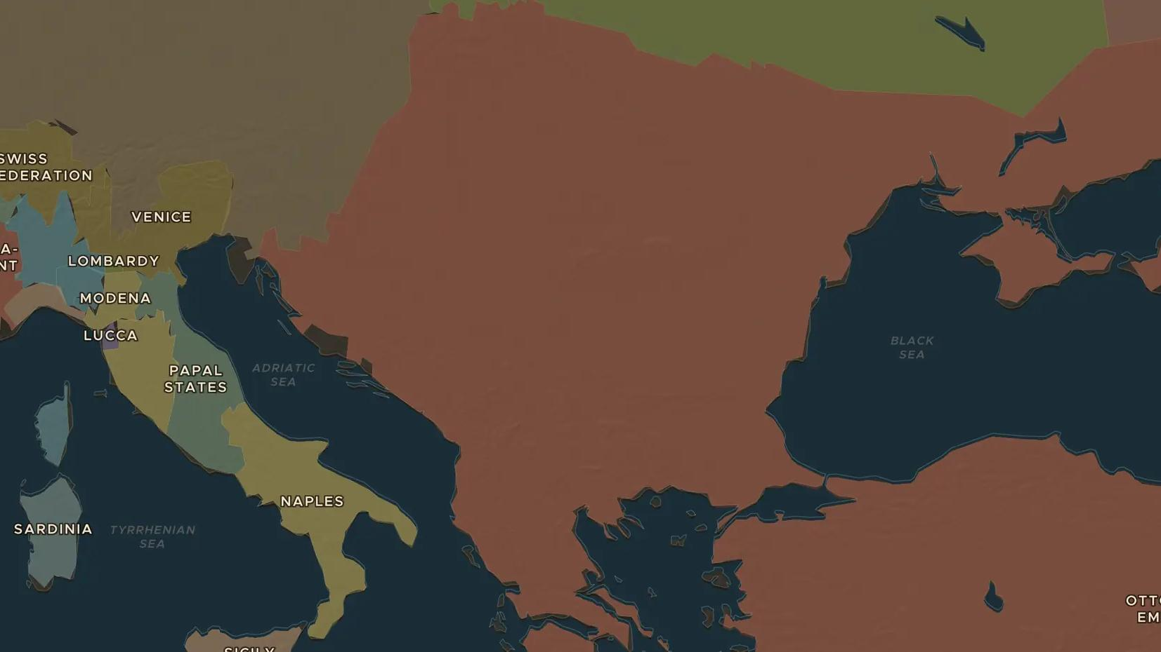
OTTOMAN EMPIRE · 1300-1683
1453: the city falls
ChronoAtlas Classroom · Plate 256 · Ages 12-15 · 50 min
ChronoAtlas Classroom · chronoatlas.nl/classroom/lesson/ottoman-1453

Slide 2
THIS LESSON
What students take from it
The conquest of Constantinople ends one empire and announces another. Students watch the Ottoman rise on the map and weigh what 1453 changed for Europe.
LENGTH
50 min
AGES
12-15
ON THE MAP
BY THE END, STUDENTS CAN
3 steps, AD 1300
Describe the growth of the Ottoman Empire between 1300 and 1683 using the map.
Explain why the fall of Constantinople in 1453 counts as a turning point.
Connect the Ottoman control of trade routes to the European age of exploration.
QUIZ
7 rounds
ChronoAtlas Classroom · chronoatlas.nl/classroom/lesson/ottoman-1453
2

Slide 3
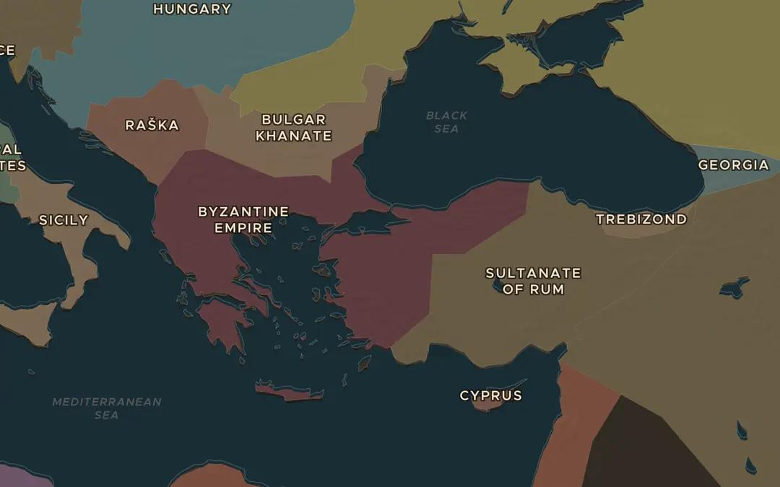
EXPLORE THE MAP · STEP A OF 3 · AD 1300
a
A small beginning
Open the map in 1300 on Anatolia. Find the small Ottoman state among its neighbours. What is left of the Byzantine Empire?
Open this view on the live map →
ChronoAtlas Classroom · chronoatlas.nl/classroom/lesson/ottoman-1453
3
Notes:
Open the map in 1300 on Anatolia. Find the small Ottoman state among its neighbours. What is left of the Byzantine Empire?
https://chronoatlas.nl/?year=1300&lat=40&lng=29&zoom=5

Slide 4
CHRONOATLAS CLASSROOM
The rest of this deck comes with Classroom
19 more slides: the other map steps, the discussion questions, the quiz with its answers, and the worksheet.
Every lesson as a deck, every worksheet, every live lesson and homework.
€19 a month, cancel anytime. The free lesson, Rome at its height, comes whole.
https://chronoatlas.nl/pricing
ChronoAtlas Classroom · chronoatlas.nl/classroom/lesson/ottoman-1453
4

