Slide 1
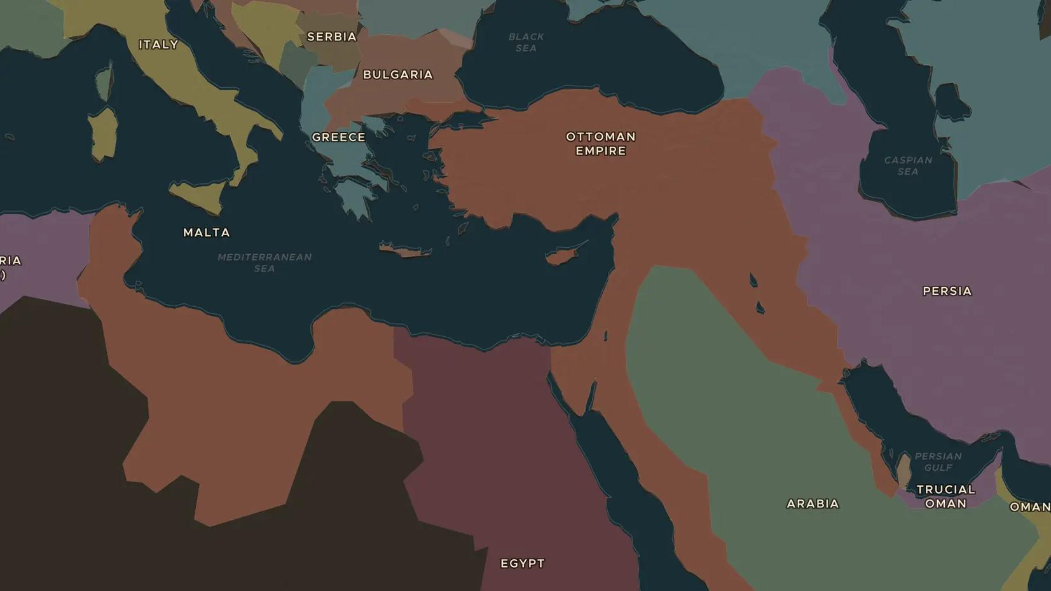
OTTOMAN EMPIRE · 1839-1908
The Ottoman Empire: reform and retreat
ChronoAtlas Classroom · Plate 445 · Ages 13-16 · 50 min
ChronoAtlas Classroom · chronoatlas.nl/classroom/lesson/ottoman-reform-and-retreat

Slide 2
THIS LESSON
What students take from it
Called "the sick man of Europe" by its rivals, the Ottoman Empire tries to save itself with sweeping reforms, a constitution and railways, while it loses land in the Balkans. Students follow the Tanzimat, the crisis of 1878 and the Young Turk revolution of 1908.
LENGTH
50 min
AGES
13-16
ON THE MAP
BY THE END, STUDENTS CAN
3 steps, AD 1880
Explain what the Tanzimat reforms (1839-1876) tried to achieve.
Describe how the empire lost land in the Balkans after 1878.
Explain what the Young Turk revolution of 1908 wanted.
QUIZ
7 rounds
ChronoAtlas Classroom · chronoatlas.nl/classroom/lesson/ottoman-reform-and-retreat
2

Slide 3
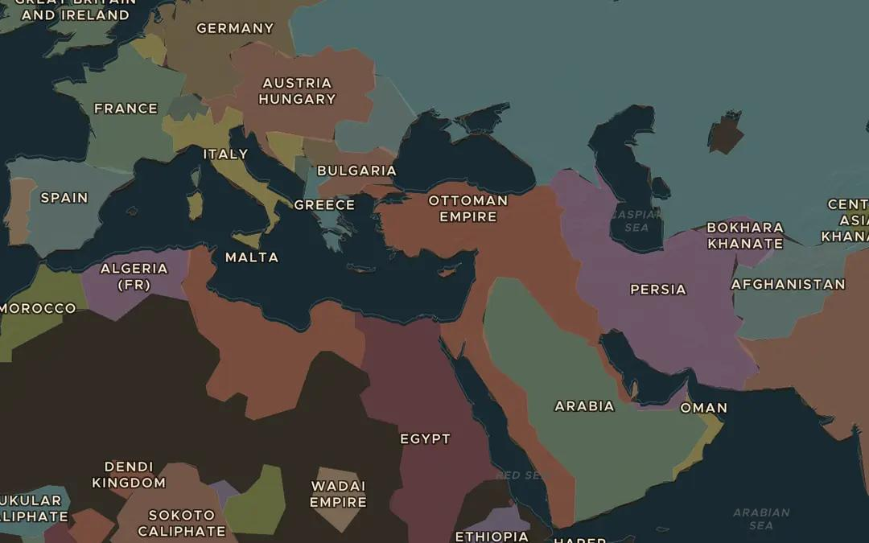
EXPLORE THE MAP · STEP A OF 3 · AD 1880
a
An old map
Open the map in 1880 and turn on Historical Maps: a map of the Ottoman Empire from 1880 appears. On which three continents does the empire still hold land?
Open this view on the live map →
ChronoAtlas Classroom · chronoatlas.nl/classroom/lesson/ottoman-reform-and-retreat
3
Notes:
Open the map in 1880 and turn on Historical Maps: a map of the Ottoman Empire from 1880 appears. On which three continents does the empire still hold land?
https://chronoatlas.nl/?year=1880&lat=35&lng=32&zoom=3.6

Slide 4
CHRONOATLAS CLASSROOM
The rest of this deck comes with Classroom
19 more slides: the other map steps, the discussion questions, the quiz with its answers, and the worksheet.
Every lesson as a deck, every worksheet, every live lesson and homework.
€19 a month, cancel anytime. The free lesson, Rome at its height, comes whole.
https://chronoatlas.nl/pricing
ChronoAtlas Classroom · chronoatlas.nl/classroom/lesson/ottoman-reform-and-retreat
4

