Slide 1
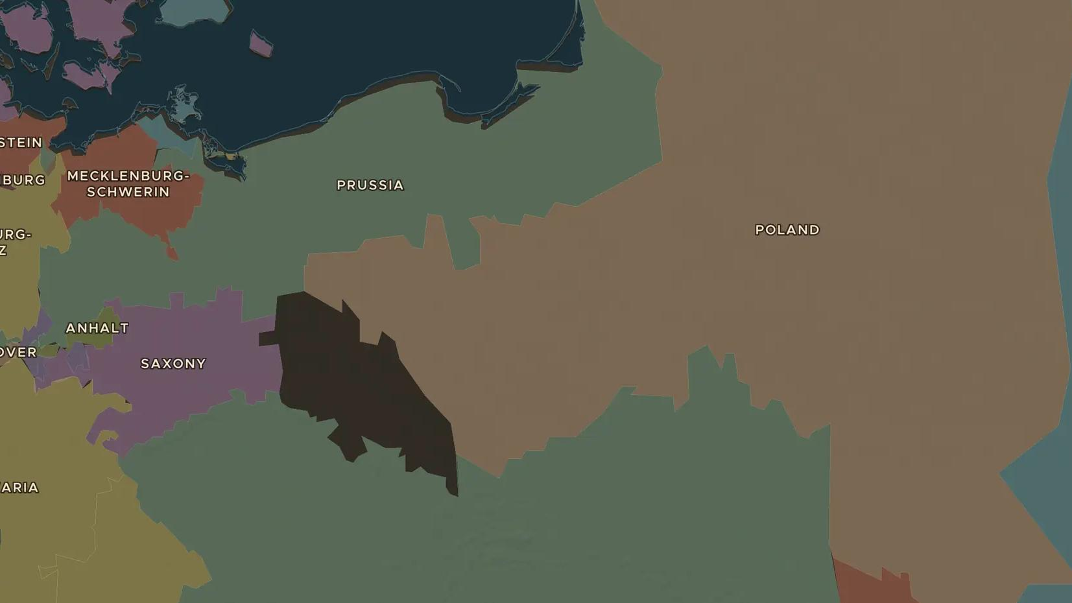
POLISH-LITHUANIAN COMMONWEALTH · 1772-1795
The partitions of Poland
ChronoAtlas Classroom · Plate 375 · Ages 13-16 · 50 min
ChronoAtlas Classroom · chronoatlas.nl/classroom/lesson/partitions-of-poland

Slide 2
THIS LESSON
What students take from it
In 23 years three neighbours divide one of Europe's largest states among themselves until it vanishes from the map. Students compare the borders of 1700 and 1800, meet the reformers of the Constitution of 3 May 1791 and Kościuszko's rising, and ask how a country can disappear.
LENGTH
50 min
AGES
13-16
ON THE MAP
BY THE END, STUDENTS CAN
3 steps, AD 1700
Name the three powers that partitioned Poland-Lithuania and the years of the partitions.
Explain why the Commonwealth was too weak to resist its neighbours.
Explain why the Constitution of 3 May 1791 was important.
QUIZ
7 rounds
ChronoAtlas Classroom · chronoatlas.nl/classroom/lesson/partitions-of-poland
2

Slide 3
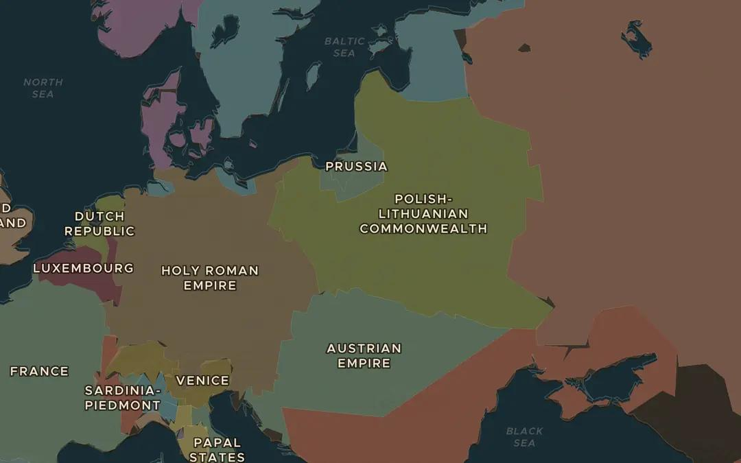
EXPLORE THE MAP · STEP A OF 3 · AD 1700
a
Before
Open the map in 1700 and zoom in on eastern Europe. Find the Polish-Lithuanian Commonwealth and its three big neighbours: Russia, Prussia and the Austrian Habsburg lands.
Open this view on the live map →
ChronoAtlas Classroom · chronoatlas.nl/classroom/lesson/partitions-of-poland
3
Notes:
Open the map in 1700 and zoom in on eastern Europe. Find the Polish-Lithuanian Commonwealth and its three big neighbours: Russia, Prussia and the Austrian Habsburg lands.
https://chronoatlas.nl/?year=1700&lat=52&lng=22&zoom=4.5

Slide 4
CHRONOATLAS CLASSROOM
The rest of this deck comes with Classroom
19 more slides: the other map steps, the discussion questions, the quiz with its answers, and the worksheet.
Every lesson as a deck, every worksheet, every live lesson and homework.
€19 a month, cancel anytime. The free lesson, Rome at its height, comes whole.
https://chronoatlas.nl/pricing
ChronoAtlas Classroom · chronoatlas.nl/classroom/lesson/partitions-of-poland
4

