Slide 1
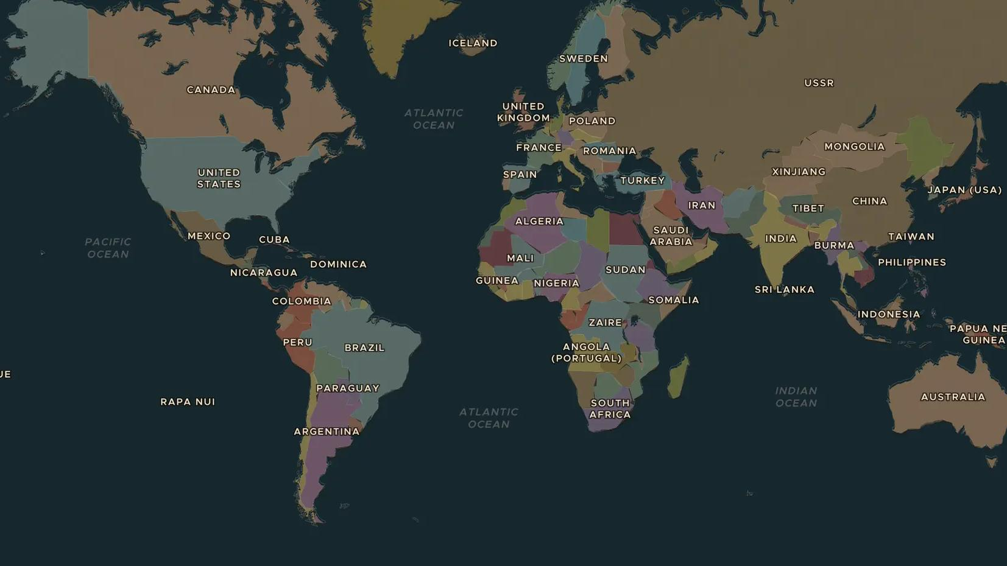
SECOND WORLD WAR · 1941-1945
Pearl Harbor and the war in the Pacific
ChronoAtlas Classroom · Plate 482 · Ages 12-15 · 50 min
ChronoAtlas Classroom · chronoatlas.nl/classroom/lesson/pearl-harbor-pacific-war

Slide 2
THIS LESSON
What students take from it
On 7 December 1941 Japanese planes attacked the US fleet at Pearl Harbor. In six months Japan conquered a huge area, from Burma to the Dutch East Indies. Then the tide turned at Midway. Students follow the war across the largest ocean on Earth.
LENGTH
50 min
AGES
12-15
ON THE MAP
BY THE END, STUDENTS CAN
3 steps, AD 1938
Explain why Japan attacked Pearl Harbor on 7 December 1941.
Locate Japan's conquests of 1941-1942 on the map, including the Dutch East Indies.
Explain why the Battle of Midway was a turning point and what "island hopping" meant.
QUIZ
7 rounds
ChronoAtlas Classroom · chronoatlas.nl/classroom/lesson/pearl-harbor-pacific-war
2

Slide 3
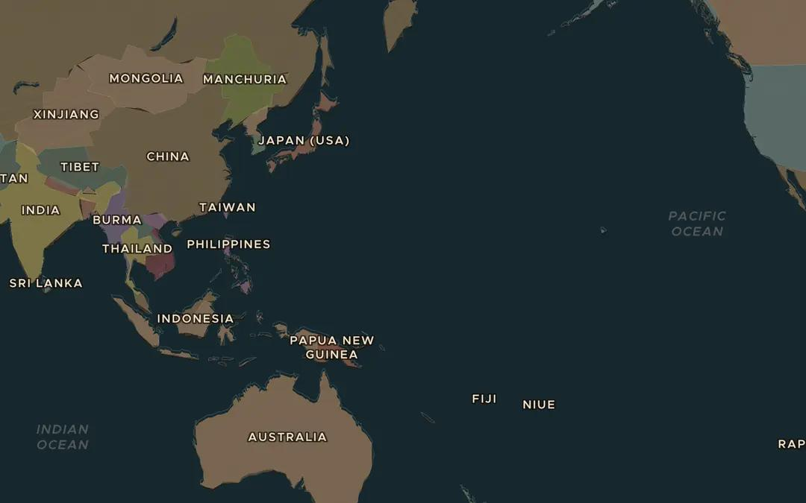
EXPLORE THE MAP · STEP A OF 3 · AD 1938
a
An ocean war
Open the map in 1938 and zoom out over the Pacific Ocean. Find Japan, Hawaii, the Philippines and the Dutch East Indies. How far is Hawaii from Japan?
Open this view on the live map →
ChronoAtlas Classroom · chronoatlas.nl/classroom/lesson/pearl-harbor-pacific-war
3
Notes:
Open the map in 1938 and zoom out over the Pacific Ocean. Find Japan, Hawaii, the Philippines and the Dutch East Indies. How far is Hawaii from Japan?
https://chronoatlas.nl/?year=1938&lat=15&lng=160&zoom=2.5

Slide 4
CHRONOATLAS CLASSROOM
The rest of this deck comes with Classroom
19 more slides: the other map steps, the discussion questions, the quiz with its answers, and the worksheet.
Every lesson as a deck, every worksheet, every live lesson and homework.
€19 a month, cancel anytime. The free lesson, Rome at its height, comes whole.
https://chronoatlas.nl/pricing
ChronoAtlas Classroom · chronoatlas.nl/classroom/lesson/pearl-harbor-pacific-war
4

