Slide 1
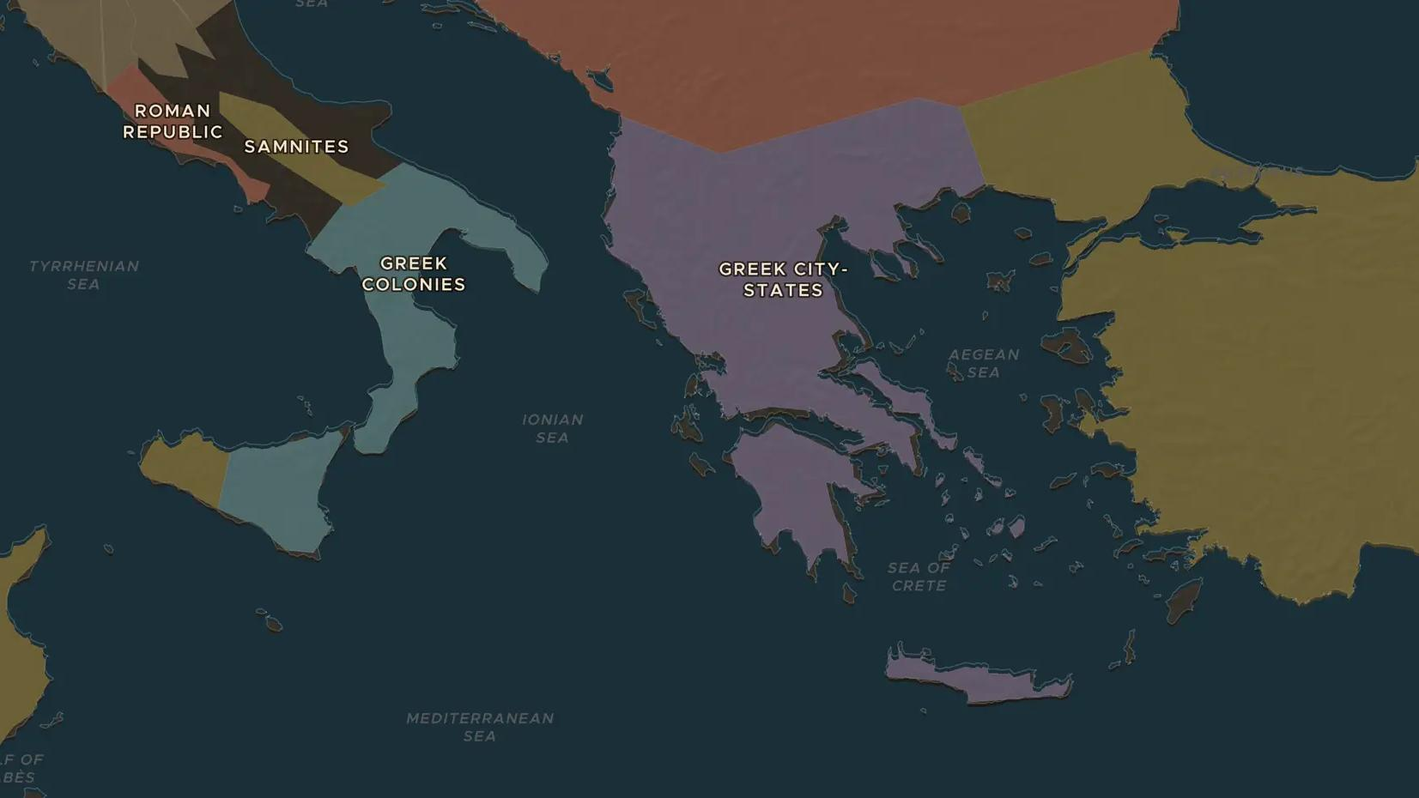
CLASSICAL GREECE · 431-404 BC
The Peloponnesian War: Athens against Sparta
ChronoAtlas Classroom · Plate 77 · Ages 12-15 · 50 min
ChronoAtlas Classroom · chronoatlas.nl/classroom/lesson/peloponnesian-war

Slide 2
THIS LESSON
What students take from it
For 27 years the two leading Greek cities fought a war that neither could win quickly: Athens ruled the sea, Sparta the land. Students follow the plague, the disaster in Sicily and the final defeat, with the historian Thucydides as their guide.
LENGTH
50 min
AGES
12-15
ON THE MAP
BY THE END, STUDENTS CAN
3 steps, 431 BC
Explain why Athens and Sparta went to war in 431 BC.
Describe Pericles's strategy and why the plague of 430 BC undermined it.
Locate Syracuse and Aegospotami and explain how each sealed Athens's fate.
QUIZ
7 rounds
ChronoAtlas Classroom · chronoatlas.nl/classroom/lesson/peloponnesian-war
2

Slide 3
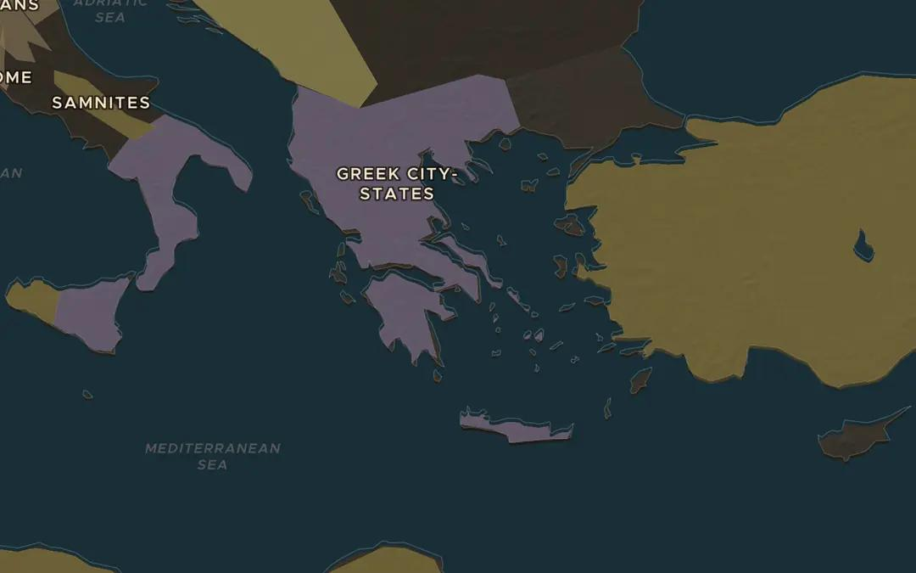
EXPLORE THE MAP · STEP A OF 3 · 431 BC
a
Sea power against land power
Open the map in 431 BC. Sparta led most of the Peloponnese; Athens led the islands and coasts of the Aegean. Turn on the Cities layer and find both. Pericles planned to stay behind the walls, feed the city by sea and raid Sparta's coast. Why did neither side have an easy way to hurt the other?
Open this view on the live map →
ChronoAtlas Classroom · chronoatlas.nl/classroom/lesson/peloponnesian-war
3
Notes:
Open the map in 431 BC. Sparta led most of the Peloponnese; Athens led the islands and coasts of the Aegean. Turn on the Cities layer and find both. Pericles planned to stay behind the walls, feed the city by sea and raid Sparta's coast. Why did neither side have an easy way to hurt the other?
https://chronoatlas.nl/?year=-431&lat=38&lng=23.5&zoom=5.5

Slide 4
CHRONOATLAS CLASSROOM
The rest of this deck comes with Classroom
19 more slides: the other map steps, the discussion questions, the quiz with its answers, and the worksheet.
Every lesson as a deck, every worksheet, every live lesson and homework.
€19 a month, cancel anytime. The free lesson, Rome at its height, comes whole.
https://chronoatlas.nl/pricing
ChronoAtlas Classroom · chronoatlas.nl/classroom/lesson/peloponnesian-war
4

