Slide 1
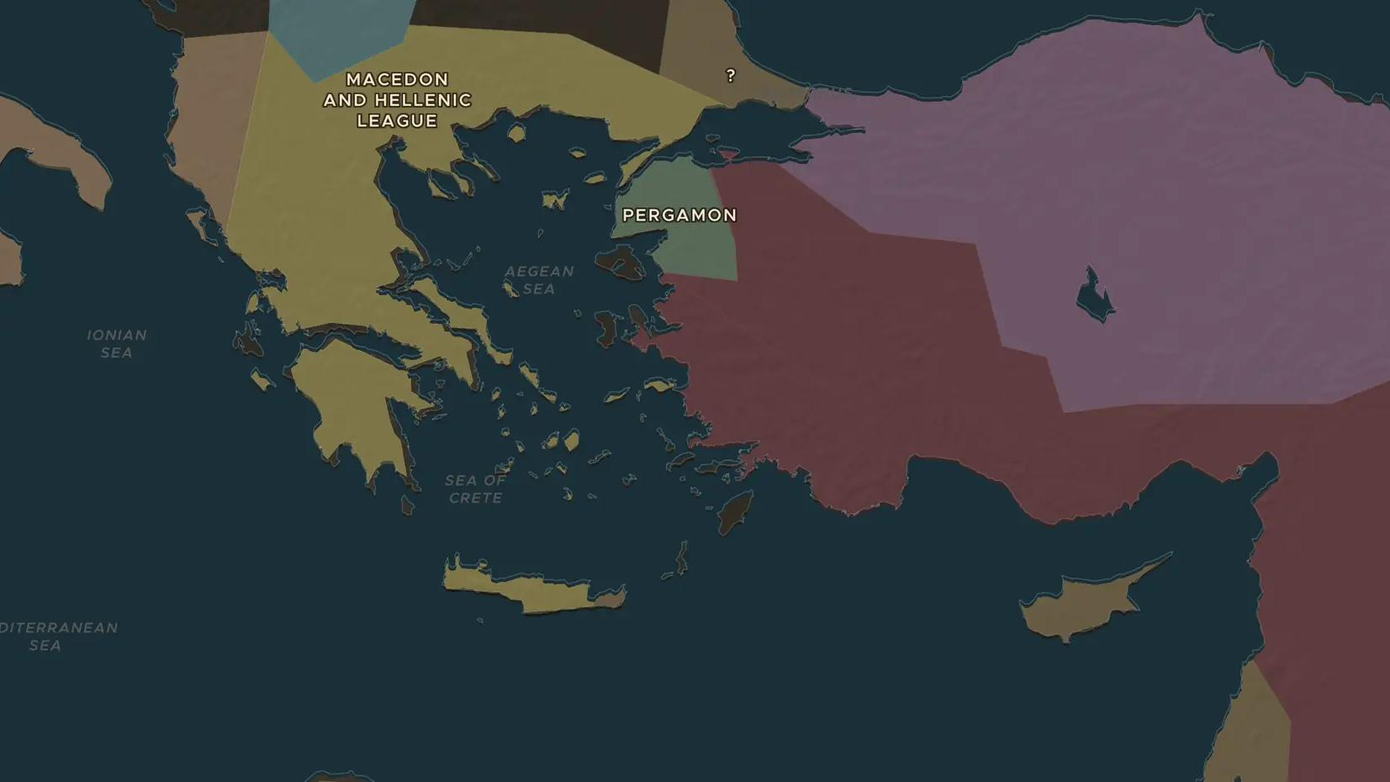
HELLENISTIC WORLD · 305-133 BC
Pergamon and Rhodes: small states, big ideas
ChronoAtlas Classroom · Plate 95 · Ages 11-14 · 45 min
ChronoAtlas Classroom · chronoatlas.nl/classroom/lesson/pergamon-and-rhodes

Slide 2
THIS LESSON
What students take from it
Between the great kingdoms, a hill town and an island grew rich and famous. Students visit Pergamon, with its library, altar and parchment, and Rhodes, whose Colossus stood at the harbor for only 54 years, and ask how small states survived among giants.
LENGTH
45 min
AGES
11-14
ON THE MAP
BY THE END, STUDENTS CAN
3 steps, 280 BC
Locate Pergamon and Rhodes and describe one famous thing from each.
Explain how the Attalids of Pergamon used art, a library and an alliance with Rome to stay independent.
Explain why Rhodes was important for trade and what the Colossus was.
QUIZ
7 rounds
ChronoAtlas Classroom · chronoatlas.nl/classroom/lesson/pergamon-and-rhodes
2

Slide 3
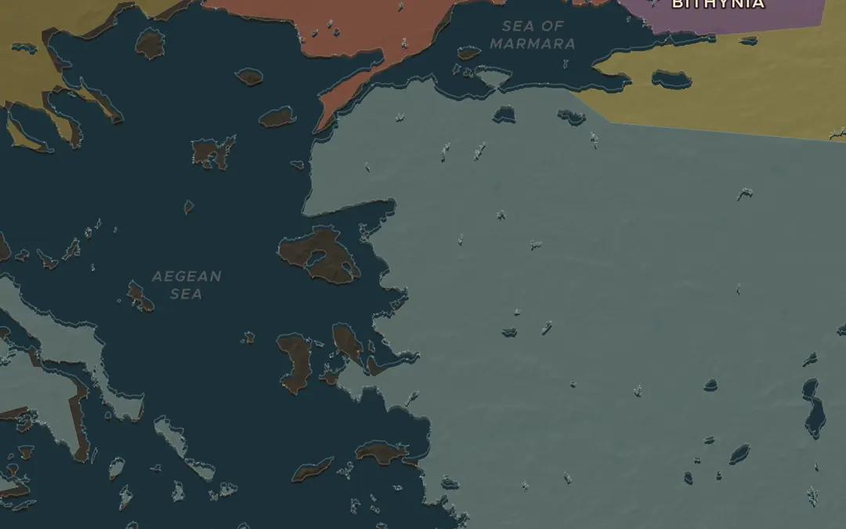
EXPLORE THE MAP · STEP A OF 3 · 280 BC
a
A fortress treasury
Open the map in 280 BC on the west coast of Anatolia and find Pergamon, inland from the Aegean. A treasurer named Philetaerus kept 9,000 talents of a dead king's silver here and used it to make himself independent. Zoom in: the city sits on a steep hill. Why does a treasure need a hill?
Open this view on the live map →
ChronoAtlas Classroom · chronoatlas.nl/classroom/lesson/pergamon-and-rhodes
3
Notes:
Open the map in 280 BC on the west coast of Anatolia and find Pergamon, inland from the Aegean. A treasurer named Philetaerus kept 9,000 talents of a dead king's silver here and used it to make himself independent. Zoom in: the city sits on a steep hill. Why does a treasure need a hill?
https://chronoatlas.nl/?year=-280&lat=39.1&lng=27.2&zoom=7

Slide 4
CHRONOATLAS CLASSROOM
The rest of this deck comes with Classroom
19 more slides: the other map steps, the discussion questions, the quiz with its answers, and the worksheet.
Every lesson as a deck, every worksheet, every live lesson and homework.
€19 a month, cancel anytime. The free lesson, Rome at its height, comes whole.
https://chronoatlas.nl/pricing
ChronoAtlas Classroom · chronoatlas.nl/classroom/lesson/pergamon-and-rhodes
4

