Slide 1
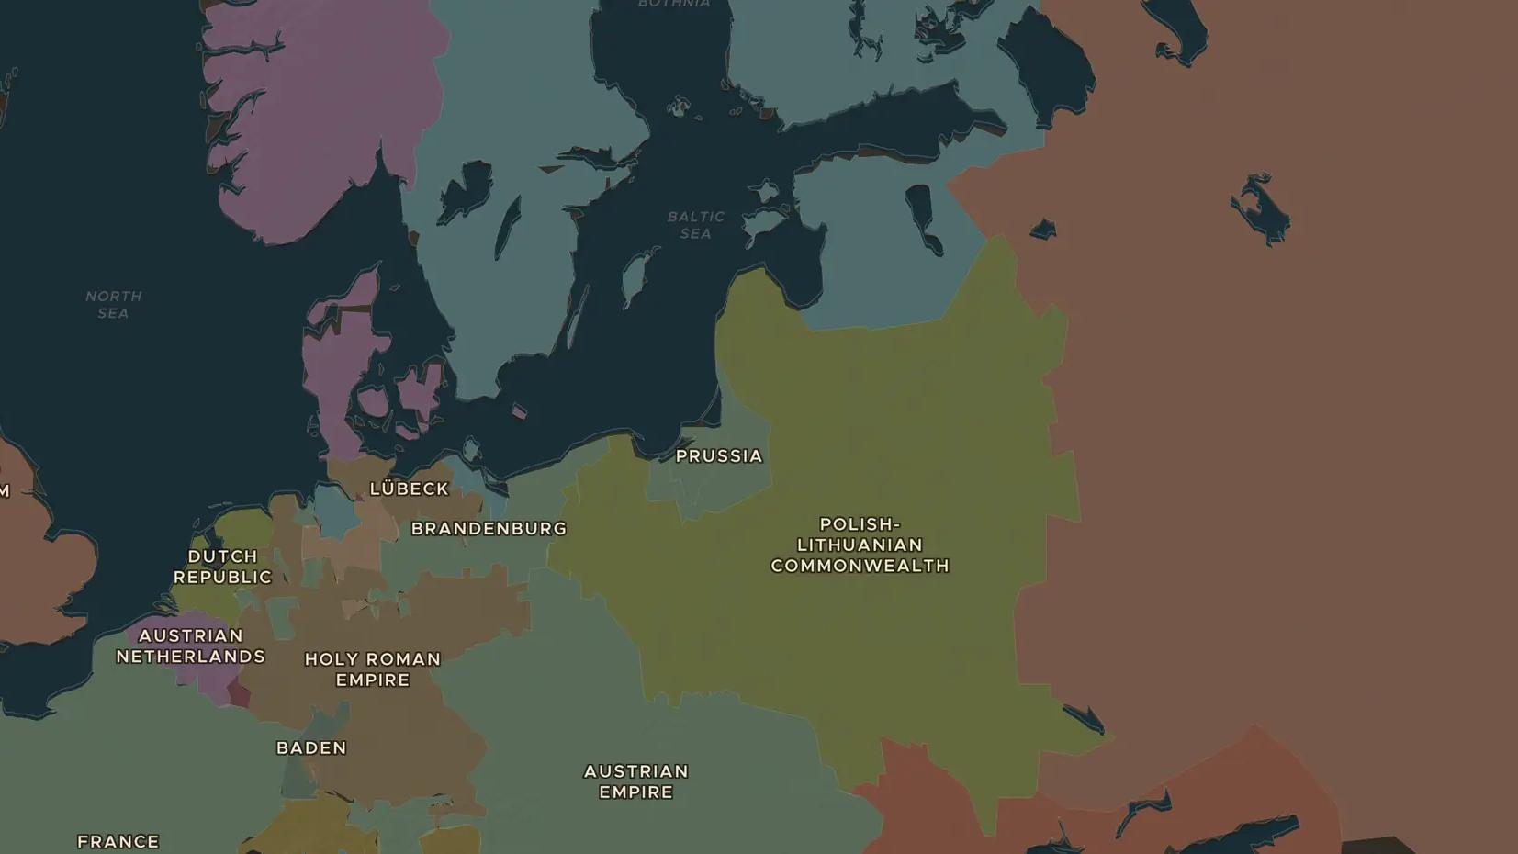
RUSSIAN EMPIRE · 1682-1725
Peter the Great and St Petersburg
ChronoAtlas Classroom · Plate 370 · Ages 11-14 · 50 min
ChronoAtlas Classroom · chronoatlas.nl/classroom/lesson/peter-the-great-st-petersburg

Slide 2
THIS LESSON
What students take from it
A very tall young tsar travels to Holland and England to learn shipbuilding, then builds a new capital on the marshes of the Baltic. Students follow Peter's journey and wars, and weigh the cost of his reforms for the people who built his city.
LENGTH
50 min
AGES
11-14
ON THE MAP
BY THE END, STUDENTS CAN
3 steps, AD 1700
Explain why Peter the Great travelled to western Europe in 1697-1698.
Explain why Peter built a new capital on the Baltic coast.
Weigh the benefits and costs of Peter's reforms for different groups in Russia.
QUIZ
7 rounds
ChronoAtlas Classroom · chronoatlas.nl/classroom/lesson/peter-the-great-st-petersburg
2

Slide 3
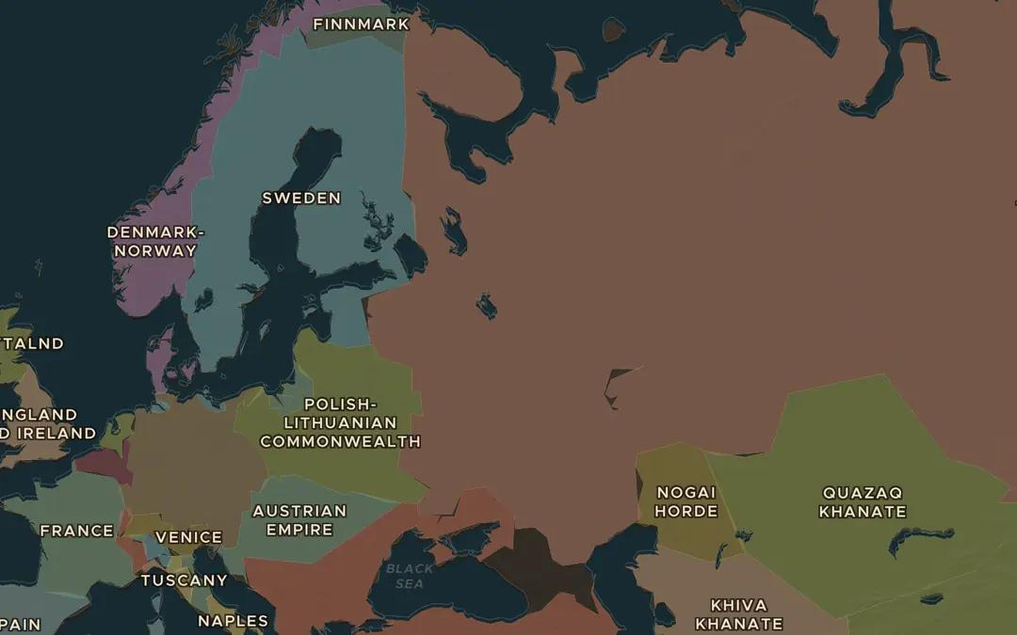
EXPLORE THE MAP · STEP A OF 3 · AD 1700
a
Russia without a sea
Open the map in 1700 and zoom out over Russia. Find its coasts. Which seas can Russian ships reach, and are those waters open all year?
Open this view on the live map →
ChronoAtlas Classroom · chronoatlas.nl/classroom/lesson/peter-the-great-st-petersburg
3
Notes:
Open the map in 1700 and zoom out over Russia. Find its coasts. Which seas can Russian ships reach, and are those waters open all year?
https://chronoatlas.nl/?year=1700&lat=58&lng=40&zoom=3.5

Slide 4
CHRONOATLAS CLASSROOM
The rest of this deck comes with Classroom
19 more slides: the other map steps, the discussion questions, the quiz with its answers, and the worksheet.
Every lesson as a deck, every worksheet, every live lesson and homework.
€19 a month, cancel anytime. The free lesson, Rome at its height, comes whole.
https://chronoatlas.nl/pricing
ChronoAtlas Classroom · chronoatlas.nl/classroom/lesson/peter-the-great-st-petersburg
4

