Slide 1
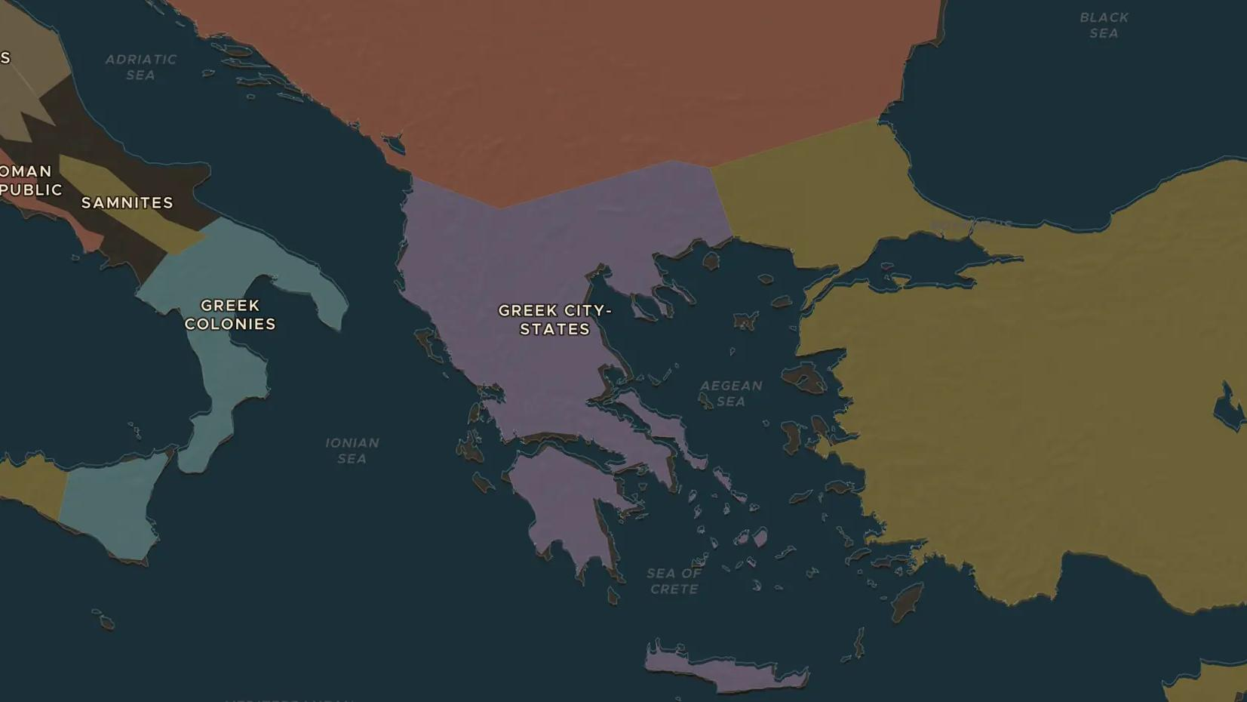
MACEDON · 359-336 BC
Philip II: the king who united Greece
ChronoAtlas Classroom · Plate 81 · Ages 12-15 · 50 min
ChronoAtlas Classroom · chronoatlas.nl/classroom/lesson/philip-ii-of-macedon

Slide 2
THIS LESSON
What students take from it
Alexander's father inherited a weak kingdom on the edge of the Greek world and in twenty years made it master of Greece. Students study his new army with its long pikes, follow the money from the gold mines, and visit the field of Chaeronea where the free city-states lost.
LENGTH
50 min
AGES
12-15
ON THE MAP
BY THE END, STUDENTS CAN
3 steps, 370 BC
Locate Macedon, Pella, Amphipolis and Chaeronea on the map.
Explain two reasons Philip's army beat the Greek city-states: the sarissa phalanx and the gold of Mount Pangaion.
Describe the League of Corinth and what Philip planned to do next.
QUIZ
7 rounds
ChronoAtlas Classroom · chronoatlas.nl/classroom/lesson/philip-ii-of-macedon
2

Slide 3
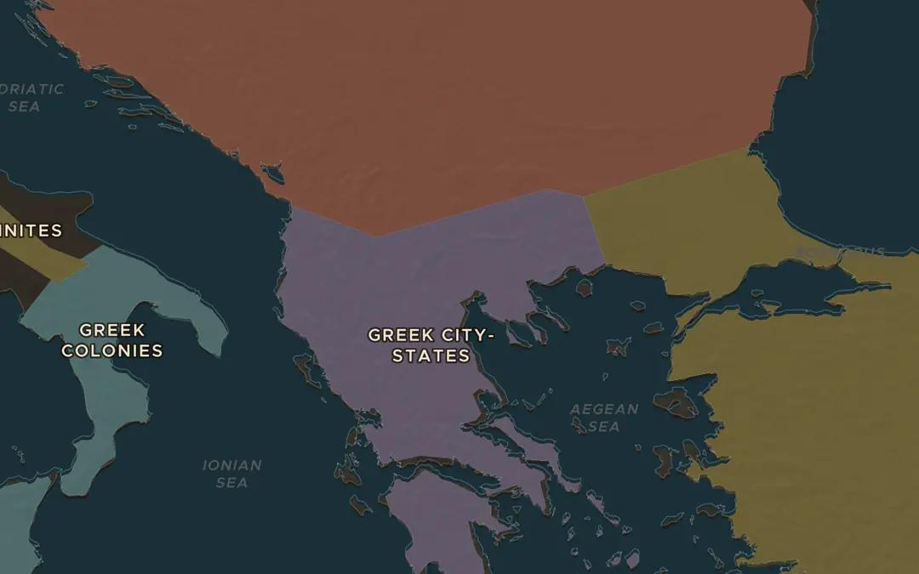
EXPLORE THE MAP · STEP A OF 3 · 370 BC
a
A kingdom on the edge
Open the map in 370 BC on Macedon, north of Greece. Turn on the Cities layer: no big city shows here yet. Many Greeks did not count the Macedonians as proper Greeks. Note how the map's borders jump: the next snapshot it can show is Alexander's empire of 323 BC. Everything between is Philip's work.
Open this view on the live map →
ChronoAtlas Classroom · chronoatlas.nl/classroom/lesson/philip-ii-of-macedon
3
Notes:
Open the map in 370 BC on Macedon, north of Greece. Turn on the Cities layer: no big city shows here yet. Many Greeks did not count the Macedonians as proper Greeks. Note how the map's borders jump: the next snapshot it can show is Alexander's empire of 323 BC. Everything between is Philip's work.
https://chronoatlas.nl/?year=-370&lat=40.7&lng=22.5&zoom=6

Slide 4
CHRONOATLAS CLASSROOM
The rest of this deck comes with Classroom
19 more slides: the other map steps, the discussion questions, the quiz with its answers, and the worksheet.
Every lesson as a deck, every worksheet, every live lesson and homework.
€19 a month, cancel anytime. The free lesson, Rome at its height, comes whole.
https://chronoatlas.nl/pricing
ChronoAtlas Classroom · chronoatlas.nl/classroom/lesson/philip-ii-of-macedon
4

