Slide 1
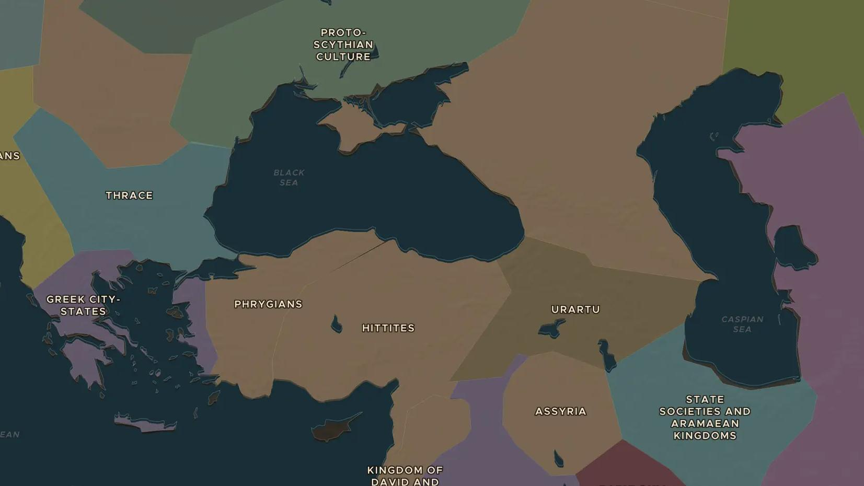
PHRYGIA · 750-690 BC
Phrygia and King Midas: a real king behind the legend
ChronoAtlas Classroom · Plate 50 · Ages 10-13 · 45 min
ChronoAtlas Classroom · chronoatlas.nl/classroom/lesson/phrygia-king-midas

Slide 2
THIS LESSON
What students take from it
Everyone knows the king whose touch turned things to gold. Fewer know that Midas really ruled in central Anatolia around 700 BC, that Assyrian records mention him, and that his capital Gordion holds a giant burial mound. Students separate legend from evidence.
LENGTH
45 min
AGES
10-13
ON THE MAP
BY THE END, STUDENTS CAN
3 steps, 740 BC
Locate Gordion and the kingdom of Phrygia in central Anatolia.
Tell the difference between the Midas of Greek legend and the Midas of Assyrian records and archaeology.
Explain who the Cimmerians were and why they ended Phrygia's golden age around 700 BC.
QUIZ
7 rounds
ChronoAtlas Classroom · chronoatlas.nl/classroom/lesson/phrygia-king-midas
2

Slide 3
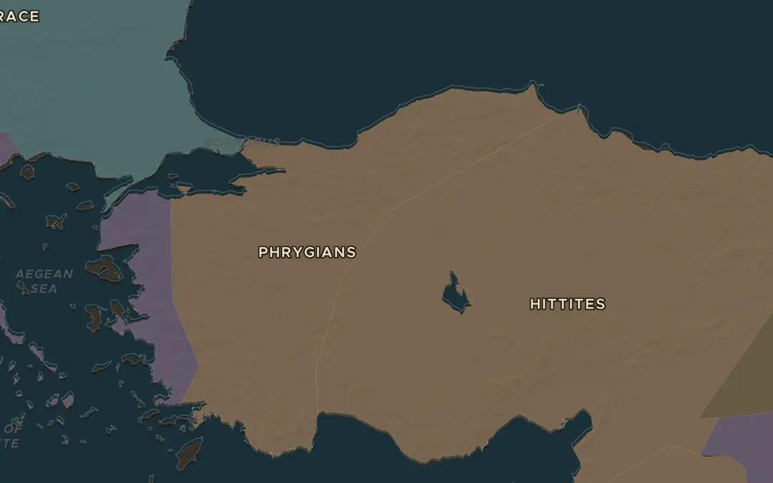
EXPLORE THE MAP · STEP A OF 3 · 740 BC
a
The kingdom on the plateau
Open the map in 740 BC. The map shows the Phrygians covering much of Anatolia. Turn on the Cities layer: no big city shows, but Gordion lay on the Sangarius river, about 80 km southwest of modern Ankara. Zoom in to find the spot.
Open this view on the live map →
ChronoAtlas Classroom · chronoatlas.nl/classroom/lesson/phrygia-king-midas
3
Notes:
Open the map in 740 BC. The map shows the Phrygians covering much of Anatolia. Turn on the Cities layer: no big city shows, but Gordion lay on the Sangarius river, about 80 km southwest of modern Ankara. Zoom in to find the spot.
https://chronoatlas.nl/?year=-740&lat=39.6&lng=32&zoom=6

Slide 4
CHRONOATLAS CLASSROOM
The rest of this deck comes with Classroom
19 more slides: the other map steps, the discussion questions, the quiz with its answers, and the worksheet.
Every lesson as a deck, every worksheet, every live lesson and homework.
€19 a month, cancel anytime. The free lesson, Rome at its height, comes whole.
https://chronoatlas.nl/pricing
ChronoAtlas Classroom · chronoatlas.nl/classroom/lesson/phrygia-king-midas
4

