Slide 1
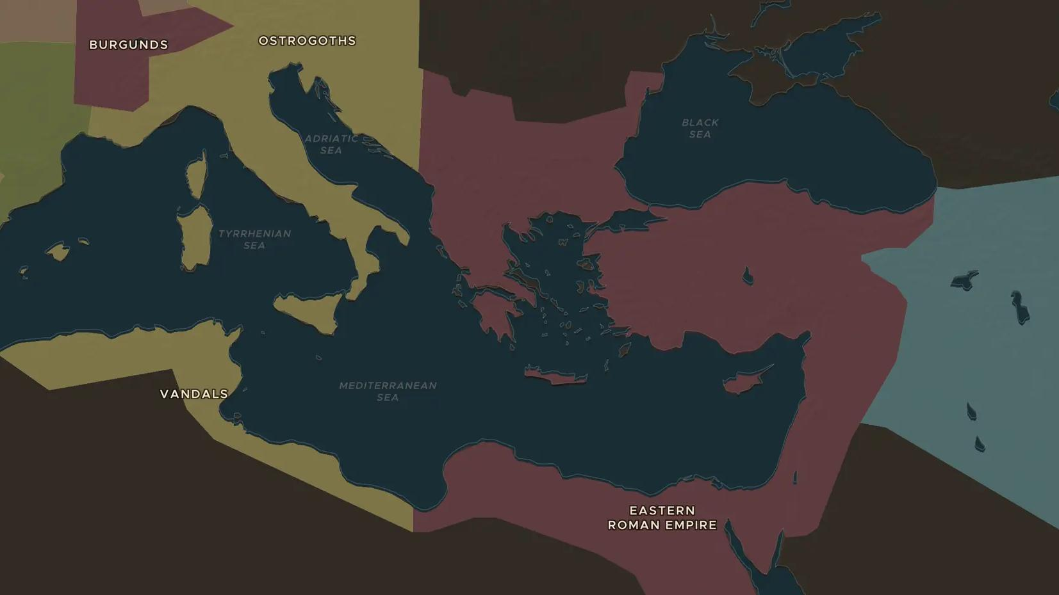
BYZANTINE EMPIRE · 536-549
The Plague of Justinian
ChronoAtlas Classroom · Plate 156 · Ages 12-15 · 50 min
ChronoAtlas Classroom · chronoatlas.nl/classroom/lesson/plague-of-justinian

Slide 2
THIS LESSON
What students take from it
In 536 a strange haze dims the sun, and in 541 a new disease arrives with the grain ships from Egypt. Students track the first known pandemic of plague and weigh how much it changed Justinian's empire.
LENGTH
50 min
AGES
12-15
ON THE MAP
BY THE END, STUDENTS CAN
3 steps, AD 536
Describe how the plague traveled from Egypt to Constantinople and across the Mediterranean.
Explain how a cold climate, trade and crowded cities helped a disease spread.
Discuss why historians disagree about how many people died.
QUIZ
7 rounds
ChronoAtlas Classroom · chronoatlas.nl/classroom/lesson/plague-of-justinian
2

Slide 3
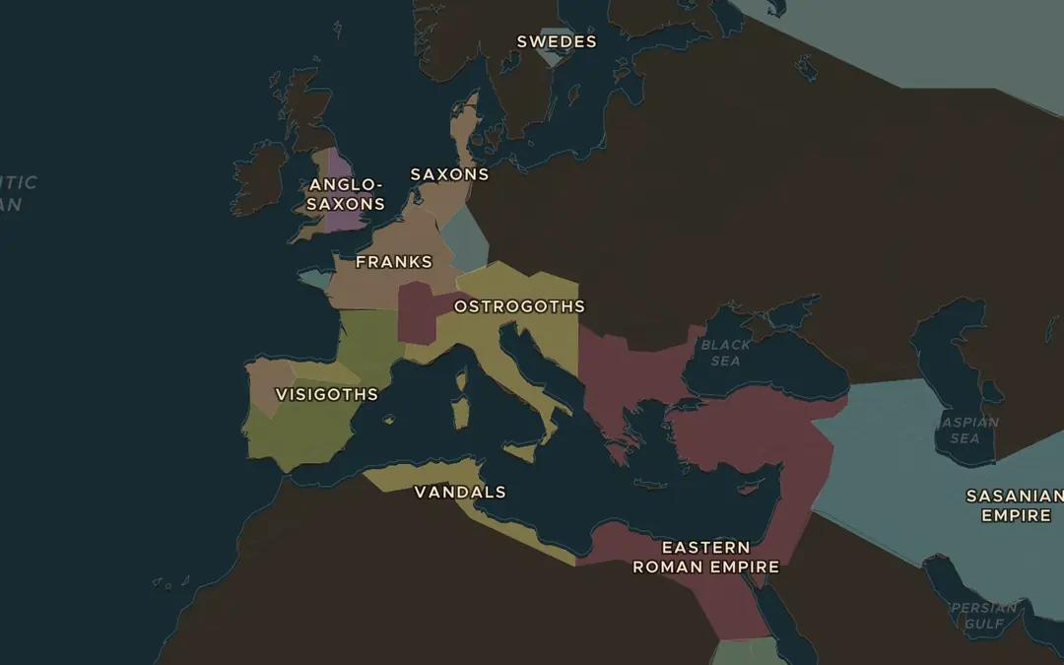
EXPLORE THE MAP · STEP A OF 3 · AD 536
a
A darkened sky
Open the map in 536 and turn on Weather of History. Read the card about the volcanic winter of 536. What happened to harvests, and what followed in 541?
Open this view on the live map →
ChronoAtlas Classroom · chronoatlas.nl/classroom/lesson/plague-of-justinian
3
Notes:
Open the map in 536 and turn on Weather of History. Read the card about the volcanic winter of 536. What happened to harvests, and what followed in 541?
https://chronoatlas.nl/?year=536&lat=45&lng=15&zoom=3.5

Slide 4
CHRONOATLAS CLASSROOM
The rest of this deck comes with Classroom
19 more slides: the other map steps, the discussion questions, the quiz with its answers, and the worksheet.
Every lesson as a deck, every worksheet, every live lesson and homework.
€19 a month, cancel anytime. The free lesson, Rome at its height, comes whole.
https://chronoatlas.nl/pricing
ChronoAtlas Classroom · chronoatlas.nl/classroom/lesson/plague-of-justinian
4

