Slide 1
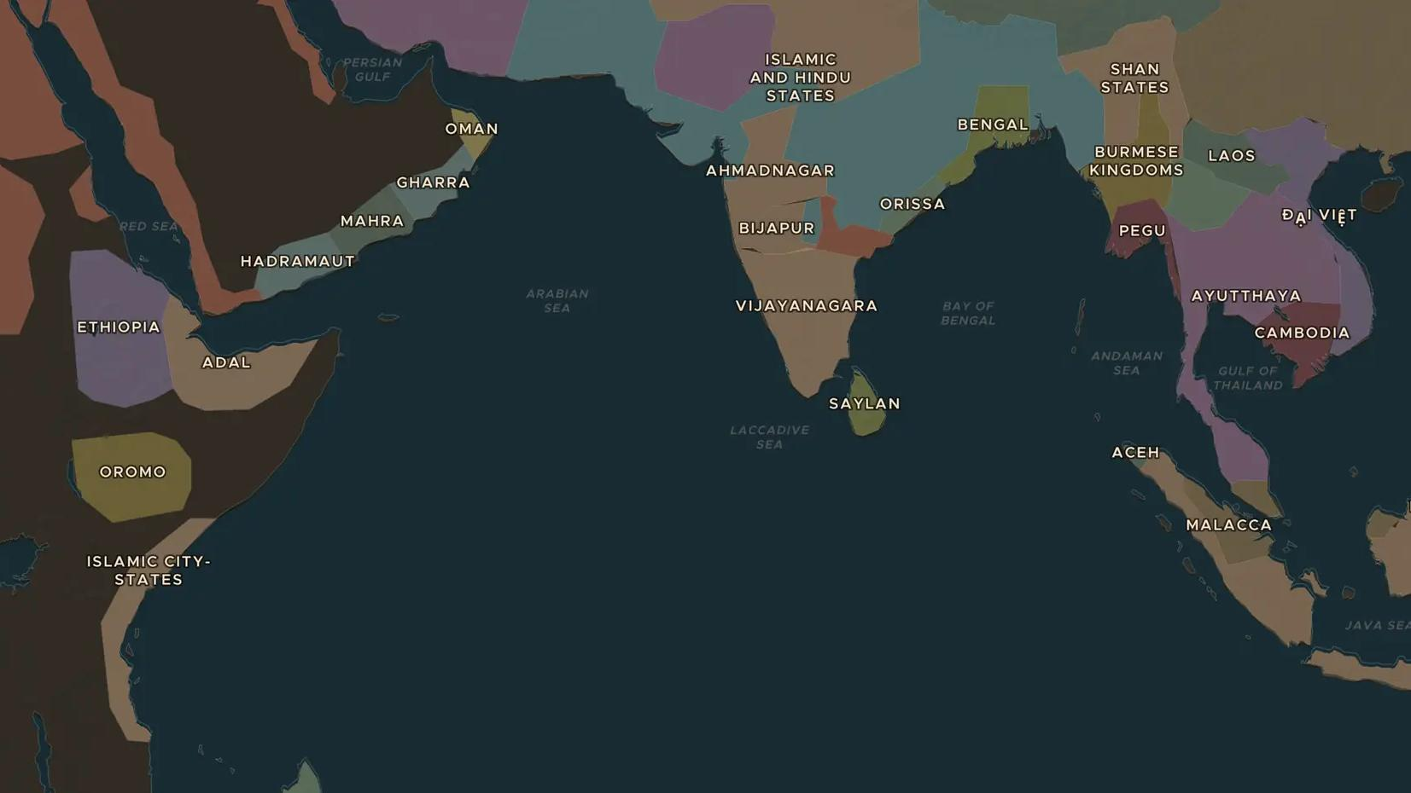
PORTUGUESE EMPIRE · 1505-1641
Portugal's sea empire in Asia
ChronoAtlas Classroom · Plate 289 · Ages 11-14 · 50 min
ChronoAtlas Classroom · chronoatlas.nl/classroom/lesson/portuguese-estado-da-india

Slide 2
THIS LESSON
What students take from it
Portugal builds an empire of forts and sea lanes rather than land, from Mozambique to Goa, Malacca and Macau. Students map the chain of bases, meet the Asian rulers and merchants who already ran Indian Ocean trade, and ask how a small kingdom held it.
LENGTH
50 min
AGES
11-14
ON THE MAP
BY THE END, STUDENTS CAN
3 steps, AD 1490
Explain how the Portuguese tried to control trade with a chain of forts rather than large territories.
Locate Goa, Malacca, Hormuz and Macau and explain why each place mattered.
Describe how Asian rulers and merchants responded to the Portuguese.
QUIZ
7 rounds
ChronoAtlas Classroom · chronoatlas.nl/classroom/lesson/portuguese-estado-da-india
2

Slide 3
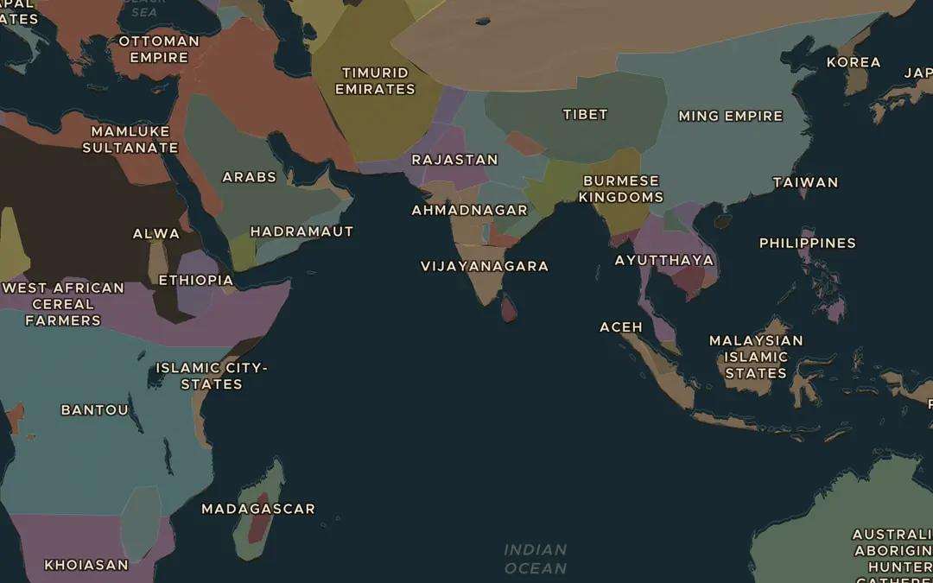
EXPLORE THE MAP · STEP A OF 3 · AD 1490
a
An ocean of traders
Open the map in 1490 and turn on Trade Routes. Follow the Maritime Spice Route across the Indian Ocean. Who traded on it before any Portuguese ship arrived?
Open this view on the live map →
ChronoAtlas Classroom · chronoatlas.nl/classroom/lesson/portuguese-estado-da-india
3
Notes:
Open the map in 1490 and turn on Trade Routes. Follow the Maritime Spice Route across the Indian Ocean. Who traded on it before any Portuguese ship arrived?
https://chronoatlas.nl/?year=1490&lat=10&lng=75&zoom=3

Slide 4
CHRONOATLAS CLASSROOM
The rest of this deck comes with Classroom
19 more slides: the other map steps, the discussion questions, the quiz with its answers, and the worksheet.
Every lesson as a deck, every worksheet, every live lesson and homework.
€19 a month, cancel anytime. The free lesson, Rome at its height, comes whole.
https://chronoatlas.nl/pricing
ChronoAtlas Classroom · chronoatlas.nl/classroom/lesson/portuguese-estado-da-india
4

