Slide 1
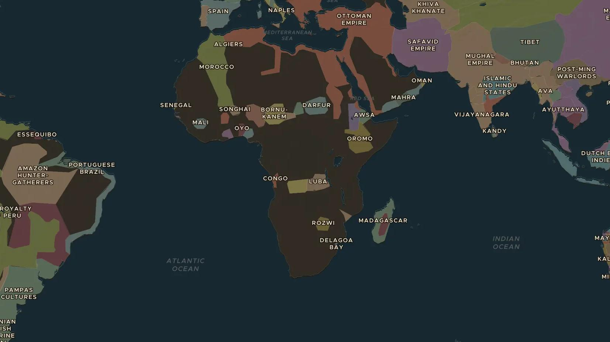
VICEROYALTY OF PERU · 1545-1650
Potosí: the mountain of silver
ChronoAtlas Classroom · Plate 360 · Ages 12-15 · 50 min
ChronoAtlas Classroom · chronoatlas.nl/classroom/lesson/potosi-mountain-of-silver

Slide 2
THIS LESSON
What students take from it
In 1545 a mountain of silver was found high in the Andes. Potosí became one of the largest cities in the world, built on the forced labour of Indigenous miners, and its silver flowed to Spain, Europe and China. Students follow the silver and ask who paid for it.
LENGTH
50 min
AGES
12-15
ON THE MAP
BY THE END, STUDENTS CAN
3 steps, AD 1650
Locate Potosí and explain why its silver mattered to the whole world.
Describe the mita system of forced labour and its effects on Andean communities.
Trace the routes that carried American silver to Europe and to China.
QUIZ
7 rounds
ChronoAtlas Classroom · chronoatlas.nl/classroom/lesson/potosi-mountain-of-silver
2

Slide 3
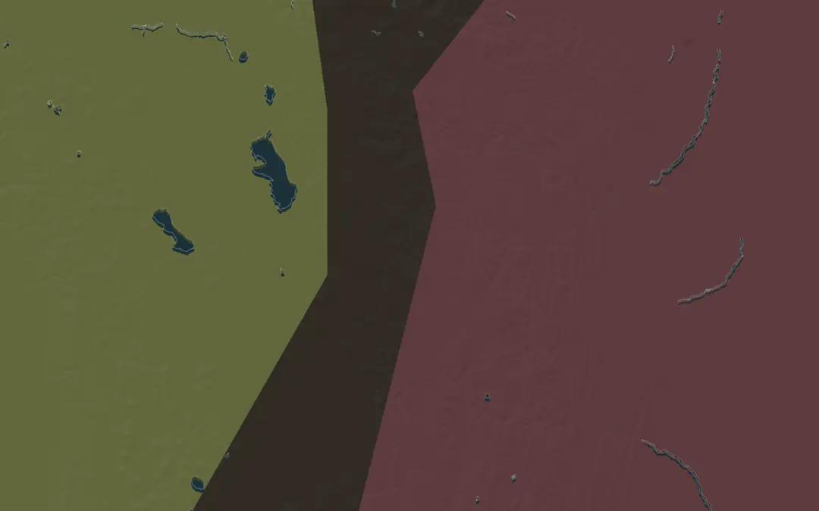
EXPLORE THE MAP · STEP A OF 3 · AD 1650
a
A mountain of silver
Open the map in 1650 and zoom in on Potosí, high in the Andes at about 4,000 m. In the early 1600s it may have had about 160,000 people. Why is it surprising that such a big city grew here?
Open this view on the live map →
ChronoAtlas Classroom · chronoatlas.nl/classroom/lesson/potosi-mountain-of-silver
3
Notes:
Open the map in 1650 and zoom in on Potosí, high in the Andes at about 4,000 m. In the early 1600s it may have had about 160,000 people. Why is it surprising that such a big city grew here?
https://chronoatlas.nl/?year=1650&lat=-19.59&lng=-65.75&zoom=7

Slide 4
CHRONOATLAS CLASSROOM
The rest of this deck comes with Classroom
19 more slides: the other map steps, the discussion questions, the quiz with its answers, and the worksheet.
Every lesson as a deck, every worksheet, every live lesson and homework.
€19 a month, cancel anytime. The free lesson, Rome at its height, comes whole.
https://chronoatlas.nl/pricing
ChronoAtlas Classroom · chronoatlas.nl/classroom/lesson/potosi-mountain-of-silver
4

