Slide 1
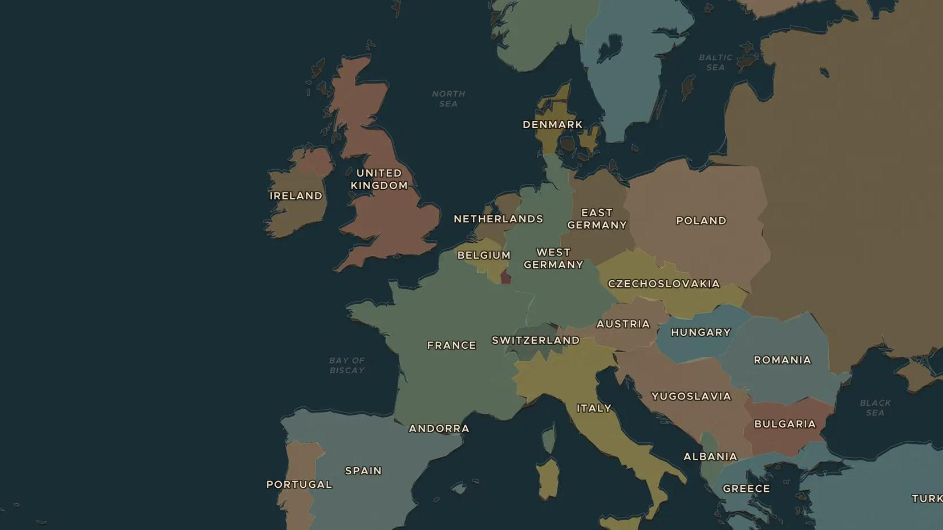
COLD WAR · 1968
1968: the Prague Spring
ChronoAtlas Classroom · Plate 498 · Ages 12-15 · 45 min
ChronoAtlas Classroom · chronoatlas.nl/classroom/lesson/prague-spring-1968

Slide 2
THIS LESSON
What students take from it
In 1968 Czechoslovakia's new leader Alexander Dubček promised "socialism with a human face": free speech, open borders, honest news. In August, tanks from the Soviet Union and four allies rolled in. Students follow the Prague Spring on the map and ask what freedom was allowed behind the Iron Curtain.
LENGTH
45 min
AGES
12-15
ON THE MAP
BY THE END, STUDENTS CAN
3 steps, AD 1960
Describe the reforms of the Prague Spring and why people welcomed them.
Explain why the Soviet Union and its allies invaded Czechoslovakia in August 1968.
Explain what the Brezhnev Doctrine meant for other countries of the Soviet bloc.
QUIZ
7 rounds
ChronoAtlas Classroom · chronoatlas.nl/classroom/lesson/prague-spring-1968
2

Slide 3
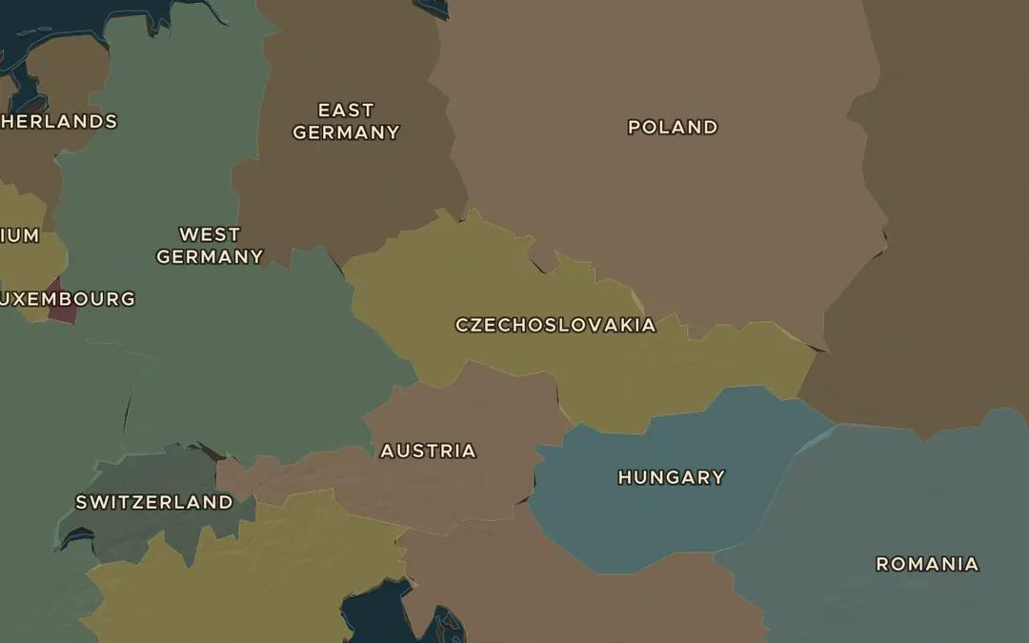
EXPLORE THE MAP · STEP A OF 3 · AD 1960
a
Czechoslovakia
Open the map in 1960 and find Czechoslovakia. Which countries surround it? Count how many of them belonged to the Warsaw Pact.
Open this view on the live map →
ChronoAtlas Classroom · chronoatlas.nl/classroom/lesson/prague-spring-1968
3
Notes:
Open the map in 1960 and find Czechoslovakia. Which countries surround it? Count how many of them belonged to the Warsaw Pact.
https://chronoatlas.nl/?year=1960&lat=49.5&lng=16&zoom=5.5

Slide 4
CHRONOATLAS CLASSROOM
The rest of this deck comes with Classroom
19 more slides: the other map steps, the discussion questions, the quiz with its answers, and the worksheet.
Every lesson as a deck, every worksheet, every live lesson and homework.
€19 a month, cancel anytime. The free lesson, Rome at its height, comes whole.
https://chronoatlas.nl/pricing
ChronoAtlas Classroom · chronoatlas.nl/classroom/lesson/prague-spring-1968
4

