Slide 1
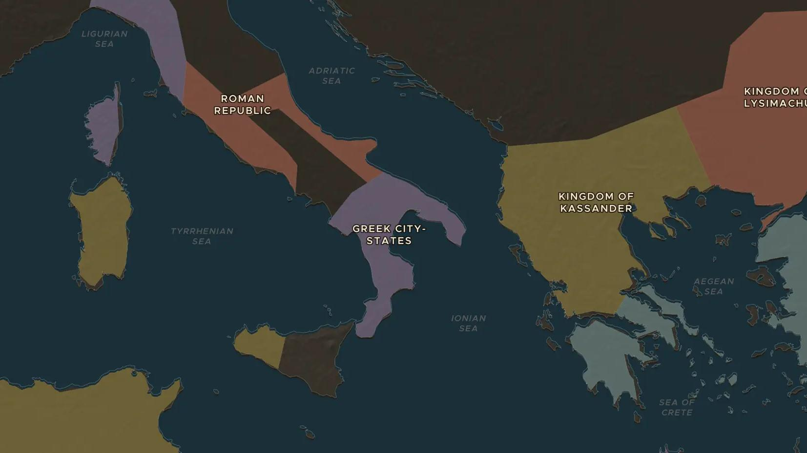
ROMAN REPUBLIC · 280-275 BC
Pyrrhus and the "Pyrrhic victory"
ChronoAtlas Classroom · Plate 90 · Ages 11-14 · 45 min
ChronoAtlas Classroom · chronoatlas.nl/classroom/lesson/pyrrhus-and-the-pyrrhic-victory

Slide 2
THIS LESSON
What students take from it
A Greek king with war elephants beat the Romans twice, but lost so many men that his name became a word. Students follow Pyrrhus across southern Italy and find out why Rome could not be worn down.
LENGTH
45 min
AGES
11-14
ON THE MAP
BY THE END, STUDENTS CAN
3 steps, 300 BC
Explain why the Greek city of Tarentum called in King Pyrrhus of Epirus.
Locate Tarentum, Heraclea and Beneventum on the map.
Explain what a "Pyrrhic victory" is and why Rome could afford its losses.
QUIZ
7 rounds
ChronoAtlas Classroom · chronoatlas.nl/classroom/lesson/pyrrhus-and-the-pyrrhic-victory
2

Slide 3
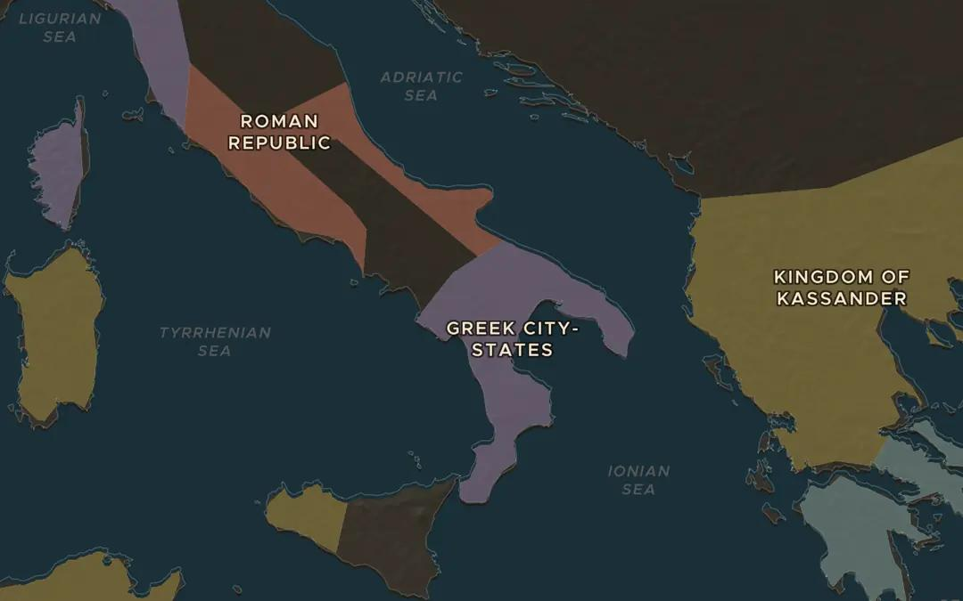
EXPLORE THE MAP · STEP A OF 3 · 300 BC
a
Greeks in Italy
Open the map in 300 BC and look at southern Italy. Find the Greek city-states on the coasts. Greeks had settled here for centuries. Where is Rome in relation to them?
Open this view on the live map →
ChronoAtlas Classroom · chronoatlas.nl/classroom/lesson/pyrrhus-and-the-pyrrhic-victory
3
Notes:
Open the map in 300 BC and look at southern Italy. Find the Greek city-states on the coasts. Greeks had settled here for centuries. Where is Rome in relation to them?
https://chronoatlas.nl/?year=-300&lat=40.5&lng=16&zoom=6

Slide 4
CHRONOATLAS CLASSROOM
The rest of this deck comes with Classroom
19 more slides: the other map steps, the discussion questions, the quiz with its answers, and the worksheet.
Every lesson as a deck, every worksheet, every live lesson and homework.
€19 a month, cancel anytime. The free lesson, Rome at its height, comes whole.
https://chronoatlas.nl/pricing
ChronoAtlas Classroom · chronoatlas.nl/classroom/lesson/pyrrhus-and-the-pyrrhic-victory
4

