Slide 1
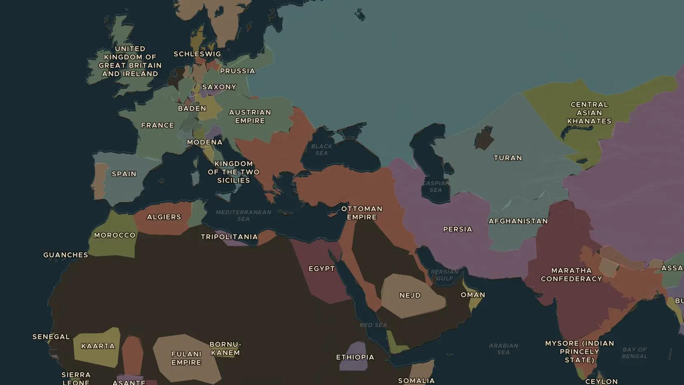
INDUSTRIAL REVOLUTION · 1825-1872
The railway age
ChronoAtlas Classroom · Plate 420 · Ages 11-14 · 45 min
ChronoAtlas Classroom · chronoatlas.nl/classroom/lesson/railway-age

Slide 2
THIS LESSON
What students take from it
In 1825 a steam locomotive pulls the first public train. Within fifty years railways cross continents from Britain to India, North America and Japan. Students trace the spread of the railway and how it changed time, travel and trade.
LENGTH
45 min
AGES
11-14
ON THE MAP
BY THE END, STUDENTS CAN
3 steps, AD 1830
Describe the first steam railways in Britain (1825-1830).
Trace how railways spread to Europe, the Americas and Asia by 1872.
Explain three ways railways changed daily life, such as standard time, travel and trade.
QUIZ
7 rounds
ChronoAtlas Classroom · chronoatlas.nl/classroom/lesson/railway-age
2

Slide 3
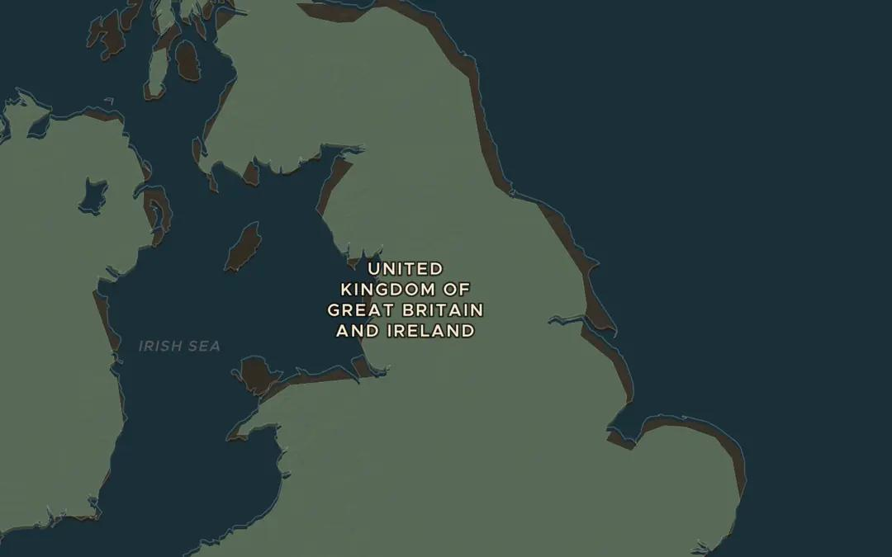
EXPLORE THE MAP · STEP A OF 3 · AD 1830
a
The first lines
Open the map in 1830 and zoom in on northern England. Find Stockton, Darlington, Liverpool and Manchester. What do you think the first railways carried?
Open this view on the live map →
ChronoAtlas Classroom · chronoatlas.nl/classroom/lesson/railway-age
3
Notes:
Open the map in 1830 and zoom in on northern England. Find Stockton, Darlington, Liverpool and Manchester. What do you think the first railways carried?
https://chronoatlas.nl/?year=1830&lat=54&lng=-2&zoom=6.5

Slide 4
CHRONOATLAS CLASSROOM
The rest of this deck comes with Classroom
19 more slides: the other map steps, the discussion questions, the quiz with its answers, and the worksheet.
Every lesson as a deck, every worksheet, every live lesson and homework.
€19 a month, cancel anytime. The free lesson, Rome at its height, comes whole.
https://chronoatlas.nl/pricing
ChronoAtlas Classroom · chronoatlas.nl/classroom/lesson/railway-age
4

