Slide 1
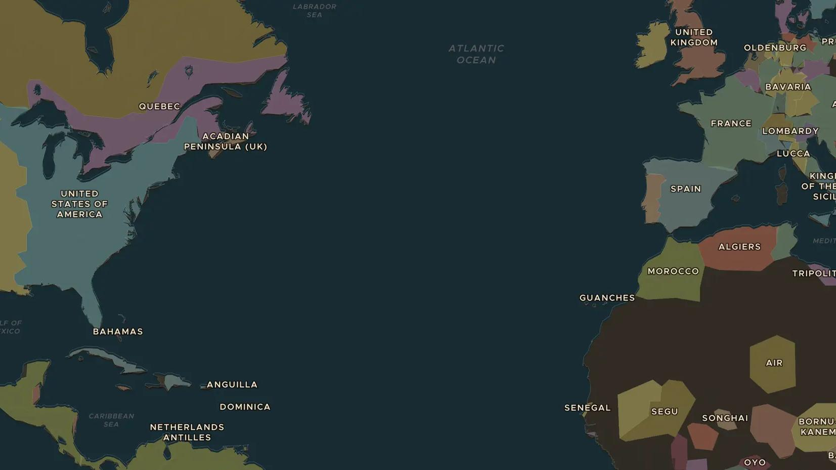
ATLANTIC WORLD · 1760-1789
Resistance and the first abolitionists
ChronoAtlas Classroom · Plate 387 · Ages 13-16 · 50 min
ChronoAtlas Classroom · chronoatlas.nl/classroom/lesson/resistance-and-early-abolition

Slide 2
THIS LESSON
What students take from it
Enslaved people never accepted slavery: they revolted, ran away and went to court. By the 1780s they had allies among Quakers, writers and a new campaign in London. Students follow the struggle from Jamaica to Philadelphia and London and ask who really ended the slave trade.
LENGTH
50 min
AGES
13-16
ON THE MAP
BY THE END, STUDENTS CAN
3 steps, AD 1760
Describe three ways enslaved people resisted slavery before 1789.
Explain how the campaign against the slave trade began in Britain and North America.
Judge the roles of enslaved people, Black writers and white campaigners in ending the trade.
QUIZ
7 rounds
ChronoAtlas Classroom · chronoatlas.nl/classroom/lesson/resistance-and-early-abolition
2

Slide 3
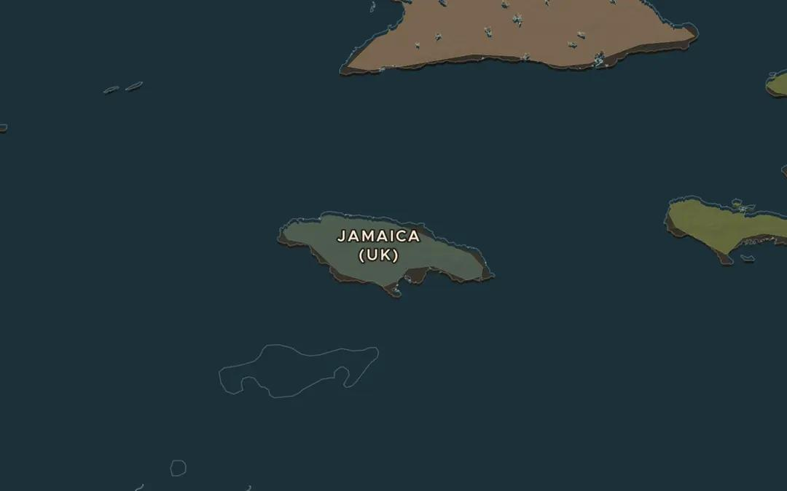
EXPLORE THE MAP · STEP A OF 3 · AD 1760
a
Jamaica, 1760
Open the map in 1760 and zoom in on Jamaica. That year many enslaved people rose in the parish of St Mary on the north coast, in Tacky's Revolt. Why might a rising start far from the capital?
Open this view on the live map →
ChronoAtlas Classroom · chronoatlas.nl/classroom/lesson/resistance-and-early-abolition
3
Notes:
Open the map in 1760 and zoom in on Jamaica. That year many enslaved people rose in the parish of St Mary on the north coast, in Tacky's Revolt. Why might a rising start far from the capital?
https://chronoatlas.nl/?year=1760&lat=18.2&lng=-77.2&zoom=7

Slide 4
CHRONOATLAS CLASSROOM
The rest of this deck comes with Classroom
19 more slides: the other map steps, the discussion questions, the quiz with its answers, and the worksheet.
Every lesson as a deck, every worksheet, every live lesson and homework.
€19 a month, cancel anytime. The free lesson, Rome at its height, comes whole.
https://chronoatlas.nl/pricing
ChronoAtlas Classroom · chronoatlas.nl/classroom/lesson/resistance-and-early-abolition
4

