Slide 1
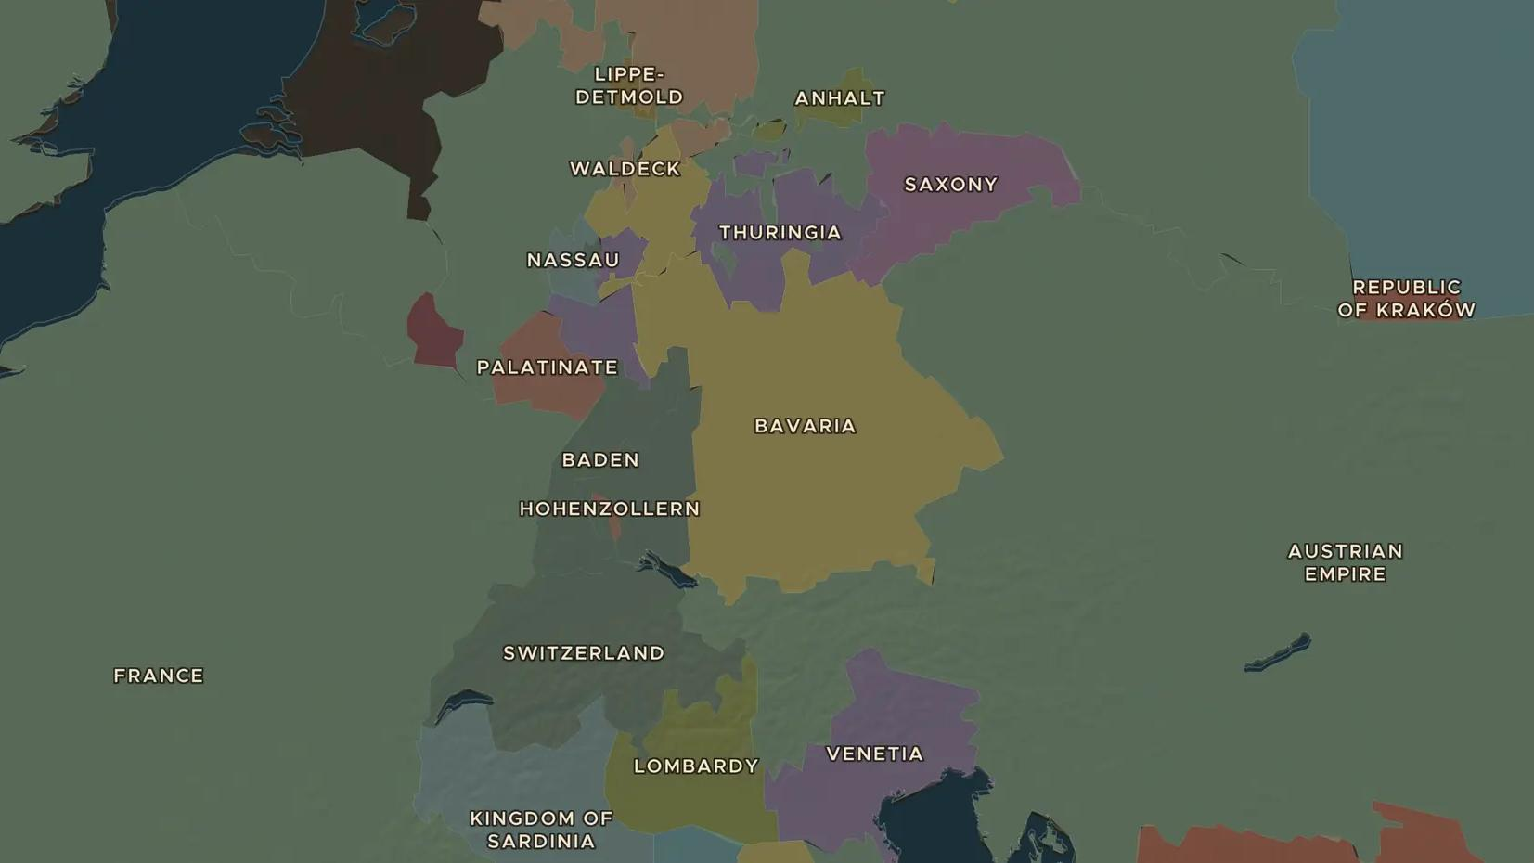
REVOLUTIONS OF 1848 · 1848-1849
1848: the springtime of peoples
ChronoAtlas Classroom · Plate 424 · Ages 13-16 · 50 min
ChronoAtlas Classroom · chronoatlas.nl/classroom/lesson/revolutions-of-1848

Slide 2
THIS LESSON
What students take from it
In 1848 revolution spreads from Palermo and Paris to Vienna, Berlin, Milan and Budapest. Kings flee, parliaments meet, serfs are freed, and within two years most of the old rulers are back. Students map a year of revolutions and ask what changed.
LENGTH
50 min
AGES
13-16
ON THE MAP
BY THE END, STUDENTS CAN
3 steps, AD 1848
Map the spread of the revolutions of 1848 across Europe.
Explain what liberals, nationalists and workers wanted in 1848.
Judge why most revolutions failed and what still changed.
QUIZ
7 rounds
ChronoAtlas Classroom · chronoatlas.nl/classroom/lesson/revolutions-of-1848
2

Slide 3
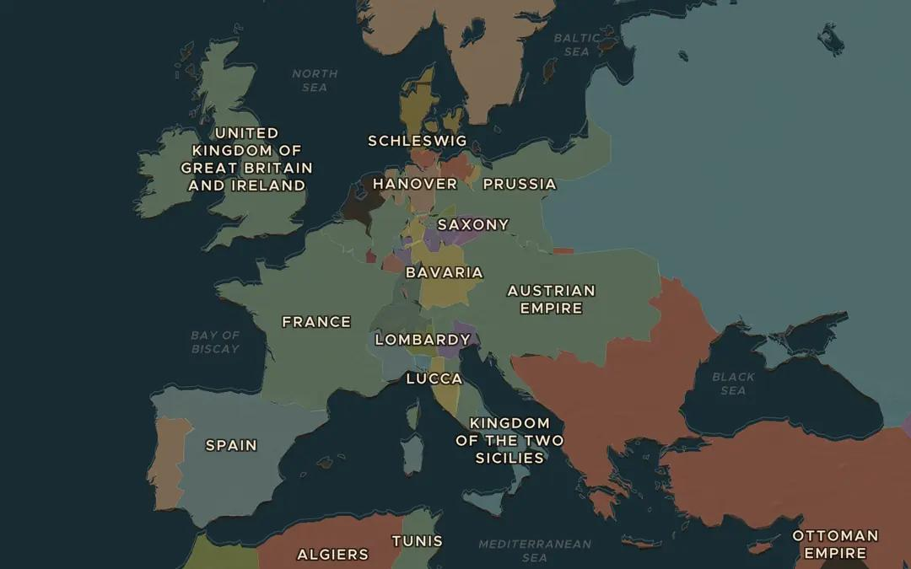
EXPLORE THE MAP · STEP A OF 3 · AD 1848
a
Europe before the storm
Open the map in 1848 and zoom out over Europe. The borders still look like 1815. Find Paris, Vienna, Berlin, Milan and Budapest. Which of them were capitals of their own state?
Open this view on the live map →
ChronoAtlas Classroom · chronoatlas.nl/classroom/lesson/revolutions-of-1848
3
Notes:
Open the map in 1848 and zoom out over Europe. The borders still look like 1815. Find Paris, Vienna, Berlin, Milan and Budapest. Which of them were capitals of their own state?
https://chronoatlas.nl/?year=1848&lat=48.5&lng=12&zoom=4

Slide 4
CHRONOATLAS CLASSROOM
The rest of this deck comes with Classroom
19 more slides: the other map steps, the discussion questions, the quiz with its answers, and the worksheet.
Every lesson as a deck, every worksheet, every live lesson and homework.
€19 a month, cancel anytime. The free lesson, Rome at its height, comes whole.
https://chronoatlas.nl/pricing
ChronoAtlas Classroom · chronoatlas.nl/classroom/lesson/revolutions-of-1848
4

