Slide 1
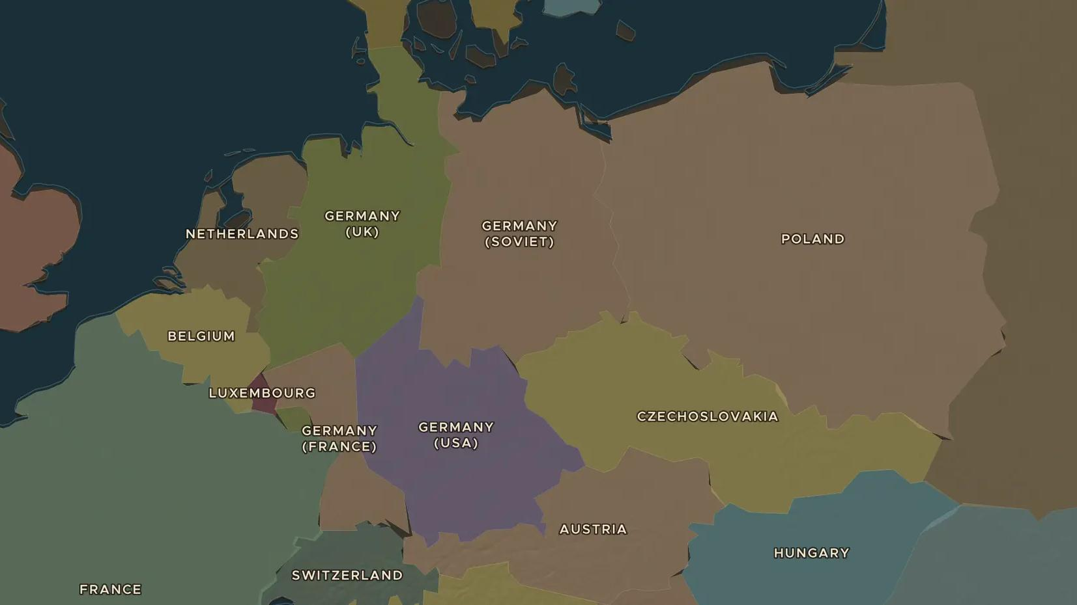
INTERWAR YEARS · 1936-1939
The road to war, 1936-1939
ChronoAtlas Classroom · Plate 489 · Ages 13-16 · 50 min
ChronoAtlas Classroom · chronoatlas.nl/classroom/lesson/road-to-war-1939

Slide 2
THIS LESSON
What students take from it
Step by step, Hitler broke the Treaty of Versailles: the Rhineland, Austria, the Sudetenland, Prague. Britain and France gave way until 1939. Students follow each step on the 1930 and 1938 maps and debate whether appeasement could have worked.
LENGTH
50 min
AGES
13-16
ON THE MAP
BY THE END, STUDENTS CAN
3 steps, AD 1938
Order the steps Hitler took between 1936 and 1939 and locate each on the map.
Explain what appeasement was and why Britain and France chose it.
Explain why the Nazi-Soviet Pact of August 1939 made war almost certain.
QUIZ
7 rounds
ChronoAtlas Classroom · chronoatlas.nl/classroom/lesson/road-to-war-1939
2

Slide 3
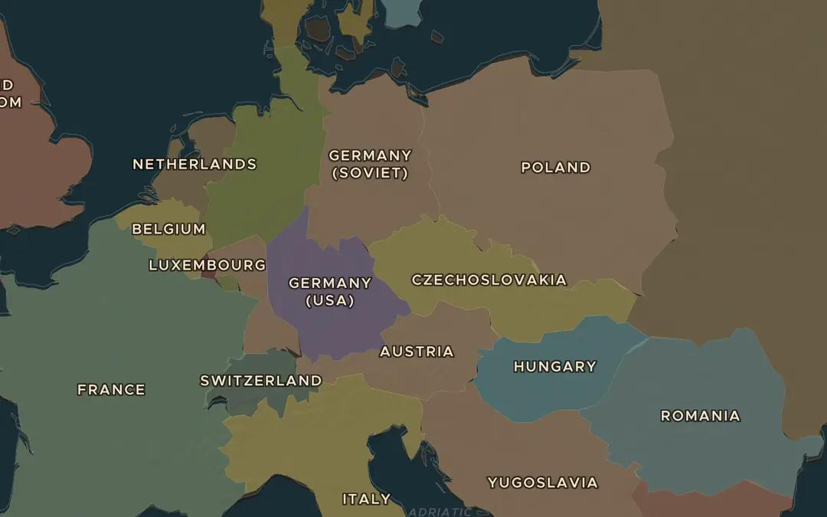
EXPLORE THE MAP · STEP A OF 3 · AD 1938
a
Germany grows
Open the map in 1930 and find Germany, Austria and Czechoslovakia. Then move the slider to 1938. Which country has disappeared, and which border areas has Germany gained?
Open this view on the live map →
ChronoAtlas Classroom · chronoatlas.nl/classroom/lesson/road-to-war-1939
3
Notes:
Open the map in 1930 and find Germany, Austria and Czechoslovakia. Then move the slider to 1938. Which country has disappeared, and which border areas has Germany gained?
https://chronoatlas.nl/?year=1938&lat=50&lng=14&zoom=5

Slide 4
CHRONOATLAS CLASSROOM
The rest of this deck comes with Classroom
19 more slides: the other map steps, the discussion questions, the quiz with its answers, and the worksheet.
Every lesson as a deck, every worksheet, every live lesson and homework.
€19 a month, cancel anytime. The free lesson, Rome at its height, comes whole.
https://chronoatlas.nl/pricing
ChronoAtlas Classroom · chronoatlas.nl/classroom/lesson/road-to-war-1939
4

