Slide 1
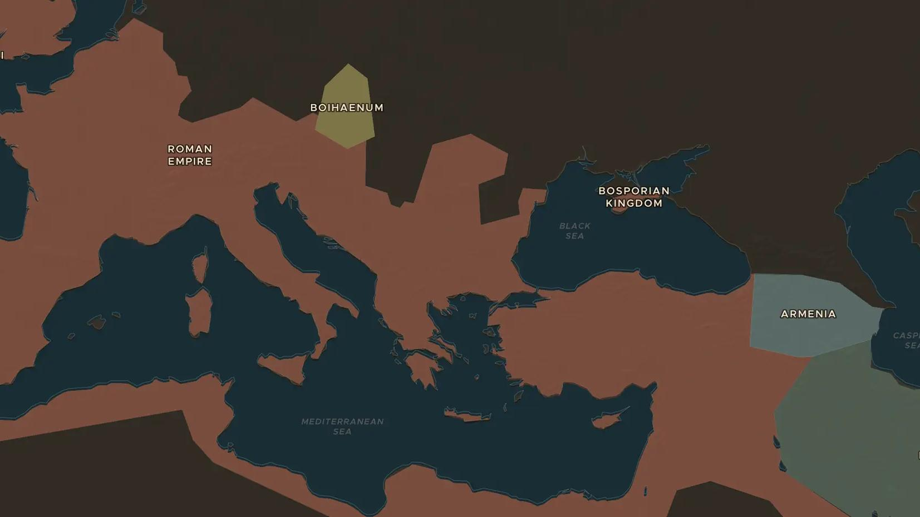
ROMAN EMPIRE · 9-260 AD
The legions and the limes: guarding Rome's frontiers
ChronoAtlas Classroom · Plate 137 · Ages 11-14 · 50 min
ChronoAtlas Classroom · chronoatlas.nl/classroom/lesson/roman-army-and-the-limes

Slide 2
THIS LESSON
What students take from it
From the Rhine to the Syrian desert, legions and auxiliary troops guarded the empire's borders. Students follow the limes on the map and find out who the soldiers were and how they lived.
LENGTH
50 min
AGES
11-14
ON THE MAP
BY THE END, STUDENTS CAN
3 steps, AD 200
Describe the limes: the forts, walls, roads and rivers along Rome's frontiers.
Explain the difference between legionaries and auxiliaries and what soldiers gained from serving.
Locate three frontier sites on the Rhine, on the Danube and in the east.
QUIZ
7 rounds
ChronoAtlas Classroom · chronoatlas.nl/classroom/lesson/roman-army-and-the-limes
2

Slide 3
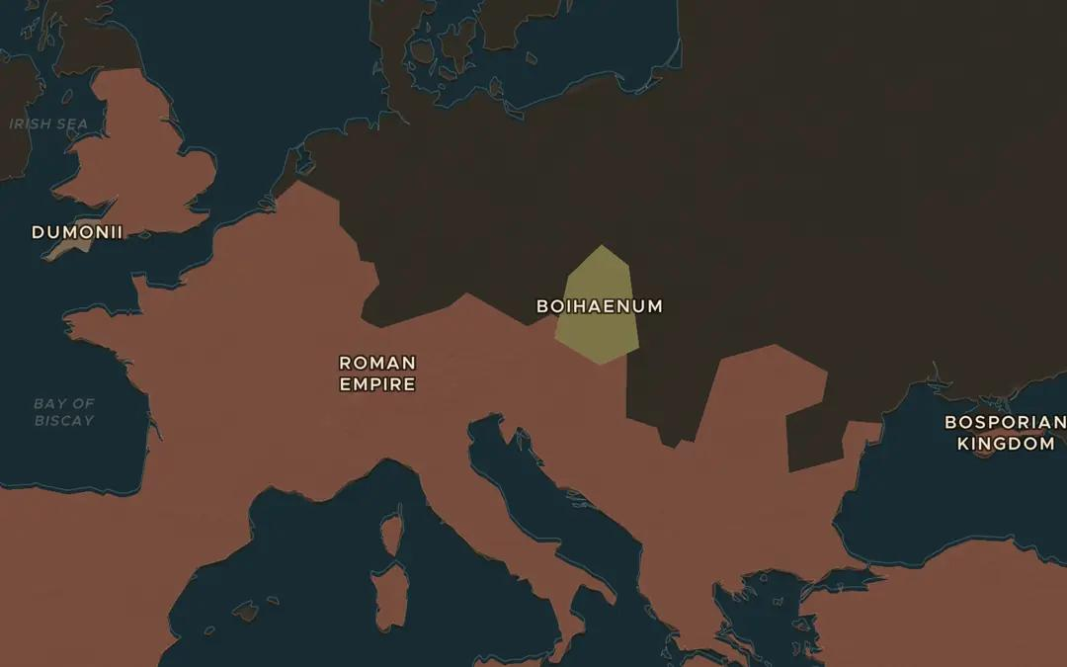
EXPLORE THE MAP · STEP A OF 3 · AD 200
a
Rivers as borders
Open the map in AD 200 and turn on Historical Maps to lay an old printed map of the Roman Empire over it. Follow the northern border from the North Sea along the Rhine and the Danube to the Black Sea. How much of it is river?
Open this view on the live map →
ChronoAtlas Classroom · chronoatlas.nl/classroom/lesson/roman-army-and-the-limes
3
Notes:
Open the map in AD 200 and turn on Historical Maps to lay an old printed map of the Roman Empire over it. Follow the northern border from the North Sea along the Rhine and the Danube to the Black Sea. How much of it is river?
https://chronoatlas.nl/?year=200&lat=48&lng=15&zoom=4.5

Slide 4
CHRONOATLAS CLASSROOM
The rest of this deck comes with Classroom
19 more slides: the other map steps, the discussion questions, the quiz with its answers, and the worksheet.
Every lesson as a deck, every worksheet, every live lesson and homework.
€19 a month, cancel anytime. The free lesson, Rome at its height, comes whole.
https://chronoatlas.nl/pricing
ChronoAtlas Classroom · chronoatlas.nl/classroom/lesson/roman-army-and-the-limes
4

