Slide 1
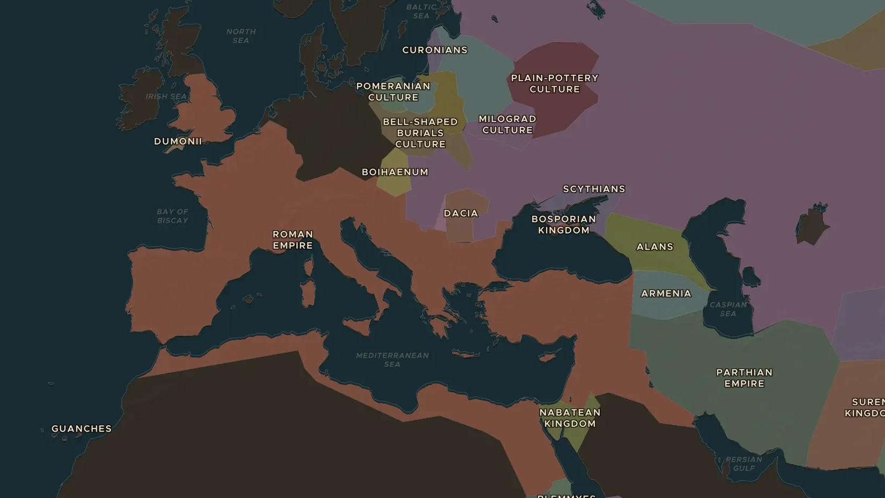
ROMAN EMPIRE · 117 AD
Rome at its height
ChronoAtlas Classroom · Plate 133 · Ages 11-14 · 50 min
ChronoAtlas Classroom · chronoatlas.nl/classroom/lesson/rome-at-its-height

Slide 2
THIS LESSON
What students take from it
Under emperor Trajan the empire reaches its greatest size. Students explore how far Rome really stretched, and what held such a giant together.
LENGTH
50 min
AGES
11-14
ON THE MAP
BY THE END, STUDENTS CAN
3 steps, AD 117
Describe the extent of the Roman Empire in 117 AD in their own words.
Name three regions under Roman rule outside Italy.
Explain one way Rome kept a huge empire connected (roads, army, trade).
QUIZ
7 rounds
ChronoAtlas Classroom · chronoatlas.nl/classroom/lesson/rome-at-its-height
2

Slide 3
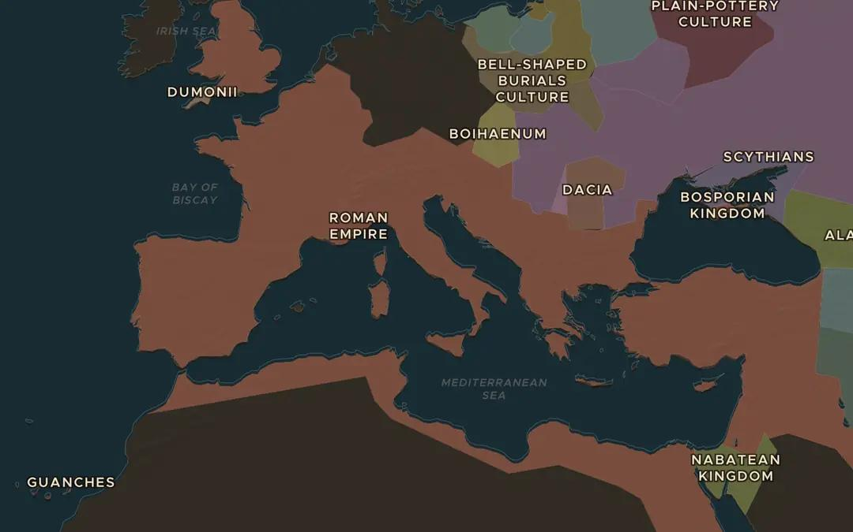
EXPLORE THE MAP · STEP A OF 3 · AD 117
a
The empire at its peak
Open the map in 117 AD. Zoom out until you see the whole empire. Which three continents does it touch?
Open this view on the live map →
ChronoAtlas Classroom · chronoatlas.nl/classroom/lesson/rome-at-its-height
3
Notes:
Open the map in 117 AD. Zoom out until you see the whole empire. Which three continents does it touch?
https://chronoatlas.nl/?year=117&lat=41.9&lng=12.5&zoom=4

Slide 4
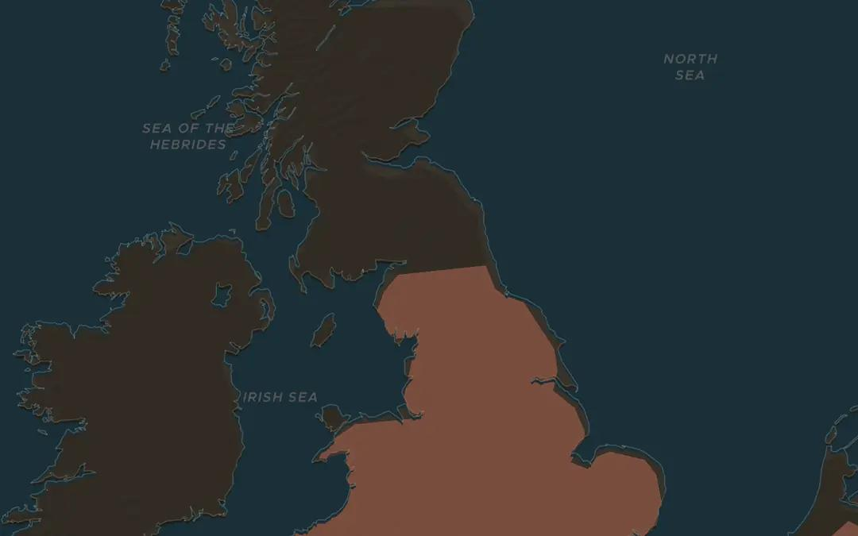
EXPLORE THE MAP · STEP B OF 3 · AD 117
b
The edge of empire
Travel to Britain. Find the northern border. Why do you think the Romans stopped here?
Open this view on the live map →
ChronoAtlas Classroom · chronoatlas.nl/classroom/lesson/rome-at-its-height
4
Notes:
Travel to Britain. Find the northern border. Why do you think the Romans stopped here?
https://chronoatlas.nl/?year=117&lat=54.9&lng=-2.6&zoom=6

Slide 5
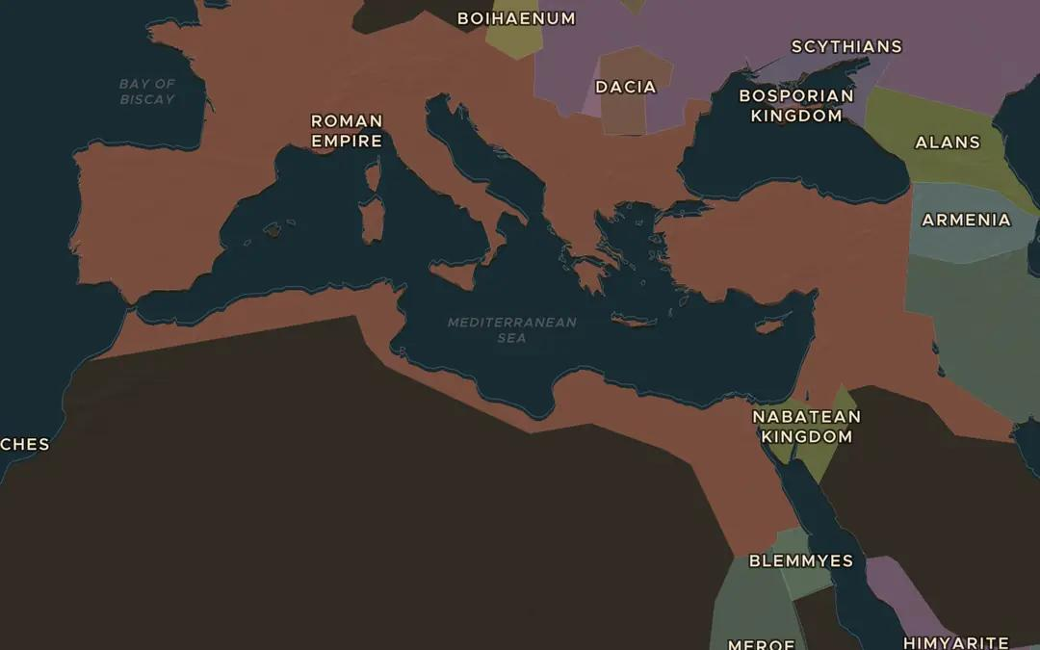
EXPLORE THE MAP · STEP C OF 3 · AD 117
c
Trade routes
Turn on the trade routes layer. Follow a route from Rome to Egypt. What was worth shipping that far?
Open this view on the live map →
ChronoAtlas Classroom · chronoatlas.nl/classroom/lesson/rome-at-its-height
5
Notes:
Turn on the trade routes layer. Follow a route from Rome to Egypt. What was worth shipping that far?
https://chronoatlas.nl/?year=117&lat=35&lng=18&zoom=4

Slide 6
CLASS DISCUSSION
From what happened to why it mattered
Why was the Mediterranean Sea called "Mare Nostrum" (our sea) by the Romans?
The empire had about 80,000 km of roads. What were they for, besides trade?
Rome ruled people with many languages and religions. How would you keep them all loyal?
Look at the borders: rivers, deserts, seas. Why do empires often stop at natural barriers?
What do you think was the biggest risk of an empire this size?
ChronoAtlas Classroom · chronoatlas.nl/classroom/lesson/rome-at-its-height
6

Slide 7
GAME ROUND · RULE HISTORY
Play it, then argue about it
Play one round of Rule History together on the classroom screen. Set the map to the Roman era and let students take turns making a ruling. Discuss: was your choice realistic for a Roman emperor?
https://chronoatlas.nl/chronoguessr
ChronoAtlas Classroom · chronoatlas.nl/classroom/lesson/rome-at-its-height
7

Slide 8
QUIZ · ROUND 1 OF 7 · QUIZ · AD 117
Trajan's empire touches three continents. Which three?
A
Europe, Africa and America
B
Europe and Asia only
C
Europe, Asia and Africa
D
Europe, Asia and Australia
ChronoAtlas Classroom · chronoatlas.nl/classroom/lesson/rome-at-its-height
8
Notes:
Answer: C. From Britain to Egypt and Mesopotamia: in 117 Rome ruled every coast around the Mediterranean, on three continents.

Slide 9
QUIZ · ROUND 1 OF 7 · QUIZ · AD 117 · ANSWER
Trajan's empire touches three continents. Which three?
A
Europe, Africa and America
B
Europe and Asia only
C
Europe, Asia and Africa
D
Europe, Asia and Australia
From Britain to Egypt and Mesopotamia: in 117 Rome ruled every coast around the Mediterranean, on three continents.
ChronoAtlas Classroom · chronoatlas.nl/classroom/lesson/rome-at-its-height
9

Slide 10
QUIZ · ROUND 2 OF 7 · FIND IT ON THE MAP · AD 117
Tap Alexandria, the second-largest city of the empire.
Point at it on the projected map, or on your own device at chronoatlas.nl.
Open the map here →
ChronoAtlas Classroom · chronoatlas.nl/classroom/lesson/rome-at-its-height
10
Notes:
Alexandria. Founded by Alexander the Great in 331 BC. Its harbour shipped the Egyptian grain that fed the city of Rome.

Slide 11
QUIZ · ROUND 2 OF 7 · FIND IT ON THE MAP · AD 117 · ANSWER
Tap Alexandria, the second-largest city of the empire.
Alexandria
Founded by Alexander the Great in 331 BC. Its harbour shipped the Egyptian grain that fed the city of Rome.
Show it on the map →
ChronoAtlas Classroom · chronoatlas.nl/classroom/lesson/rome-at-its-height
11

Slide 12
QUIZ · ROUND 3 OF 7 · FIND IT ON THE MAP · AD 117
Tap the northern frontier of the empire in Britain.
Point at it on the projected map, or on your own device at chronoatlas.nl.
Open the map here →
ChronoAtlas Classroom · chronoatlas.nl/classroom/lesson/rome-at-its-height
12
Notes:
The frontier at Vindolanda. In 117 the frontier ran along the Stanegate road. From 122 Hadrian built his wall along the same line.

Slide 13
QUIZ · ROUND 3 OF 7 · FIND IT ON THE MAP · AD 117 · ANSWER
Tap the northern frontier of the empire in Britain.
The frontier at Vindolanda
In 117 the frontier ran along the Stanegate road. From 122 Hadrian built his wall along the same line.
Show it on the map →
ChronoAtlas Classroom · chronoatlas.nl/classroom/lesson/rome-at-its-height
13

Slide 14
QUIZ · ROUND 4 OF 7 · FIND IT ON THE MAP · AD 117
In 116 Trajan stood on the shore of the Persian Gulf. Tap where.
Point at it on the projected map, or on your own device at chronoatlas.nl.
Open the map here →
ChronoAtlas Classroom · chronoatlas.nl/classroom/lesson/rome-at-its-height
14
Notes:
Charax, on the Persian Gulf. The furthest east a Roman emperor ever marched. His successor Hadrian gave up these new provinces within a year.

Slide 15
QUIZ · ROUND 4 OF 7 · FIND IT ON THE MAP · AD 117 · ANSWER
In 116 Trajan stood on the shore of the Persian Gulf. Tap where.
Charax, on the Persian Gulf
The furthest east a Roman emperor ever marched. His successor Hadrian gave up these new provinces within a year.
Show it on the map →
ChronoAtlas Classroom · chronoatlas.nl/classroom/lesson/rome-at-its-height
15

Slide 16
QUIZ · ROUND 5 OF 7 · QUIZ · AD 117
The Romans called the Mediterranean "Mare Nostrum". What does it mean?
A
The middle sea
B
Our sea
C
The great sea
D
The emperor's sea
ChronoAtlas Classroom · chronoatlas.nl/classroom/lesson/rome-at-its-height
16
Notes:
Answer: B. Every coast of the Mediterranean was Roman, so a ship could cross it without passing a single border.

Slide 17
QUIZ · ROUND 5 OF 7 · QUIZ · AD 117 · ANSWER
The Romans called the Mediterranean "Mare Nostrum". What does it mean?
A
The middle sea
B
Our sea
C
The great sea
D
The emperor's sea
Every coast of the Mediterranean was Roman, so a ship could cross it without passing a single border.
ChronoAtlas Classroom · chronoatlas.nl/classroom/lesson/rome-at-its-height
17

Slide 18
QUIZ · ROUND 6 OF 7 · VOTE · AD 117
You are Hadrian in 117. The empire is stretched thin. What do you do?
A
Keep conquering
B
Hold the borders and build walls
C
Give up the newest provinces
ChronoAtlas Classroom · chronoatlas.nl/classroom/lesson/rome-at-its-height
18
Notes:
Hadrian did the last two: he gave up Mesopotamia and built walls along the frontiers, Hadrian's Wall among them.

Slide 19
QUIZ · ROUND 6 OF 7 · VOTE · AD 117 · ANSWER
You are Hadrian in 117. The empire is stretched thin. What do you do?
What really happened
Hadrian did the last two: he gave up Mesopotamia and built walls along the frontiers, Hadrian's Wall among them.
ChronoAtlas Classroom · chronoatlas.nl/classroom/lesson/rome-at-its-height
19

Slide 20
QUIZ · ROUND 7 OF 7 · WRITE ONE LINE · AD 117
The empire had about 80,000 km of roads. What were they for, besides trade?
One sentence each. Pick two or three to read out.
ChronoAtlas Classroom · chronoatlas.nl/classroom/lesson/rome-at-its-height
20

Slide 21
WORKSHEET
On paper, or as homework
Draw the outline of the Roman Empire in 117 AD on the blank map below (use the ChronoAtlas map as your source).
Mark and name: Rome, Alexandria, Londinium (London) and the Rhine border.
Name three provinces outside Italy and one product each was known for.
In two sentences: why did the empire stop expanding after Trajan?
Bonus: find on the map one city that still exists today under a different name.
The printable version (two A4 pages, with a map page) is on the lesson page.
ChronoAtlas Classroom · chronoatlas.nl/classroom/lesson/rome-at-its-height
21

Slide 22
ChronoAtlas
The history atlas that moves: 12,000 years of borders, the lessons, the Senate, the calls from history.
https://chronoatlas.nl/classroom/lesson/rome-at-its-height
ChronoAtlas Classroom · chronoatlas.nl/classroom/lesson/rome-at-its-height
22

