Slide 1
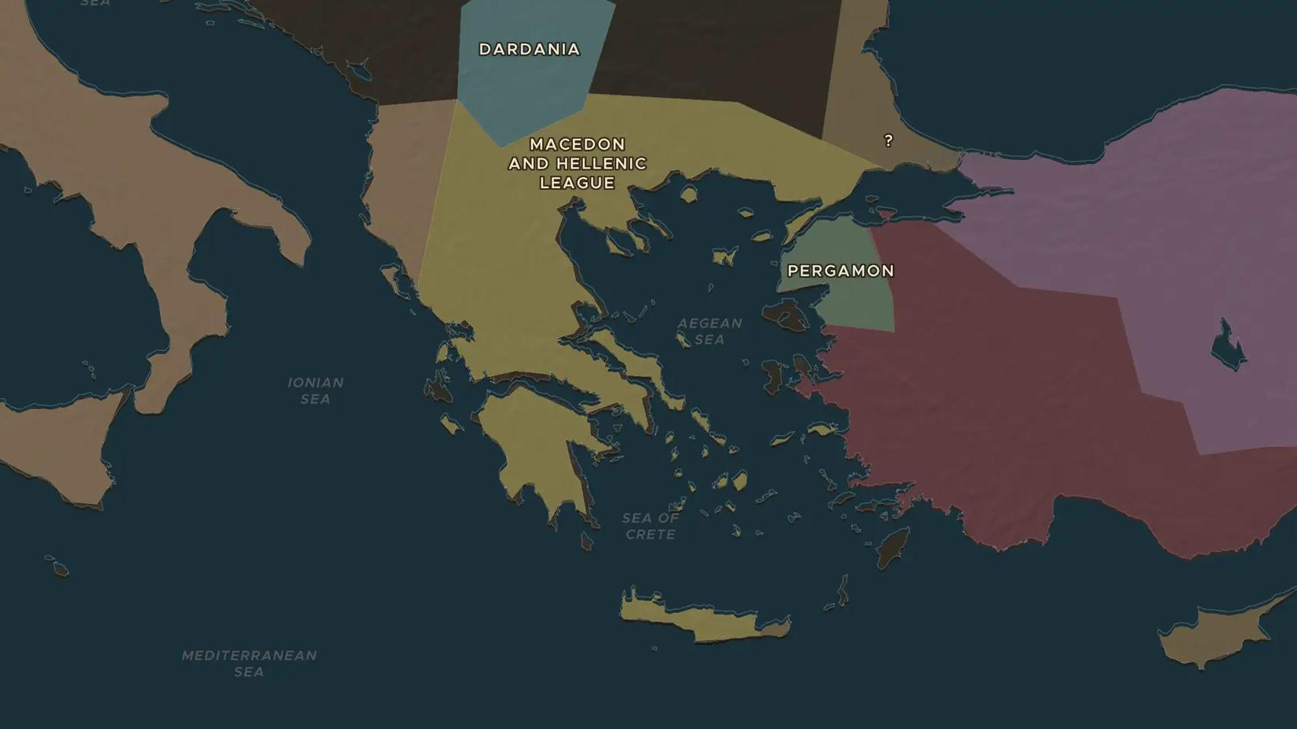
ROMAN REPUBLIC · 200-146 BC
Rome conquers Greece, Greece conquers Rome
ChronoAtlas Classroom · Plate 107 · Ages 12-15 · 50 min
ChronoAtlas Classroom · chronoatlas.nl/classroom/lesson/rome-conquers-greece

Slide 2
THIS LESSON
What students take from it
Within about 50 years Rome defeated Macedon and the Greek cities, and in 146 BC destroyed Corinth. Yet Greek art, gods and ideas took over Roman life. Students ask who really conquered whom.
LENGTH
50 min
AGES
12-15
ON THE MAP
BY THE END, STUDENTS CAN
3 steps, 200 BC
Describe how Rome took control of Macedon and Greece between 200 and 146 BC.
Locate Cynoscephalae, Pydna and Athens on the map.
Give three examples of Greek influence on Roman culture.
QUIZ
7 rounds
ChronoAtlas Classroom · chronoatlas.nl/classroom/lesson/rome-conquers-greece
2

Slide 3
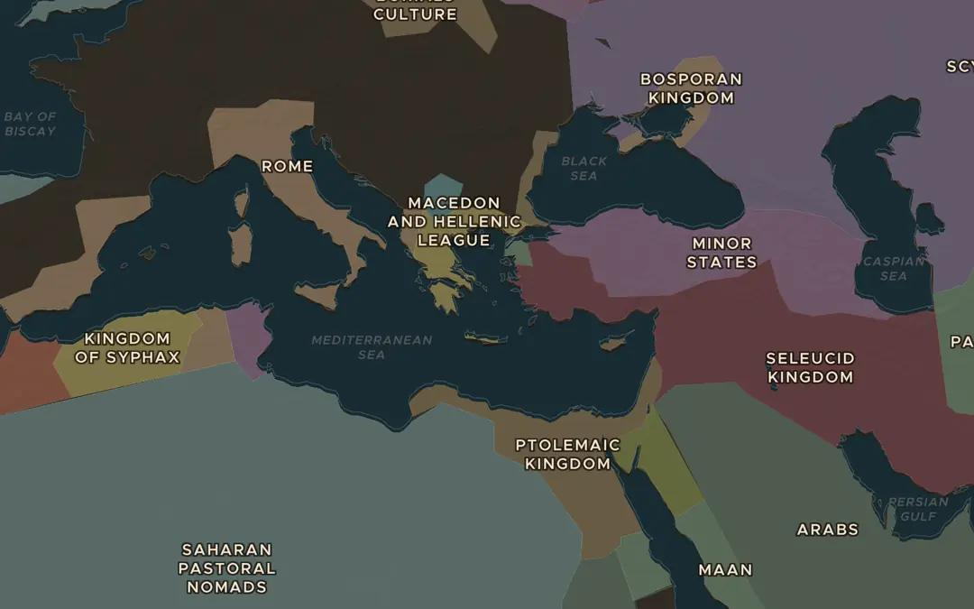
EXPLORE THE MAP · STEP A OF 3 · 200 BC
a
Kingdoms of the east
Open the map in 200 BC. Find Macedon, the Seleucid Kingdom and Ptolemaic Egypt, the kingdoms left by Alexander's generals. How do they compare in size with Rome?
Open this view on the live map →
ChronoAtlas Classroom · chronoatlas.nl/classroom/lesson/rome-conquers-greece
3
Notes:
Open the map in 200 BC. Find Macedon, the Seleucid Kingdom and Ptolemaic Egypt, the kingdoms left by Alexander's generals. How do they compare in size with Rome?
https://chronoatlas.nl/?year=-200&lat=37&lng=25&zoom=4

Slide 4
CHRONOATLAS CLASSROOM
The rest of this deck comes with Classroom
19 more slides: the other map steps, the discussion questions, the quiz with its answers, and the worksheet.
Every lesson as a deck, every worksheet, every live lesson and homework.
€19 a month, cancel anytime. The free lesson, Rome at its height, comes whole.
https://chronoatlas.nl/pricing
ChronoAtlas Classroom · chronoatlas.nl/classroom/lesson/rome-conquers-greece
4

