Slide 1
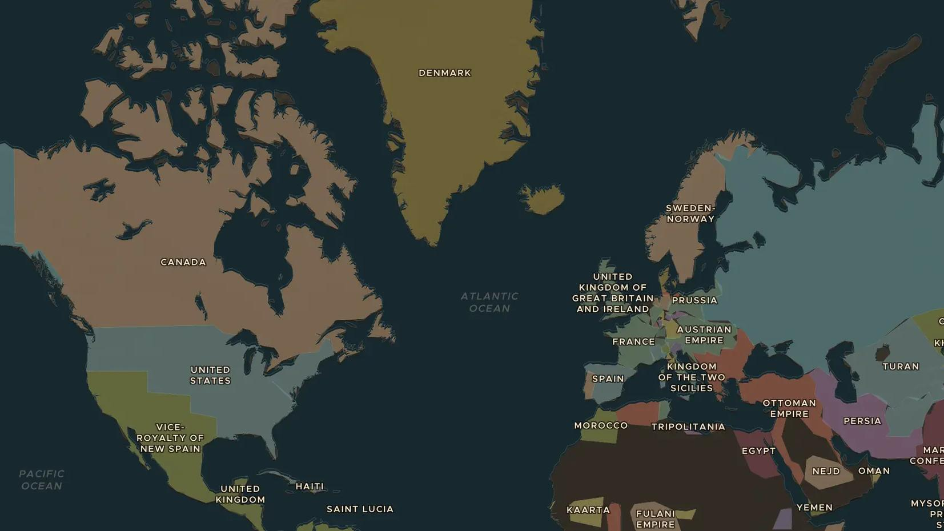
RUSSIAN EMPIRE · 1855-1881
Russia frees its serfs
ChronoAtlas Classroom · Plate 431 · Ages 13-16 · 45 min
ChronoAtlas Classroom · chronoatlas.nl/classroom/lesson/russia-frees-the-serfs

Slide 2
THIS LESSON
What students take from it
After defeat in the Crimean War, Tsar Alexander II frees more than 20 million serfs in 1861. Students explore what serfdom was, why the tsar acted, why many peasants were disappointed, and why the "Tsar Liberator" was assassinated.
LENGTH
45 min
AGES
13-16
ON THE MAP
BY THE END, STUDENTS CAN
3 steps, AD 1861
Explain what serfdom was and why Alexander II ended it in 1861.
Describe the terms of emancipation and why many peasants were disappointed.
Compare the emancipation of Russia's serfs with the end of slavery in the United States.
QUIZ
7 rounds
ChronoAtlas Classroom · chronoatlas.nl/classroom/lesson/russia-frees-the-serfs
2

Slide 3
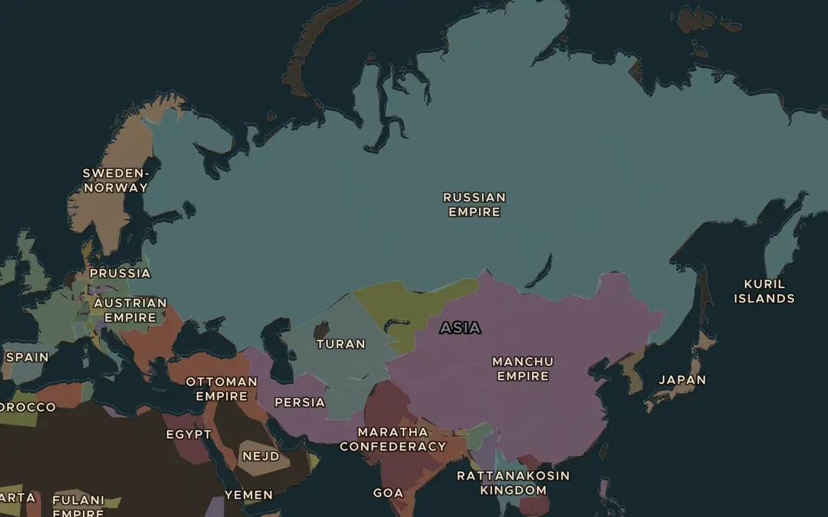
EXPLORE THE MAP · STEP A OF 3 · AD 1861
a
The largest country
Open the map in 1861 and zoom out over the Russian Empire. From which sea to which ocean does it stretch? Where do you think most of its people lived?
Open this view on the live map →
ChronoAtlas Classroom · chronoatlas.nl/classroom/lesson/russia-frees-the-serfs
3
Notes:
Open the map in 1861 and zoom out over the Russian Empire. From which sea to which ocean does it stretch? Where do you think most of its people lived?
https://chronoatlas.nl/?year=1861&lat=55&lng=80&zoom=2.5

Slide 4
CHRONOATLAS CLASSROOM
The rest of this deck comes with Classroom
19 more slides: the other map steps, the discussion questions, the quiz with its answers, and the worksheet.
Every lesson as a deck, every worksheet, every live lesson and homework.
€19 a month, cancel anytime. The free lesson, Rome at its height, comes whole.
https://chronoatlas.nl/pricing
ChronoAtlas Classroom · chronoatlas.nl/classroom/lesson/russia-frees-the-serfs
4

