Slide 1
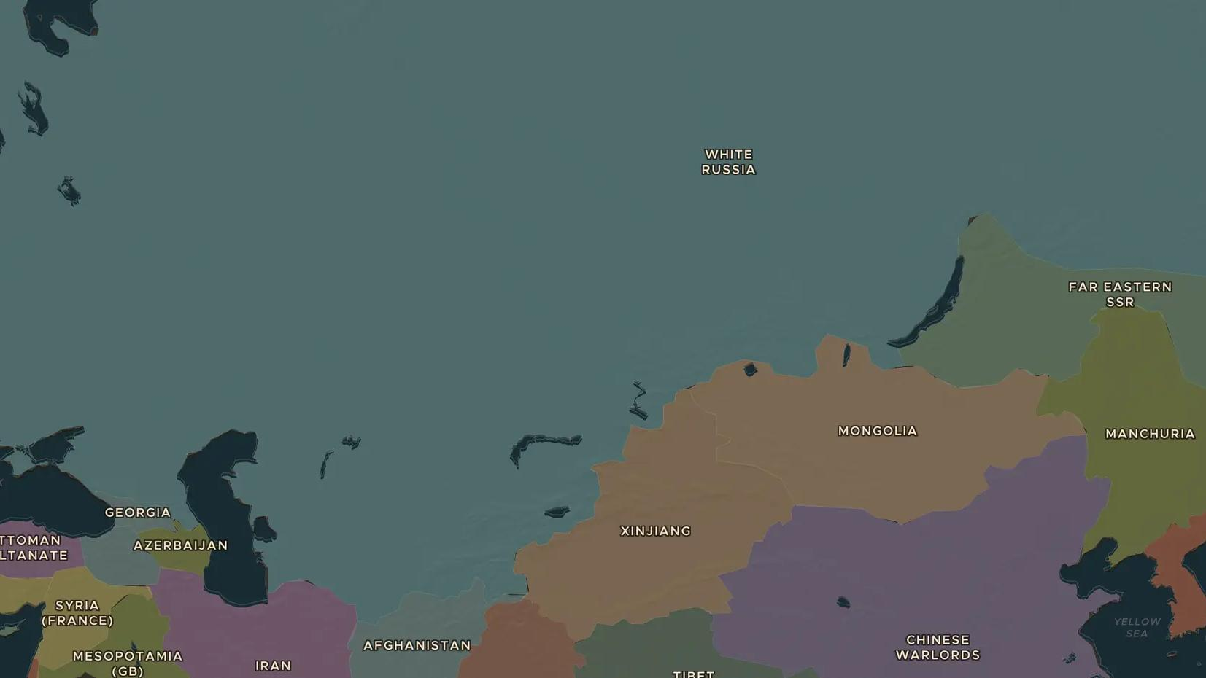
RUSSIAN REVOLUTION · 1917-1922
1917: revolution in Russia
ChronoAtlas Classroom · Plate 458 · Ages 13-16 · 50 min
ChronoAtlas Classroom · chronoatlas.nl/classroom/lesson/russian-revolution-1917

Slide 2
THIS LESSON
What students take from it
In 1917 Russia had two revolutions. In February the tsar fell; in October Lenin's Bolsheviks seized power in Petrograd. A civil war followed, and in 1922 the Soviet Union was born. Students use the 1914 and 1920 maps to see how the empire broke apart and was rebuilt.
LENGTH
50 min
AGES
13-16
ON THE MAP
BY THE END, STUDENTS CAN
3 steps, AD 1914
Explain the difference between the February and the October Revolutions of 1917.
Locate Petrograd and Moscow and explain why the capital moved in 1918.
Describe how the Bolsheviks won the civil war and created the Soviet Union in 1922.
QUIZ
7 rounds
ChronoAtlas Classroom · chronoatlas.nl/classroom/lesson/russian-revolution-1917
2

Slide 3
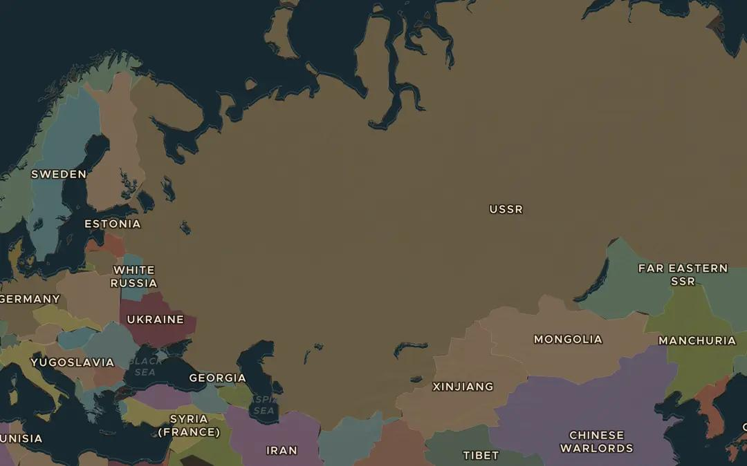
EXPLORE THE MAP · STEP A OF 3 · AD 1914
a
The Russian Empire
Open the map in 1914 and zoom out over the Russian Empire. How far does it stretch from west to east? Find Petrograd (St Petersburg) on the Baltic coast.
Open this view on the live map →
ChronoAtlas Classroom · chronoatlas.nl/classroom/lesson/russian-revolution-1917
3
Notes:
Open the map in 1914 and zoom out over the Russian Empire. How far does it stretch from west to east? Find Petrograd (St Petersburg) on the Baltic coast.
https://chronoatlas.nl/?year=1914&lat=58&lng=70&zoom=3

Slide 4
CHRONOATLAS CLASSROOM
The rest of this deck comes with Classroom
19 more slides: the other map steps, the discussion questions, the quiz with its answers, and the worksheet.
Every lesson as a deck, every worksheet, every live lesson and homework.
€19 a month, cancel anytime. The free lesson, Rome at its height, comes whole.
https://chronoatlas.nl/pricing
ChronoAtlas Classroom · chronoatlas.nl/classroom/lesson/russian-revolution-1917
4

