Slide 1
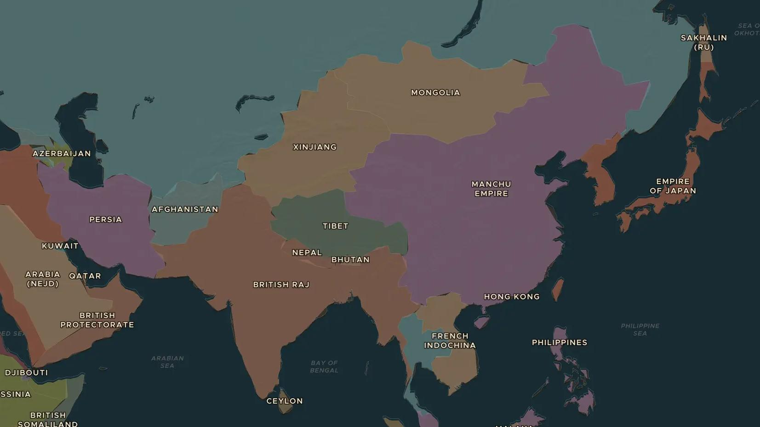
MEIJI JAPAN · 1904-1905
Russia against Japan, 1904-1905
ChronoAtlas Classroom · Plate 453 · Ages 13-16 · 45 min
ChronoAtlas Classroom · chronoatlas.nl/classroom/lesson/russo-japanese-war

Slide 2
THIS LESSON
What students take from it
Two empires clash over Manchuria and Korea. Japan attacks Russia's fleet at Port Arthur, wins on land at Mukden and destroys a Russian fleet that sailed halfway round the world. Students ask why this victory shook the world.
LENGTH
45 min
AGES
13-16
ON THE MAP
BY THE END, STUDENTS CAN
3 steps, AD 1904
Explain why Russia and Japan went to war over Manchuria and Korea.
Locate Port Arthur, Mukden and Tsushima and describe what happened there.
Explain why Japan's victory mattered for Asia, for Russia and for the world.
QUIZ
7 rounds
ChronoAtlas Classroom · chronoatlas.nl/classroom/lesson/russo-japanese-war
2

Slide 3
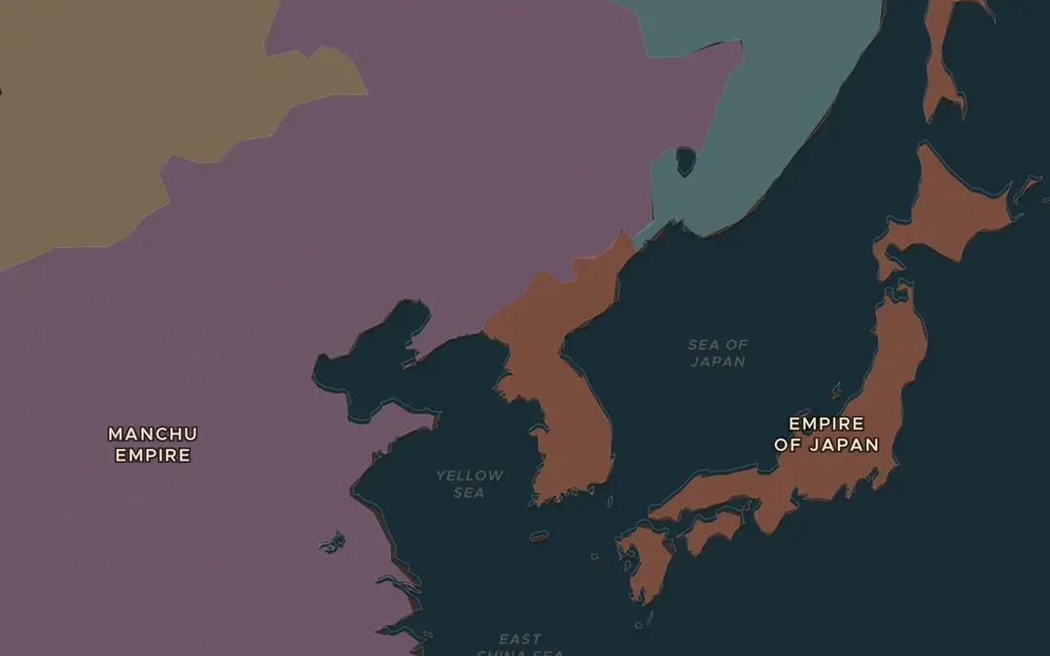
EXPLORE THE MAP · STEP A OF 3 · AD 1904
a
Rivals in Manchuria
Open the map in 1904 and zoom in on Manchuria and Korea. These borders date from just after 1910, when Japan annexed Korea. Why did both Russia and Japan want this region?
Open this view on the live map →
ChronoAtlas Classroom · chronoatlas.nl/classroom/lesson/russo-japanese-war
3
Notes:
Open the map in 1904 and zoom in on Manchuria and Korea. These borders date from just after 1910, when Japan annexed Korea. Why did both Russia and Japan want this region?
https://chronoatlas.nl/?year=1904&lat=40&lng=126&zoom=4.6

Slide 4
CHRONOATLAS CLASSROOM
The rest of this deck comes with Classroom
19 more slides: the other map steps, the discussion questions, the quiz with its answers, and the worksheet.
Every lesson as a deck, every worksheet, every live lesson and homework.
€19 a month, cancel anytime. The free lesson, Rome at its height, comes whole.
https://chronoatlas.nl/pricing
ChronoAtlas Classroom · chronoatlas.nl/classroom/lesson/russo-japanese-war
4

