Slide 1
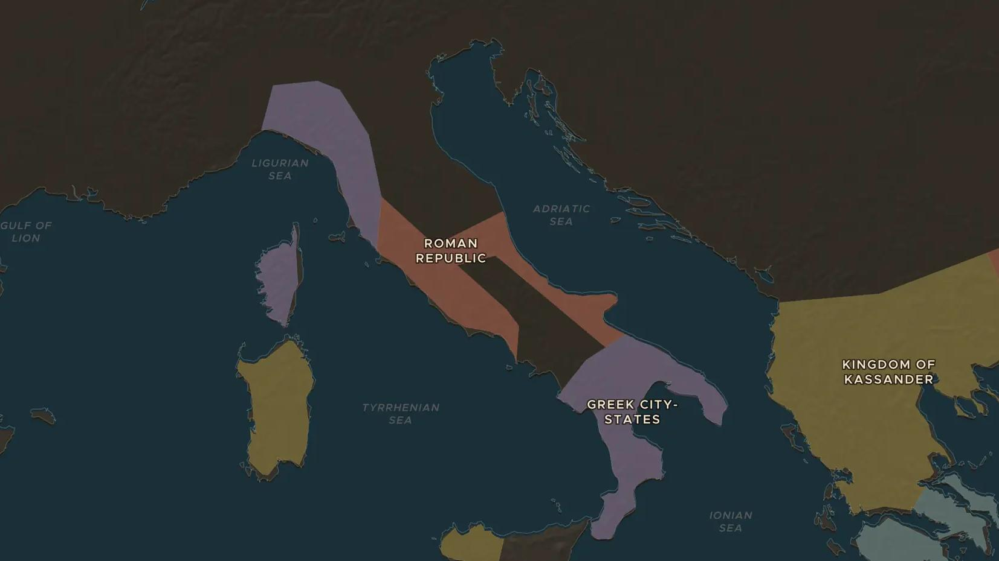
ROMAN REPUBLIC · 343-290 BC
The Samnite Wars: Rome conquers Italy
ChronoAtlas Classroom · Plate 79 · Ages 12-15 · 50 min
ChronoAtlas Classroom · chronoatlas.nl/classroom/lesson/samnite-wars-conquest-of-italy

Slide 2
THIS LESSON
What students take from it
In the mountains of central Italy, the Samnites fought Rome for half a century and once trapped a whole Roman army. Students follow the wars on the map and learn how Rome turned defeated enemies into allies.
LENGTH
50 min
AGES
12-15
ON THE MAP
BY THE END, STUDENTS CAN
3 steps, 400 BC
Locate Samnium and two key places of the Samnite Wars on the map.
Describe the Caudine Forks (321 BC) and the battle of Sentinum (295 BC).
Explain how Rome held Italy together with colonies, roads and alliances.
QUIZ
7 rounds
ChronoAtlas Classroom · chronoatlas.nl/classroom/lesson/samnite-wars-conquest-of-italy
2

Slide 3
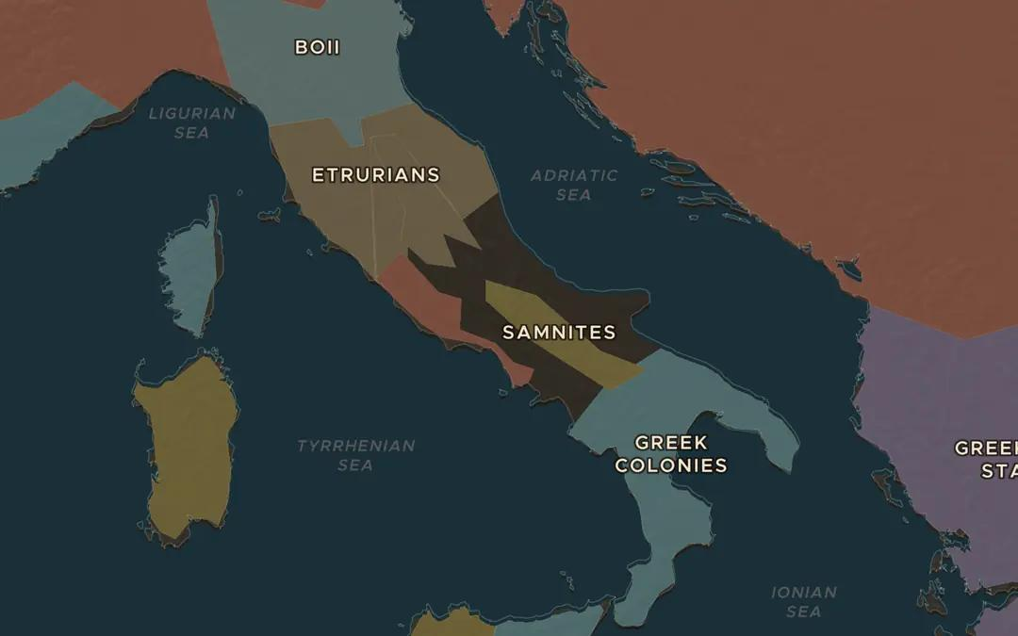
EXPLORE THE MAP · STEP A OF 3 · 400 BC
a
Two rivals
Open the map in 400 BC. Find Rome and the Samnites in the mountains to the southeast. Which side has the better land for farming, and which the better land for defense?
Open this view on the live map →
ChronoAtlas Classroom · chronoatlas.nl/classroom/lesson/samnite-wars-conquest-of-italy
3
Notes:
Open the map in 400 BC. Find Rome and the Samnites in the mountains to the southeast. Which side has the better land for farming, and which the better land for defense?
https://chronoatlas.nl/?year=-400&lat=41.6&lng=14&zoom=6

Slide 4
CHRONOATLAS CLASSROOM
The rest of this deck comes with Classroom
19 more slides: the other map steps, the discussion questions, the quiz with its answers, and the worksheet.
Every lesson as a deck, every worksheet, every live lesson and homework.
€19 a month, cancel anytime. The free lesson, Rome at its height, comes whole.
https://chronoatlas.nl/pricing
ChronoAtlas Classroom · chronoatlas.nl/classroom/lesson/samnite-wars-conquest-of-italy
4

