Slide 1
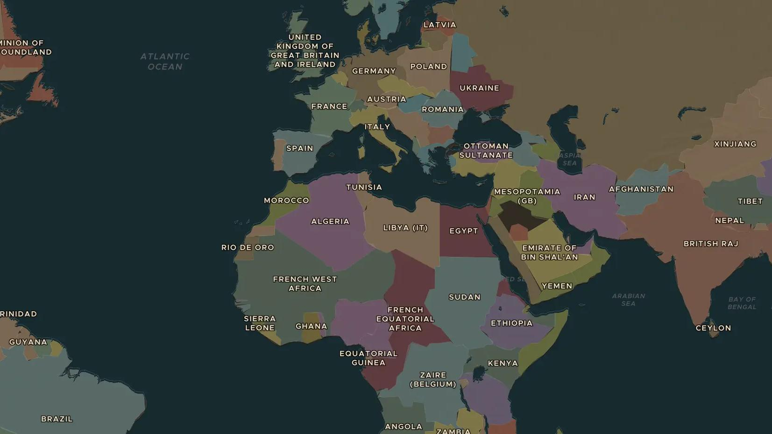
AGE OF EMPIRE · 1881-1914
The Scramble for Africa and the Berlin Conference
ChronoAtlas Classroom · Plate 446 · Ages 13-16 · 50 min
ChronoAtlas Classroom · chronoatlas.nl/classroom/lesson/scramble-for-africa-berlin

Slide 2
THIS LESSON
What students take from it
In 1880 most of Africa is ruled by Africans. By 1914 only Ethiopia and Liberia are independent. Students compare the maps, look at the Berlin Conference, where no African was present, and at resistance such as the Ethiopian victory at Adwa.
LENGTH
50 min
AGES
13-16
ON THE MAP
BY THE END, STUDENTS CAN
3 steps, AD 1880
Compare the map of Africa in 1880 and 1914 and describe the change.
Explain what the Berlin Conference (1884-1885) decided and what it did not.
Give examples of African resistance, such as Adwa (1896).
QUIZ
7 rounds
ChronoAtlas Classroom · chronoatlas.nl/classroom/lesson/scramble-for-africa-berlin
2

Slide 3
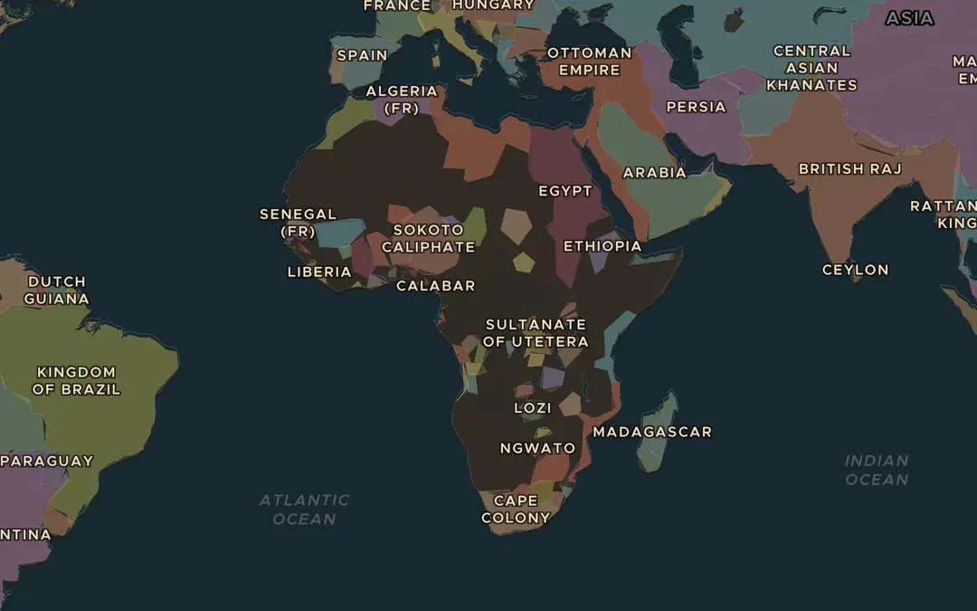
EXPLORE THE MAP · STEP A OF 3 · AD 1880
a
Africa in 1880
Open the map in 1880 and zoom out over Africa. Read the names of African states you can find. How much of the continent is shown as European colonies?
Open this view on the live map →
ChronoAtlas Classroom · chronoatlas.nl/classroom/lesson/scramble-for-africa-berlin
3
Notes:
Open the map in 1880 and zoom out over Africa. Read the names of African states you can find. How much of the continent is shown as European colonies?
https://chronoatlas.nl/?year=1880&lat=2&lng=18&zoom=2.6

Slide 4
CHRONOATLAS CLASSROOM
The rest of this deck comes with Classroom
19 more slides: the other map steps, the discussion questions, the quiz with its answers, and the worksheet.
Every lesson as a deck, every worksheet, every live lesson and homework.
€19 a month, cancel anytime. The free lesson, Rome at its height, comes whole.
https://chronoatlas.nl/pricing
ChronoAtlas Classroom · chronoatlas.nl/classroom/lesson/scramble-for-africa-berlin
4

