Slide 1
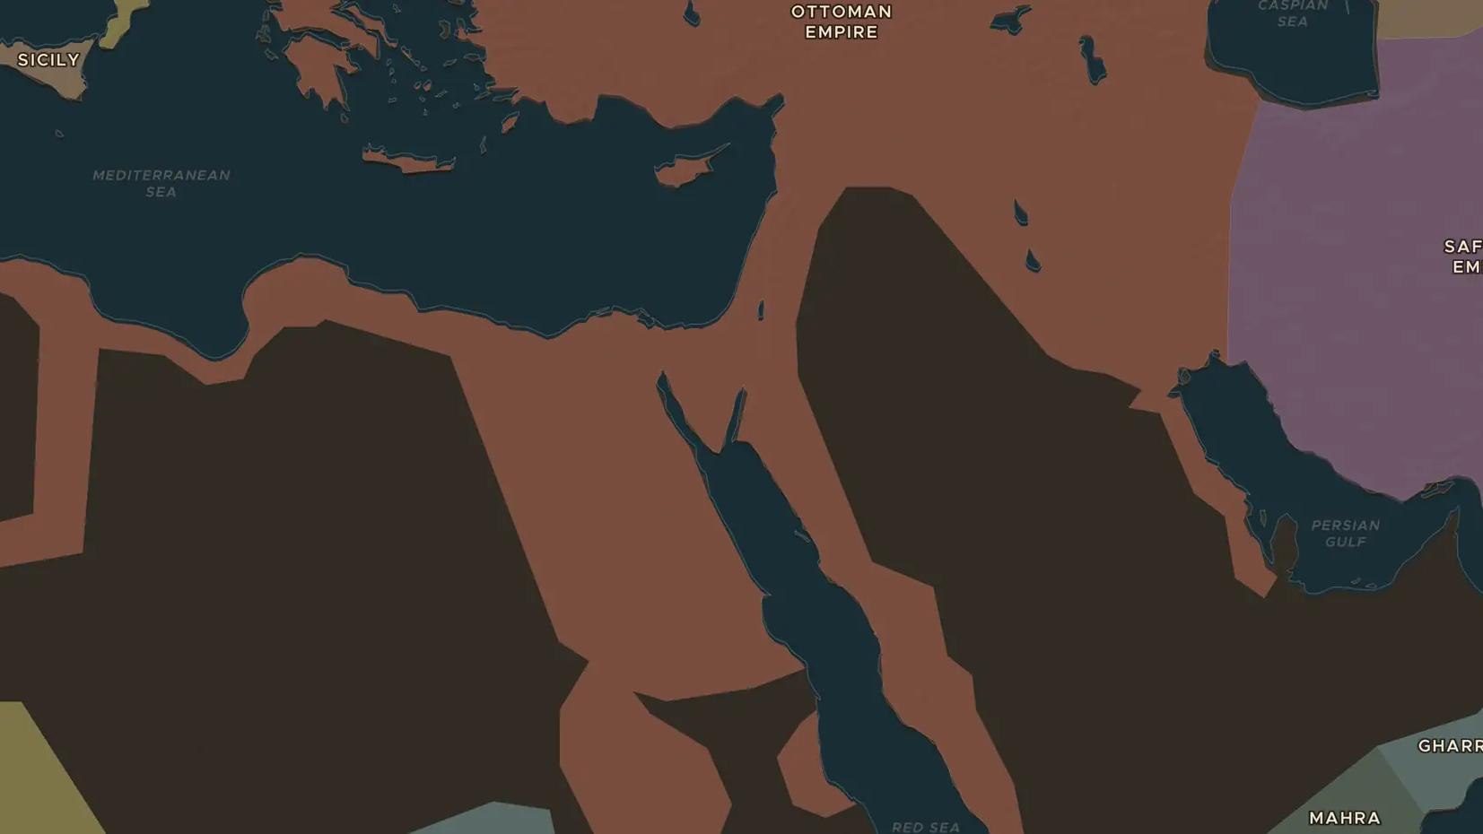
OTTOMAN EMPIRE · 1516-1517
Selim I takes Cairo, Mecca and Medina
ChronoAtlas Classroom · Plate 306 · Ages 12-15 · 45 min
ChronoAtlas Classroom · chronoatlas.nl/classroom/lesson/selim-conquers-egypt-1517

Slide 2
THIS LESSON
What students take from it
In two short campaigns Sultan Selim I destroyed the Mamluk Sultanate and made the Ottomans masters of Syria, Egypt and the holy cities of Islam. Students compare the map before and after 1517.
LENGTH
45 min
AGES
12-15
ON THE MAP
BY THE END, STUDENTS CAN
3 steps, AD 1500
Compare the Ottoman Empire on the map in 1500 and in 1530.
Describe the campaigns of 1516-1517 against the Mamluks.
Explain why ruling Egypt and protecting Mecca and Medina mattered to the sultans.
QUIZ
7 rounds
ChronoAtlas Classroom · chronoatlas.nl/classroom/lesson/selim-conquers-egypt-1517
2

Slide 3
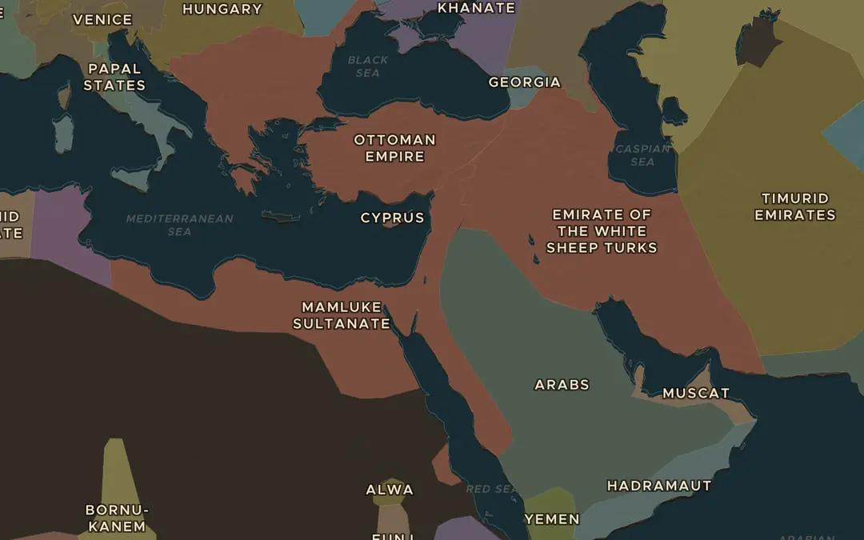
EXPLORE THE MAP · STEP A OF 3 · AD 1500
a
Two sultans
Open the map in 1500. Find the Ottoman Empire and the Mamluk Sultanate. Where do they meet? Which holy cities lie inside the Mamluk lands?
Open this view on the live map →
ChronoAtlas Classroom · chronoatlas.nl/classroom/lesson/selim-conquers-egypt-1517
3
Notes:
Open the map in 1500. Find the Ottoman Empire and the Mamluk Sultanate. Where do they meet? Which holy cities lie inside the Mamluk lands?
https://chronoatlas.nl/?year=1500&lat=32&lng=36&zoom=4

Slide 4
CHRONOATLAS CLASSROOM
The rest of this deck comes with Classroom
19 more slides: the other map steps, the discussion questions, the quiz with its answers, and the worksheet.
Every lesson as a deck, every worksheet, every live lesson and homework.
€19 a month, cancel anytime. The free lesson, Rome at its height, comes whole.
https://chronoatlas.nl/pricing
ChronoAtlas Classroom · chronoatlas.nl/classroom/lesson/selim-conquers-egypt-1517
4

